Slide 1
Thursday, April 12
Centralina Council of Governments Regional Conference

Slide 2
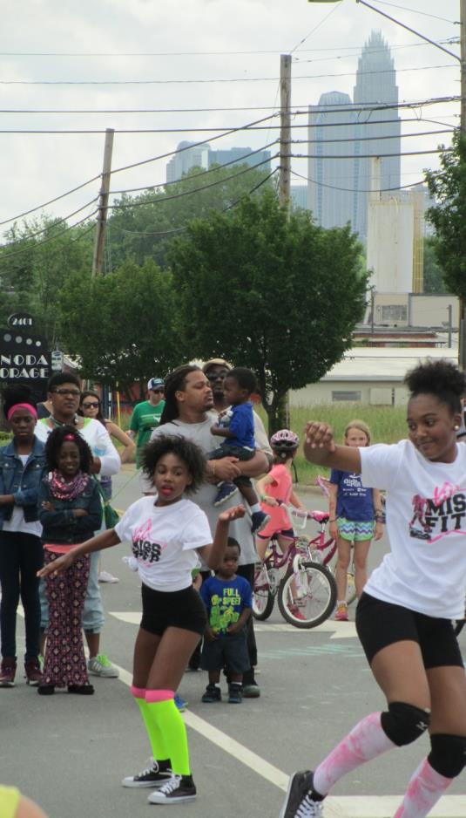
Welcome!
Al Bangoura
Mecklenburg County Park & Recreation
alfred.bangoura@mecklenburgcountync.gov
Monica Holmes
Charlotte Urban Design
monica.holmes@charlottenc.gov
Notes:
MONICA

Slide 3
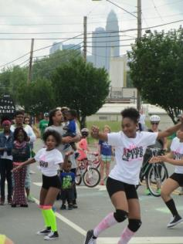
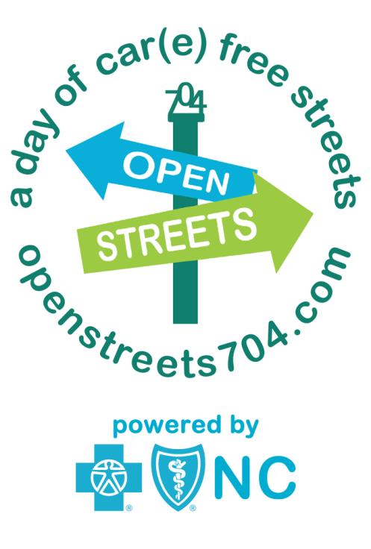
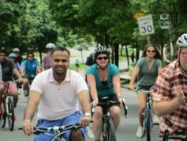
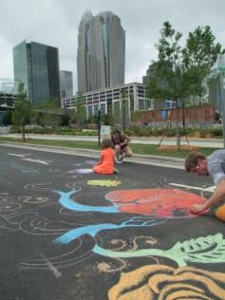
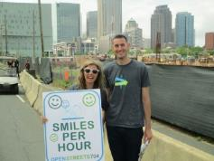
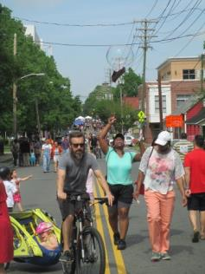
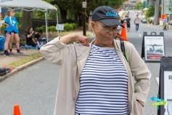
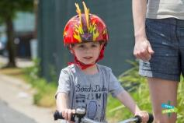
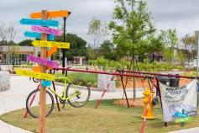
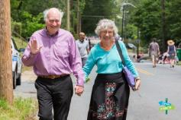
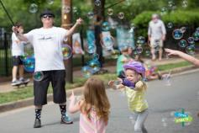
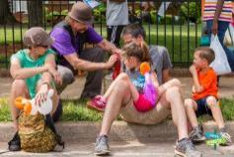
Notes:
AL

Slide 4
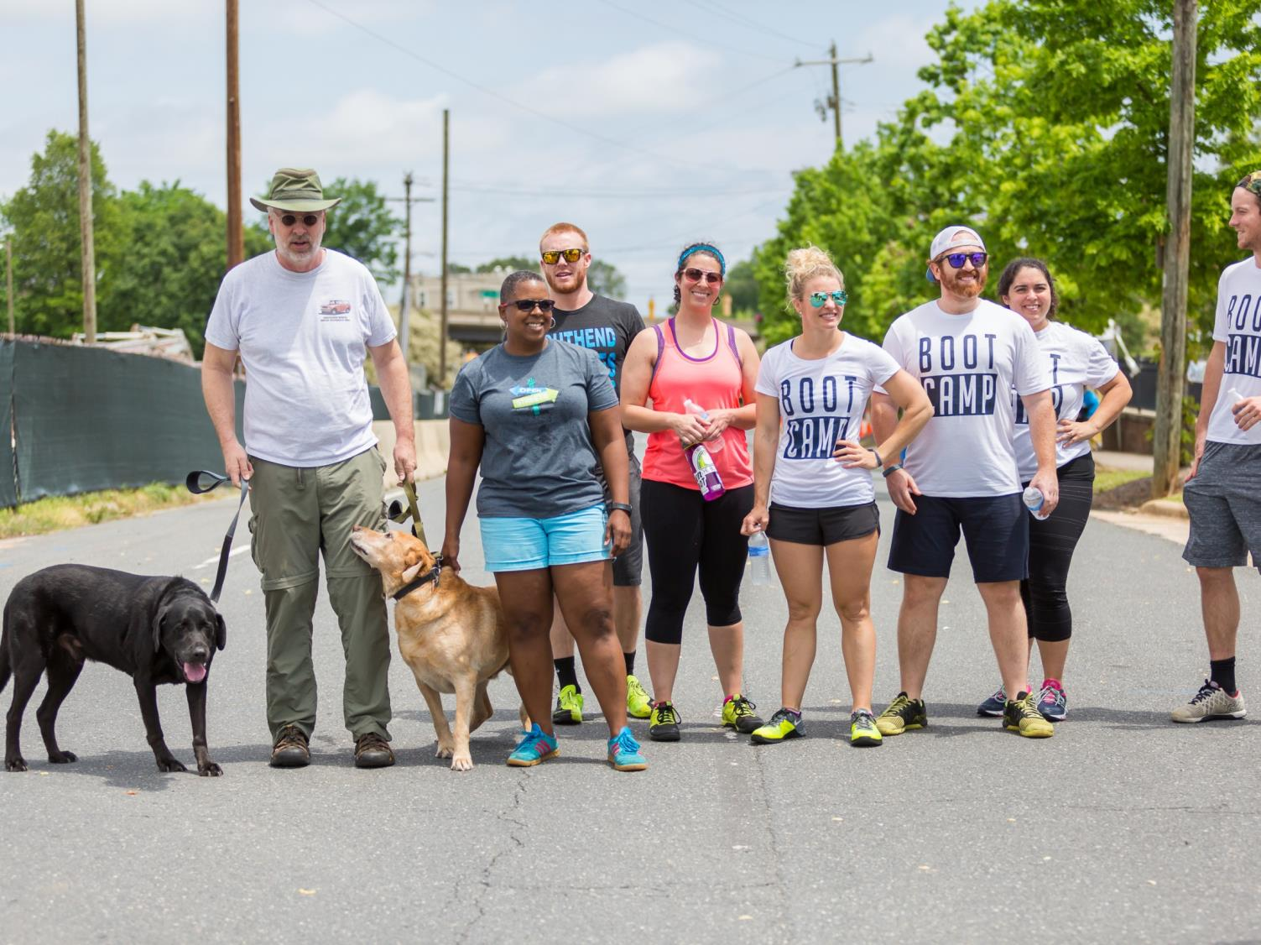
What are OPEN STREETS?

Slide 5
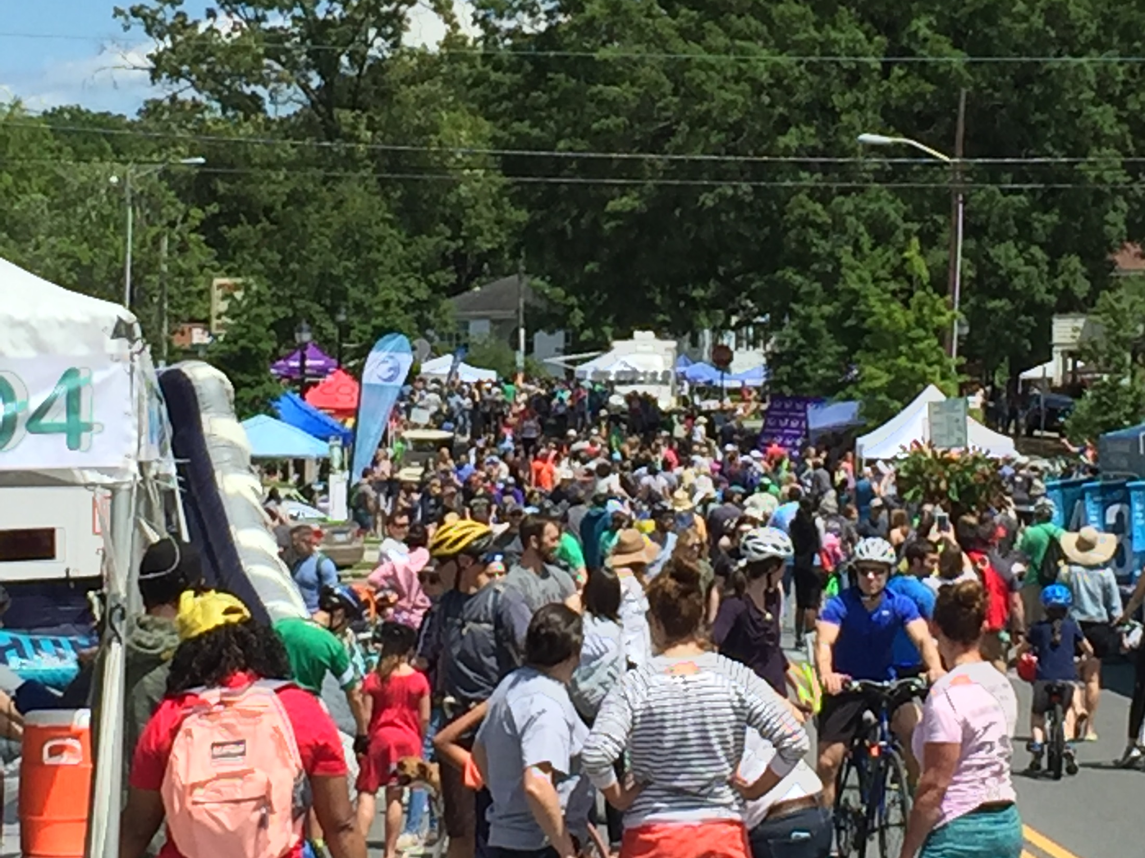
”
Open streets initiatives temporarily close streets to automobile traffic, so that people may use them for walking, bicycling, dancing, playing, and socializing.
Open Streets Project
Notes:
AL

Slide 6
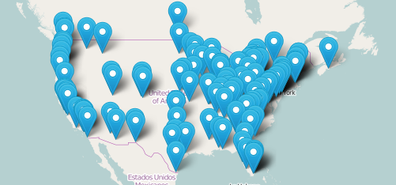
Open Streets
Over 100 initiatives in North America
Notes:
AL

Slide 7
Consultant Team
8 80 Cities
Rutgers University / Equitable Cities
Notes:
AL

Slide 8
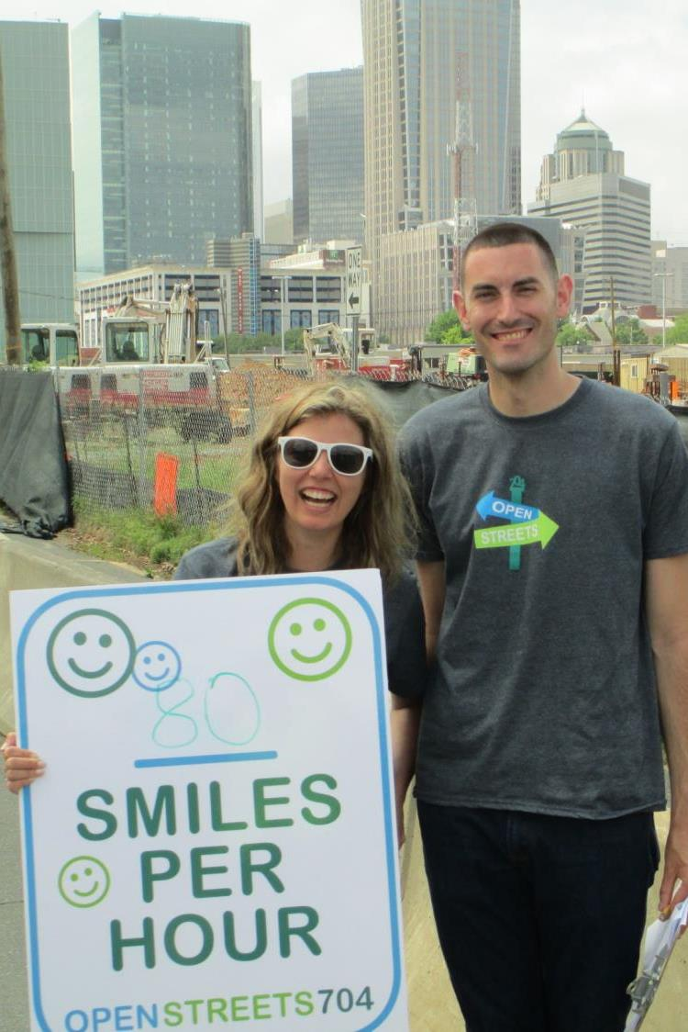
Strategic Planning Workshop
Session One
Day-Of Operations Team
Stakeholder Workshop
Neighborhood Leaders
Session Two
City & County Decision Makers
Business Leaders & Potential Funders
Notes:
AL

Slide 9
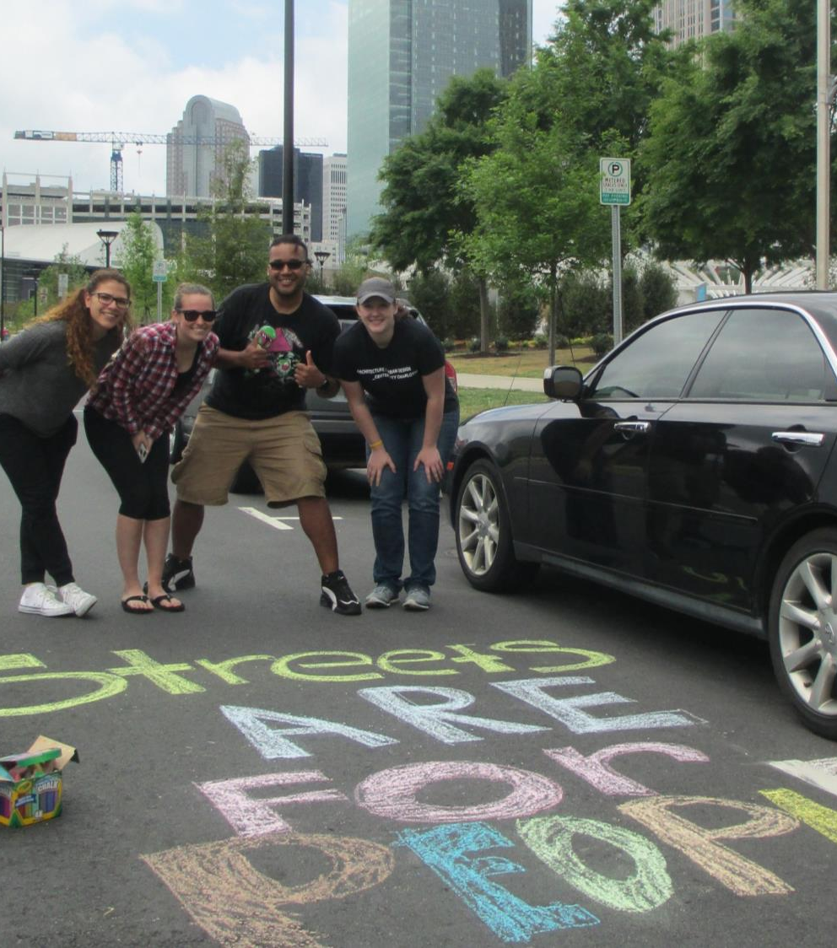
Key Questions
Where?
Future routes that unlock the most benefit for the most Charlotteans, reflecting our diversity and connecting to those in need
What?
Organizational framework that is sustainable, reduces costs, and formalizes planning
How?
Build on existing community and business enthusiasm, strengthen brand, broaden reach
Who?
Approaching partners and stakeholders that can bring more inclusivity and diversity in programming
Notes:
SCOTT

Slide 10
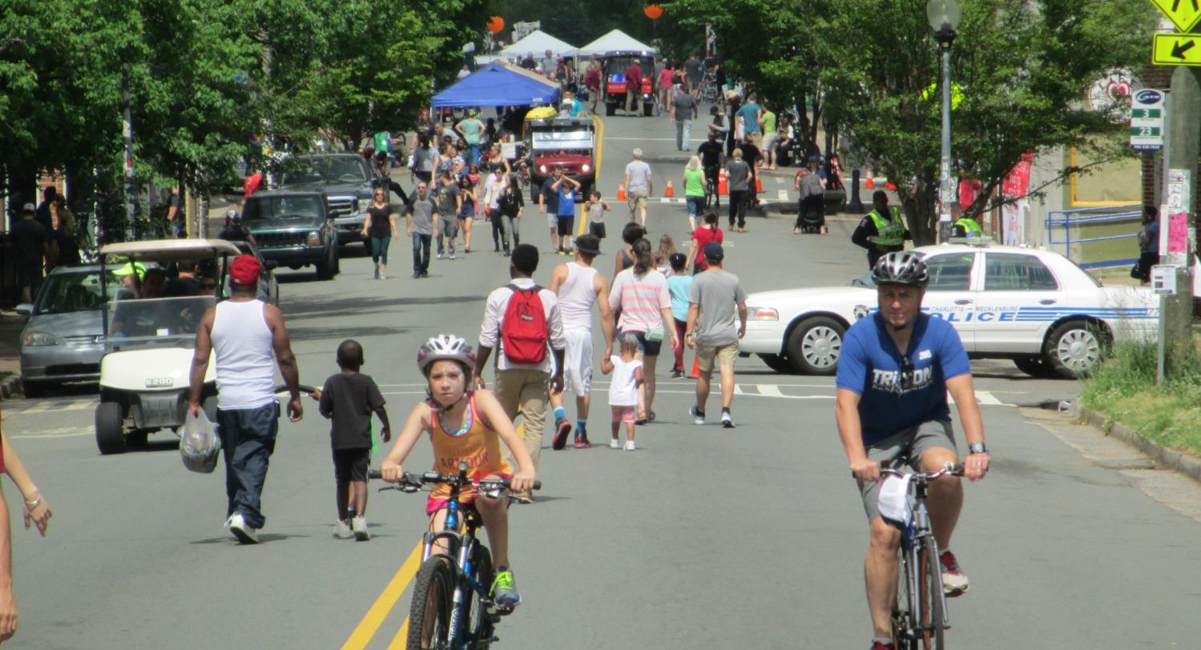
Core Values
CONNECTIVITY
Community Building
Connect people and neighborhoods; Shorten perception of distance
WELLNESS
Public Health
Get people moving!
Encourage different behavior (BEYOND a 4-hour event).
EQUITY
Access to recreation and active transportation opportunities
Diversity and inclusivity in programming
Notes:
SCOTT

Slide 11
Goals
Public Health – Get people moving!
Community Building – Connect people and neighborhoods; Shorten perception of distance
Active Transportation – Encourage different behavior (BEYOND a 4-hour event).
Recreation – Celebrate parks!
Notes:
MONICA

Slide 12
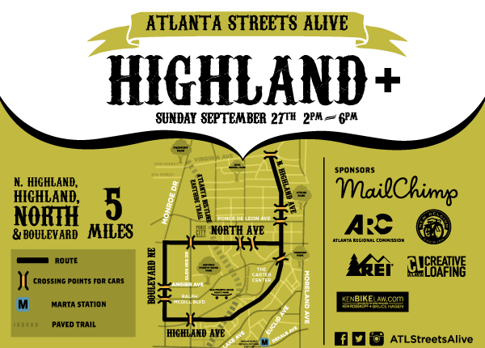
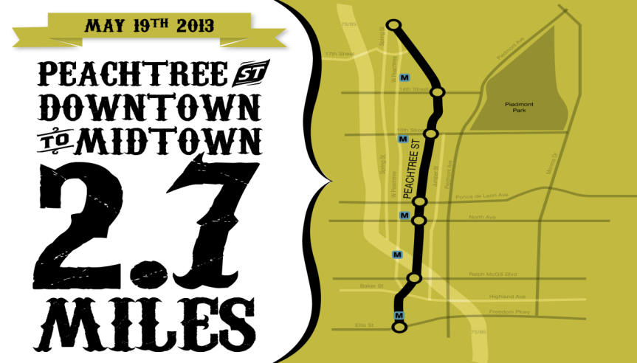
Routes
Many different models
Simplest and least disruptive is typically a linear route with vehicular traffic permitted to cross at key points
Avg. route length
3.95 miles

Slide 13
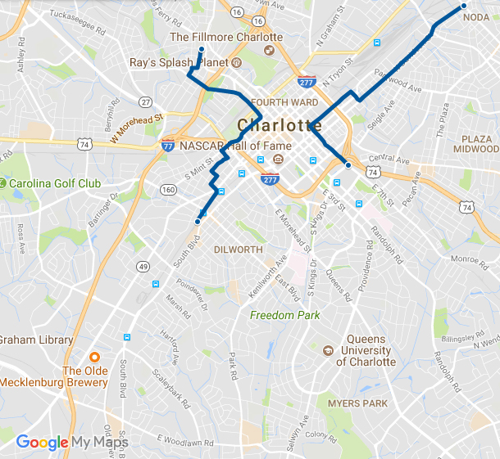
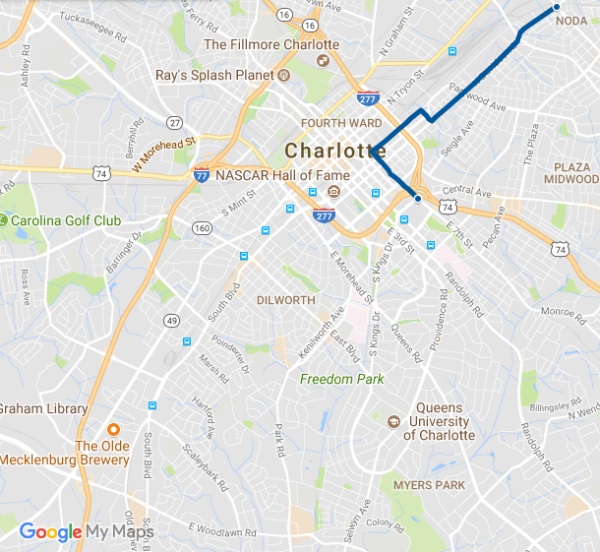
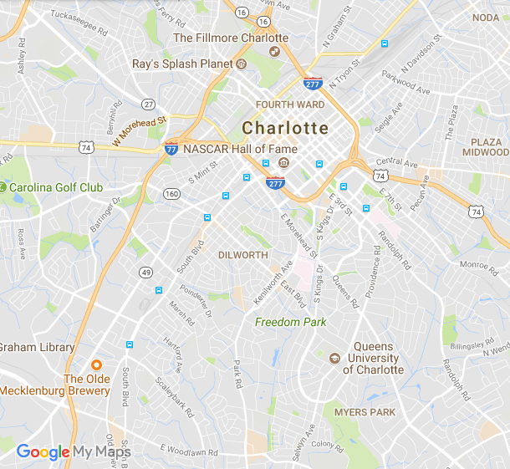
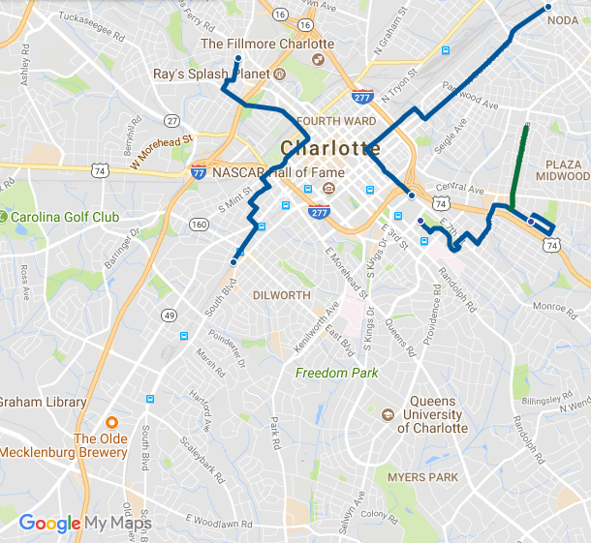
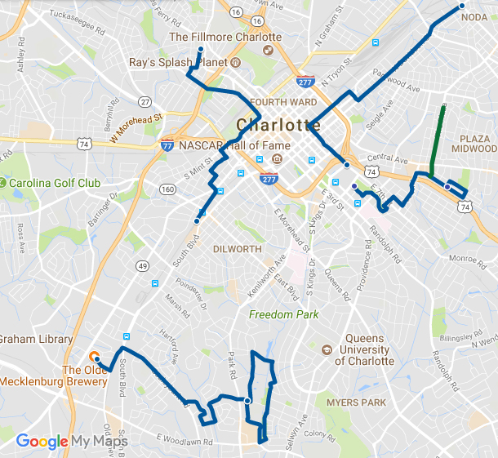
Routes
Route 1
Location: NoDa to Elizabeth
Length: 3.12 miles
Type: Linear
Route 2
Location: Five Points to SouthEnd
Length: 3.19 miles
Type: Linear
Route 3
Location: Elizabeth to Plaza Midwood
Length: 2.42 miles (+ 0.7mi. bike lane demo)
Type: Arm & Loop
Route 4
Location: Freedom Park to LoSo
Length: 5.5 Miles
Type: Arm & Loop

Slide 14
Routes – Selection Criteria
Accessibility/Visibility
Transit
Greenways
Diversity/Discovery
Income/age/race
Overcome barriers
Imagine possibilities
Proximity/Connections
Parks
Commercial nodes
Population density
Operations/Management
Emergency services
Cost

Slide 15
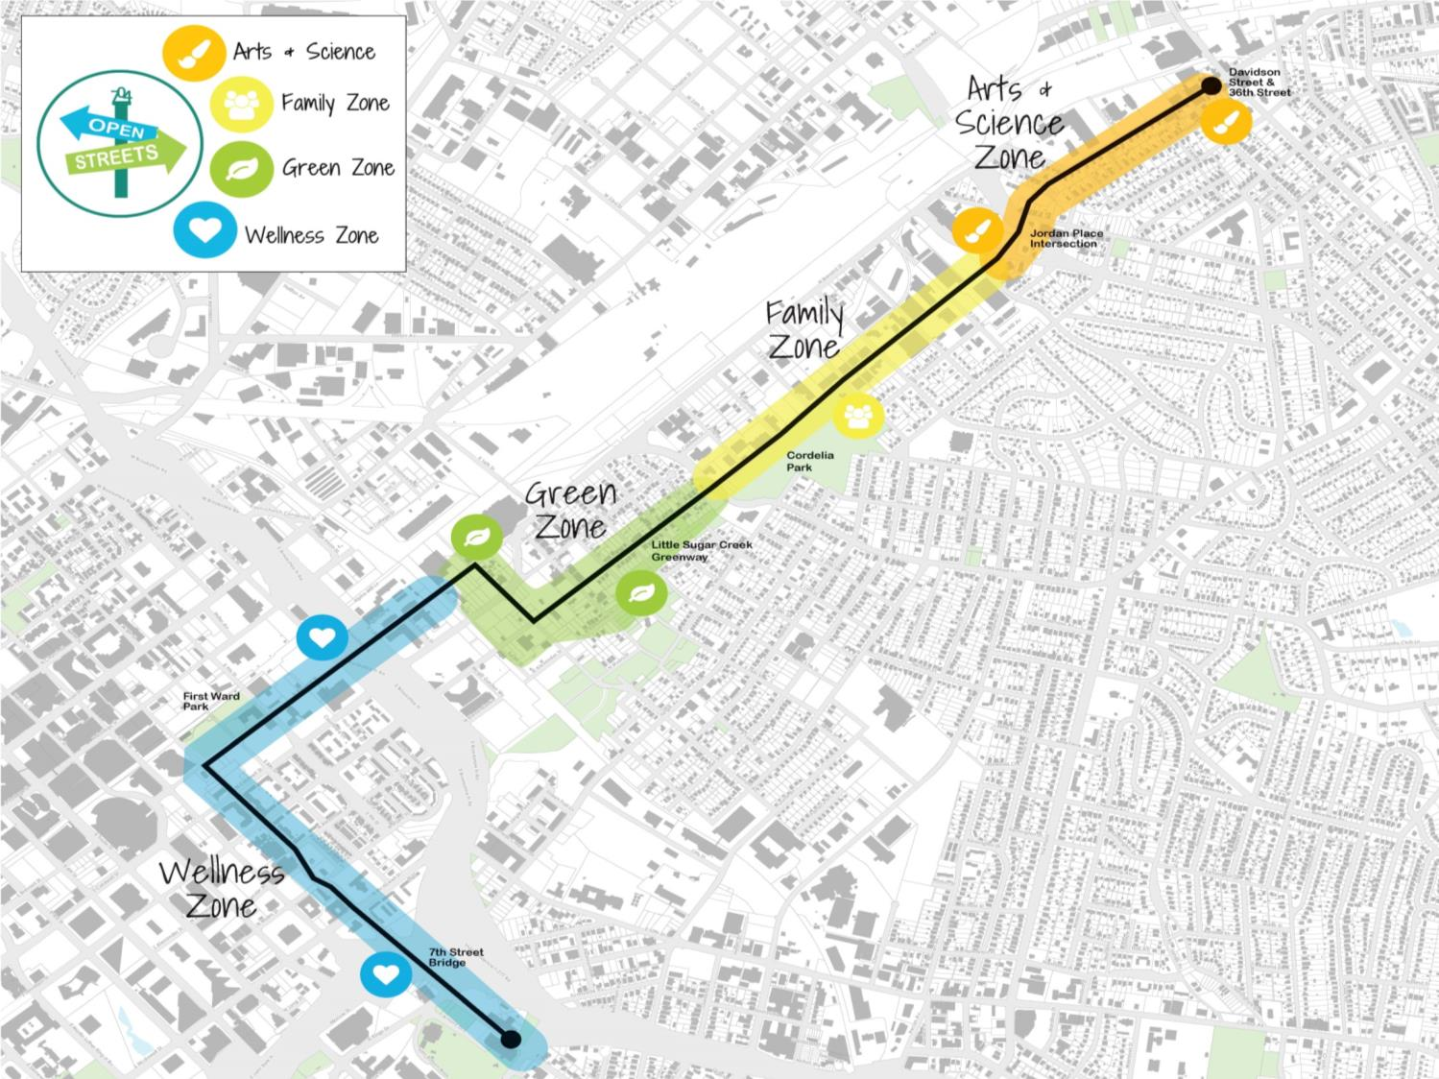
NoDa
Optimist Park
Villa Heights
Belmont
4 Activity Zones
Neighborhood-focused event
First Ward
Elizabeth
Notes:
We are working hard to involve residents and businesses along the Open Streets route. This is a neighborhood-focused event, and our goal is to invite neighbors to join in the fun by participating in or hosting activities near their homes or businesses.

Slide 16
Education & Outreach Opportunity
Interaction with elected officials and city/county leaders
Website
Media coverage (TV, radio, newspaper)
Direct mail and door-to-door outreach
Public Meetings
Calls/meetings with businesses, and institutions on the routes
NextDoor, Facebook, and Instagram posts

Slide 17
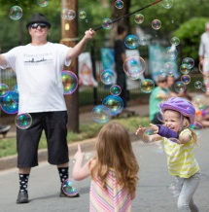
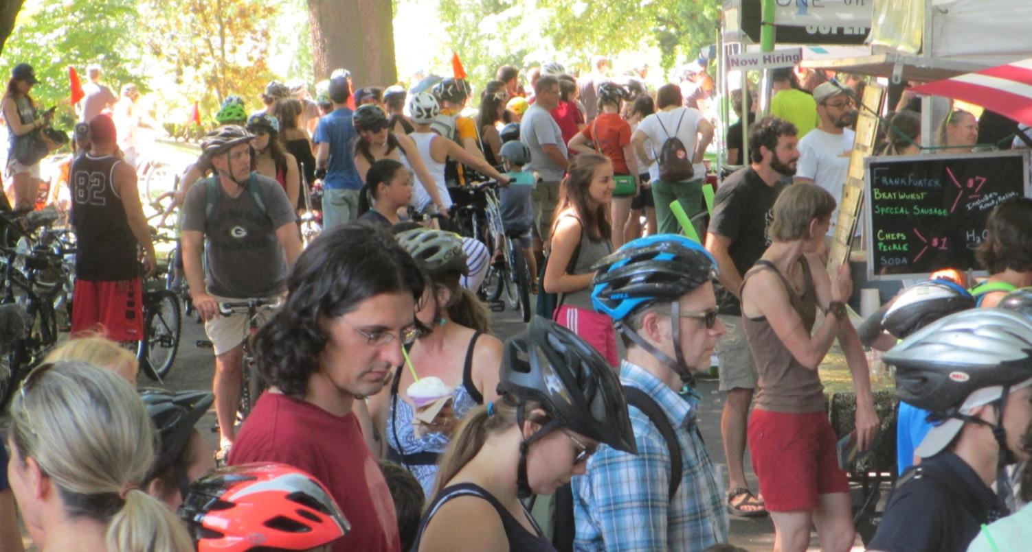
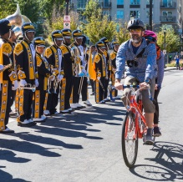
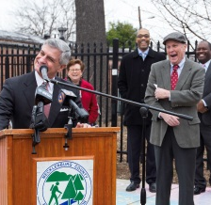
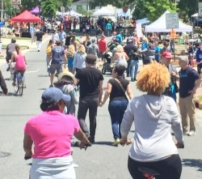
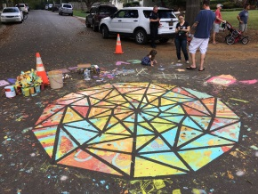
Open Streets 704 timeline
Oct. 2015
Gil Penalosa visit
Aug. 2016
Program research & benchmarking @ Open Streets Summit
Feb. 2017
Announcement of BCBS of NC as Title Sponsor
Dec. 2015
Grant Application to Knight Foundation Cycling Fund for a 4-event pilot
May 2016
Event #1: NoDa to 1st Ward
October 2017
Event #4: South Park to LoSo
Jan. 2016
Knight Foundation grant awarded
Oct. 2016
Event #2: West End to SouthEnd
May 2017
Event #3: Plaza Midwood to Elizabeth
Notes:
MONICA

Slide 18
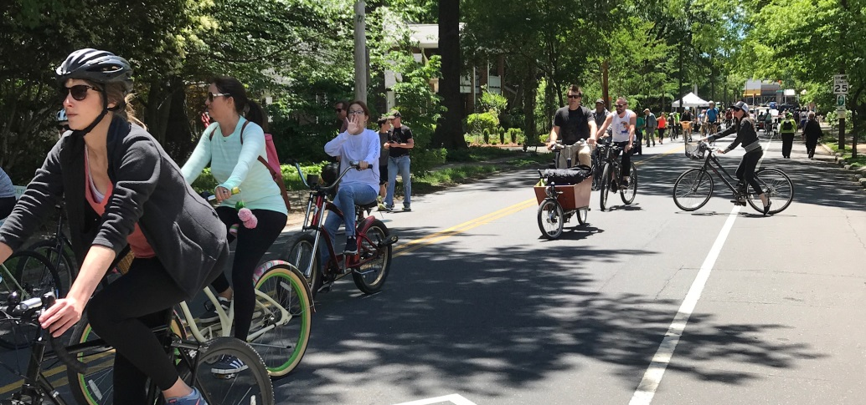
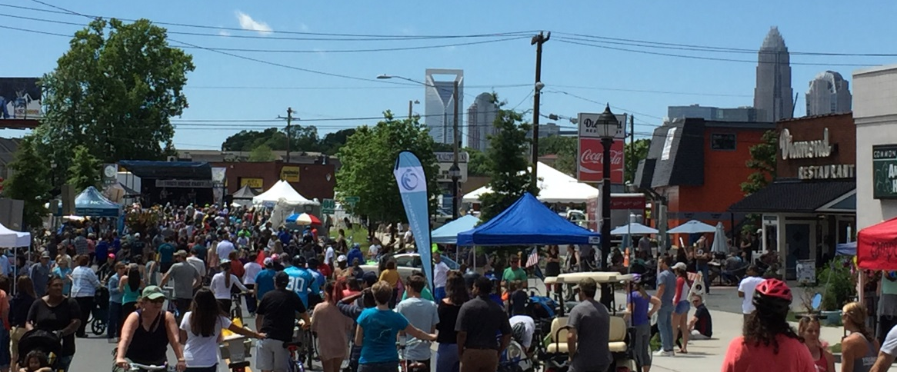
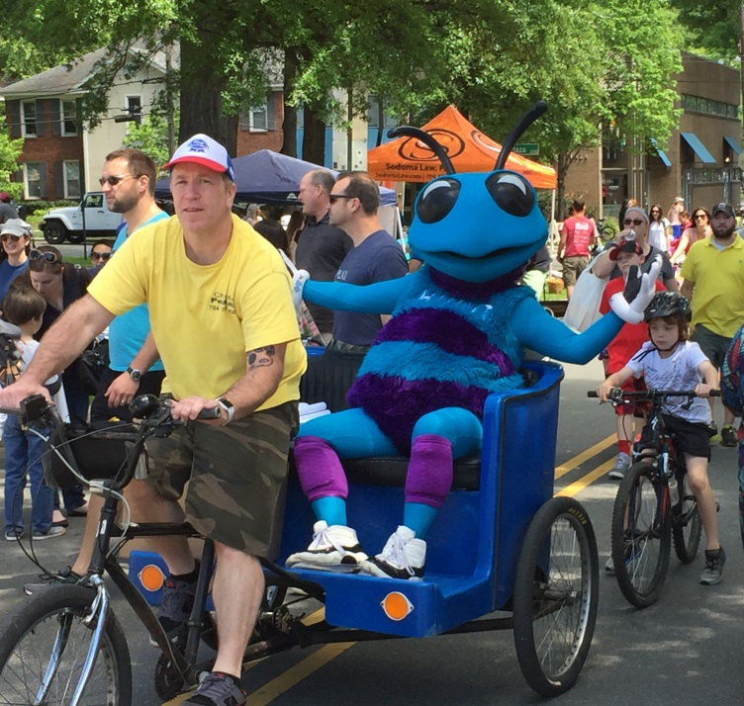
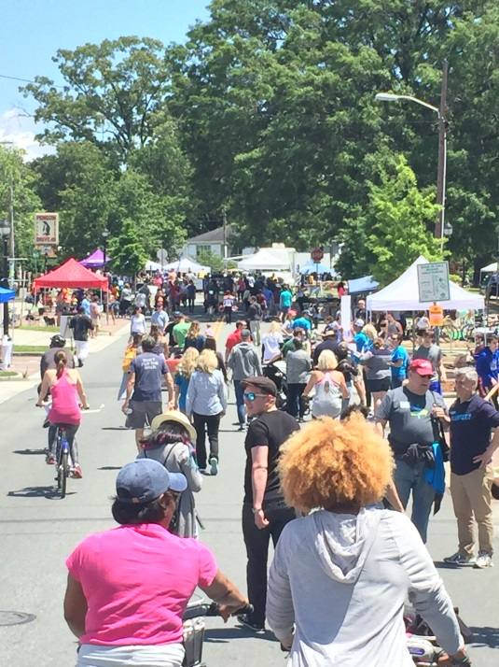
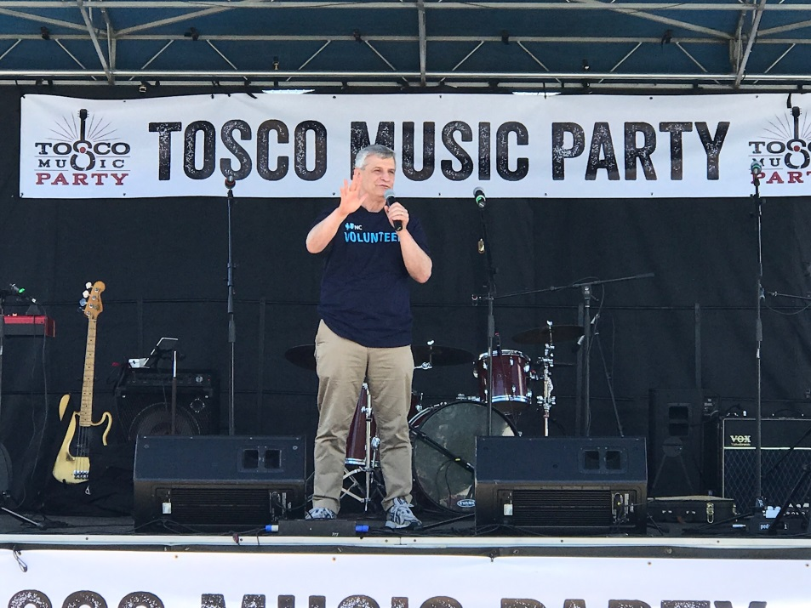
Open Streets 704
Notes:
SCOTT

Slide 19
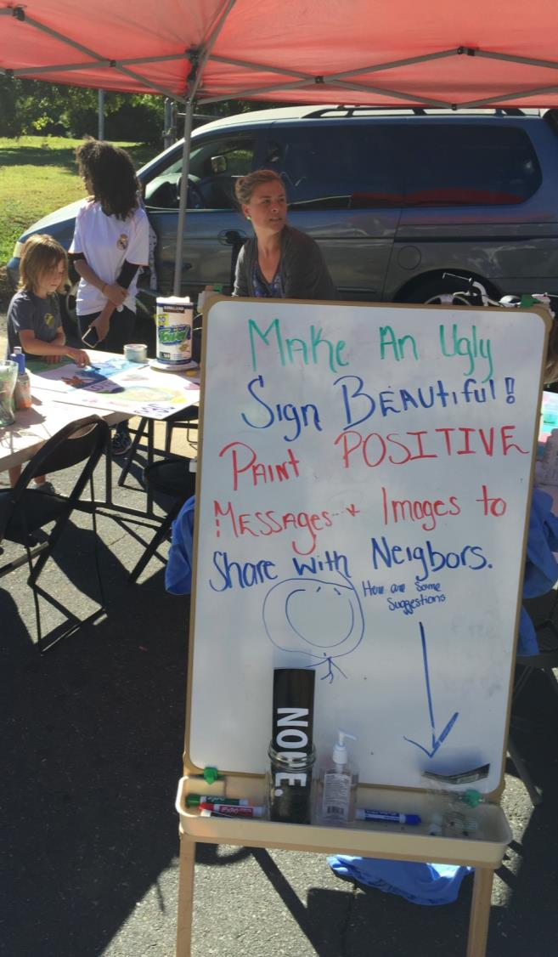
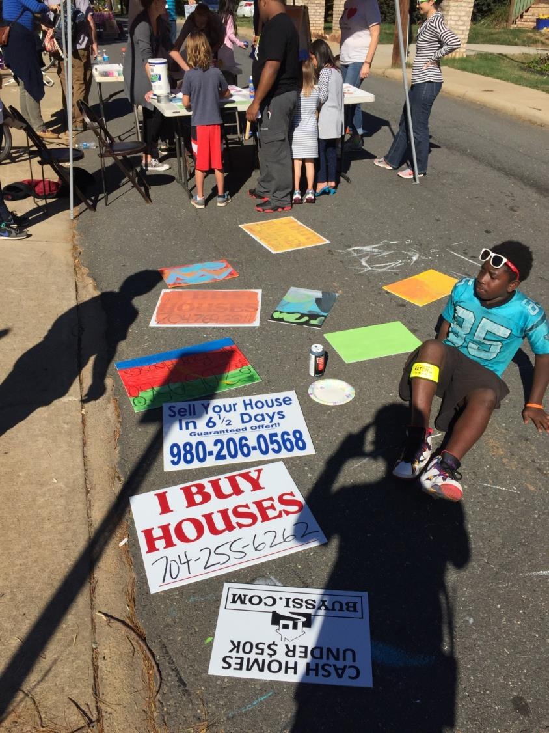

Slide 20
Activities

Slide 21
Activities
What works…
Music
Interactive (games & crafts)
Pilot projects
Anything catered toward children
Activities ON the street
What doesn’t…
Timed activities
Flyers/Hand Outs
Activities are there to supplement the street and the fact that it is OPEN!

Slide 22
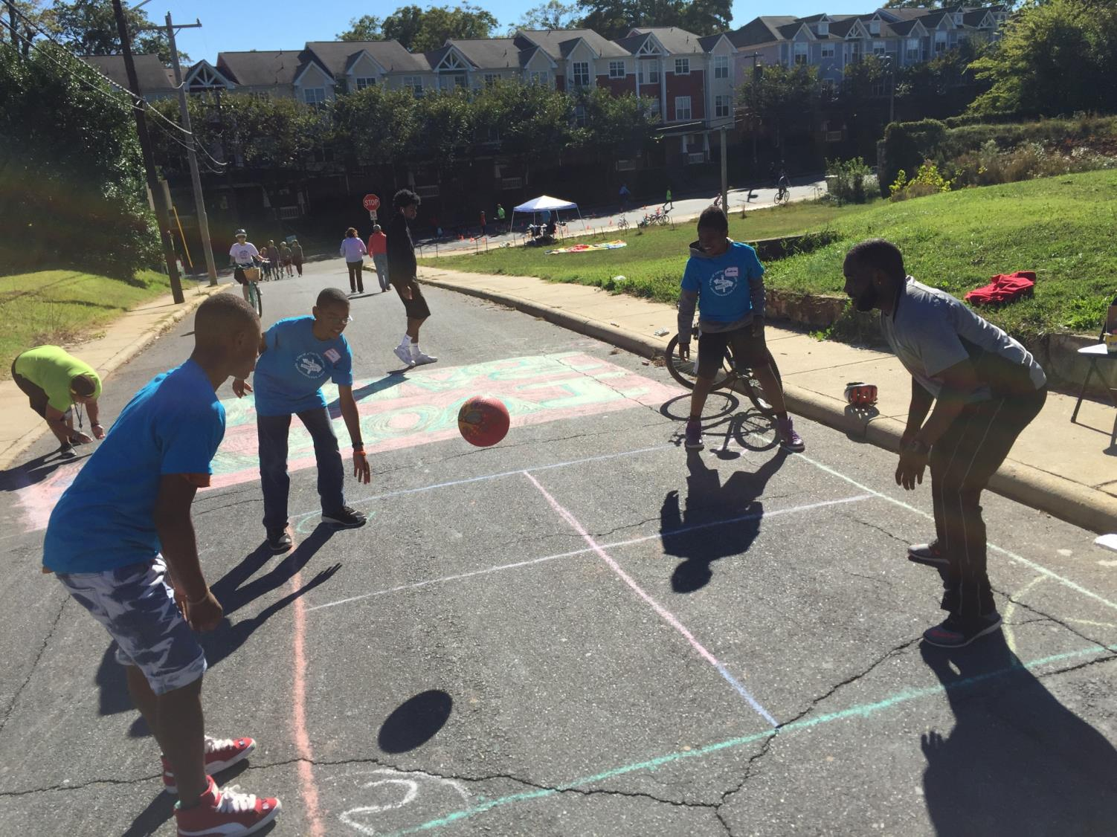

Slide 23
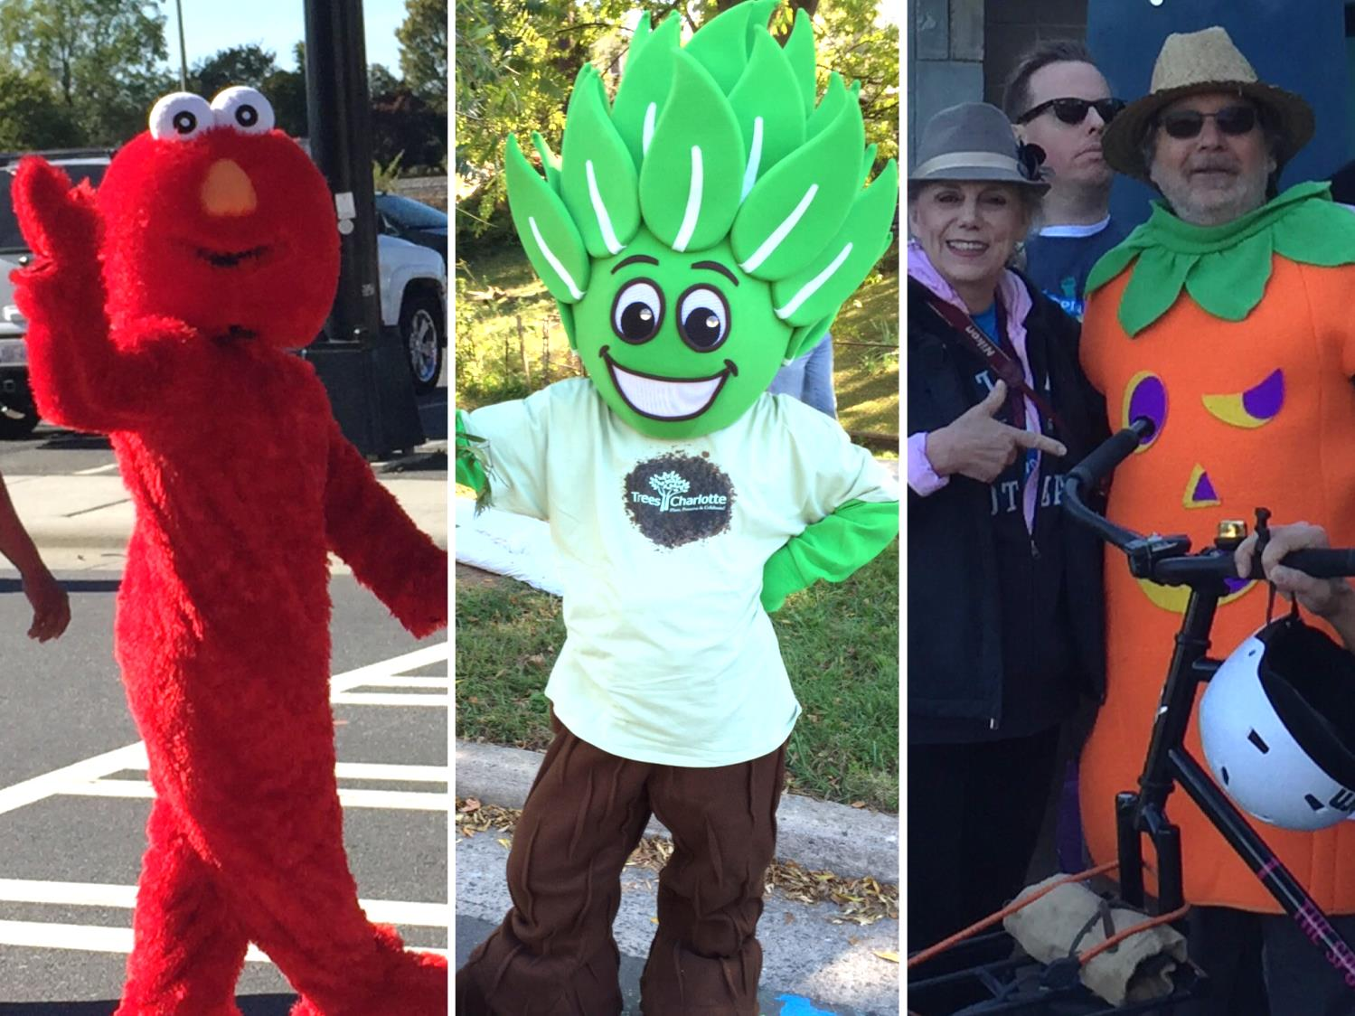

Slide 24
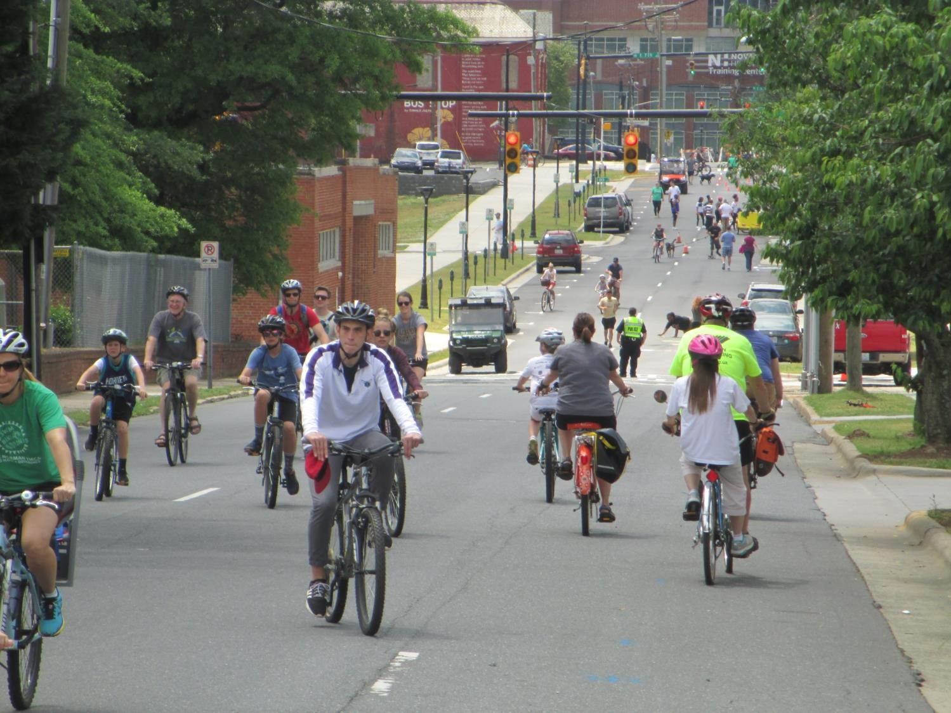
“Unprogrammed” space is good!

Slide 25
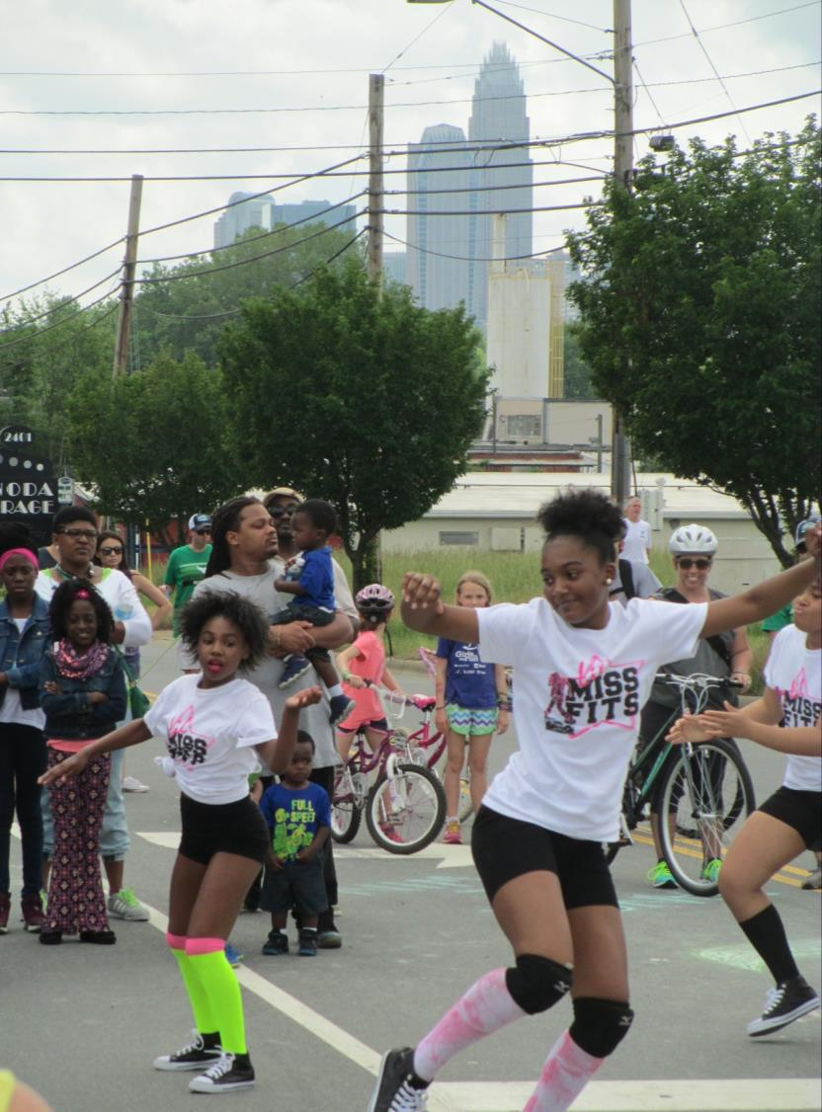
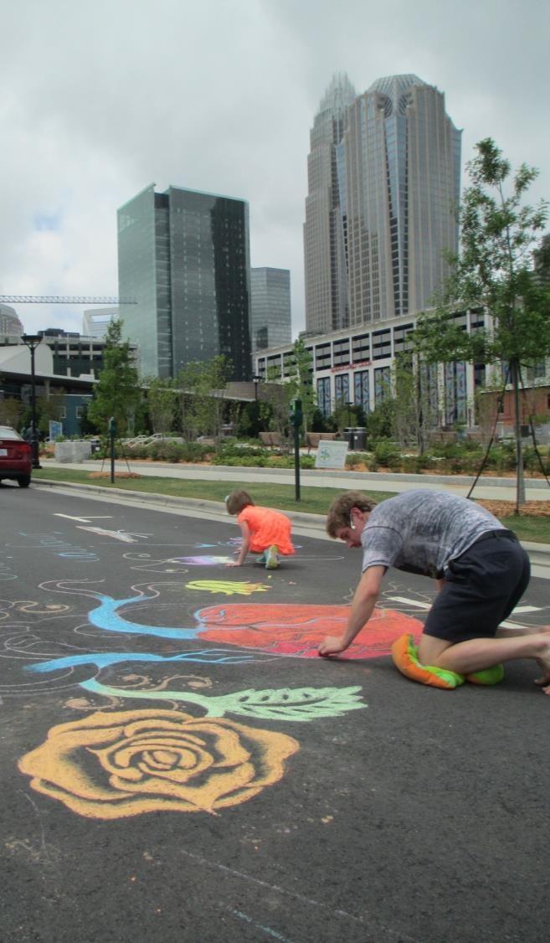
Notes:
MONICA

Slide 26
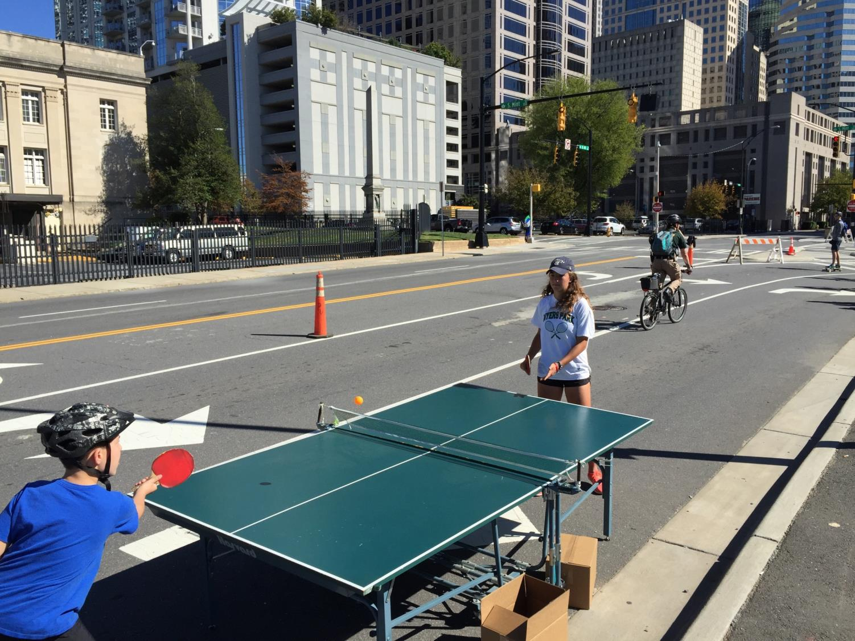
Notes:
MONICA

Slide 27
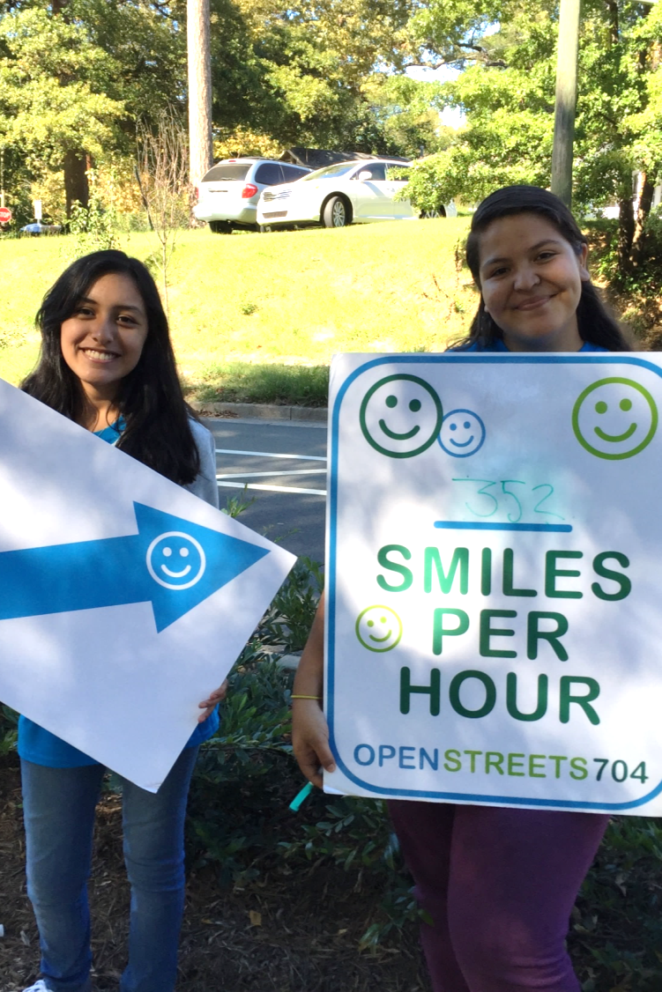
Notes:
MONICA

Slide 28
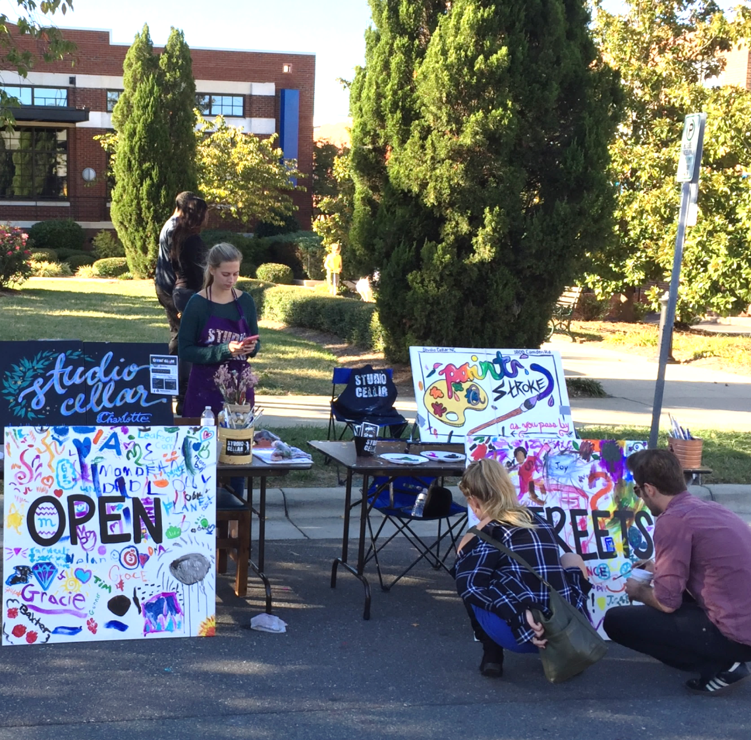
How You Can Get Involved
Host an Activity
“Price of admission” to be on the route
Engage people
Make it fun
Exposure for your organization
Sign up online
Notes:
MONICA

Slide 29
How You Can Get Involved
Help Us Get the Word Out
Tell your customers, employees, friends, family…
E-mail
Social Media
Flyers
Notes:
MONICA

Slide 30
How You Can Get Involved
3. Sponsor the Program
Sponsorship benefits available at different levels
If interested contact us
Notes:
MONICA

Slide 31
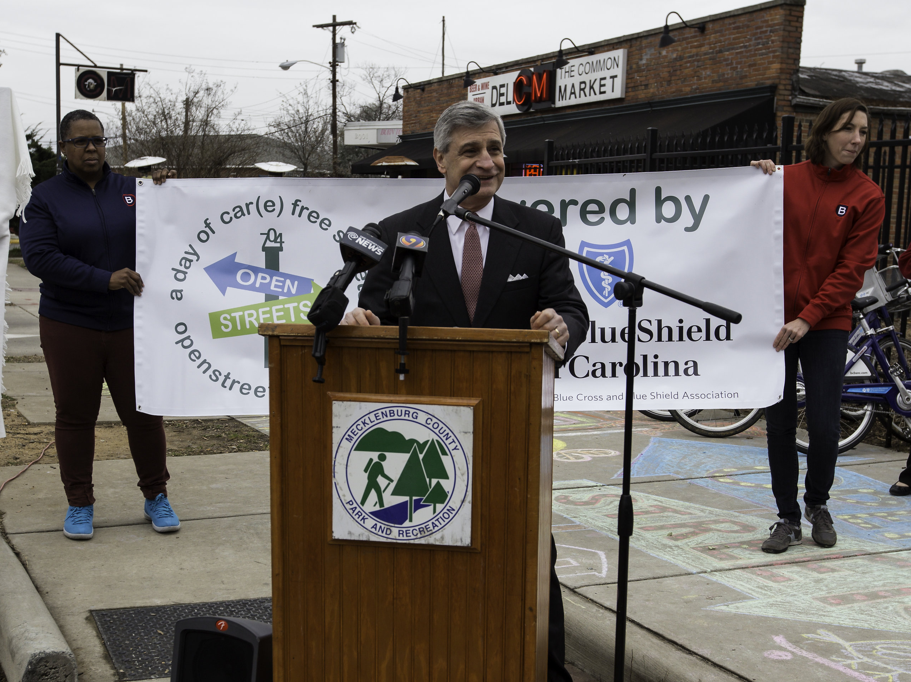
It’s going to turn into a tradition that’s going to surpass any other public event here in Charlotte.” Mike Restaino – Blue Cross Blue Shield of North Carolina
”
Notes:
MONICA

Slide 32
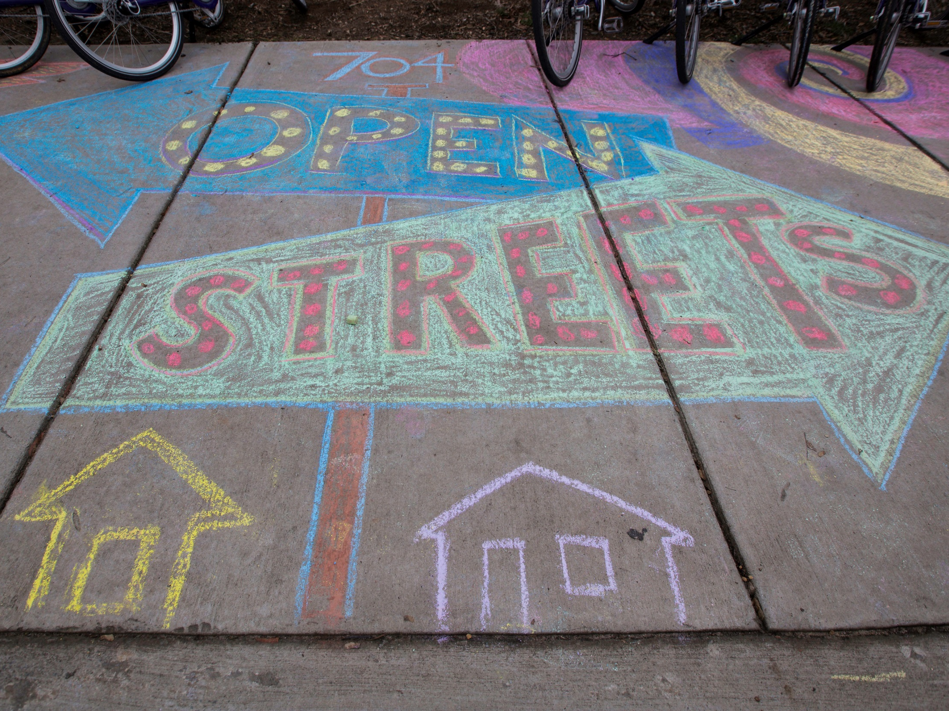
Open Streets 704
Results & Lessons
How Can We Keep This Going?
Notes:
MONICA

Slide 33
Results
Notes:
MONICA

Slide 34
4 events
15 miles
2 pilot projects
Over 60,000 participants
Building relationships
2017 year in review video
Notes:
MONICA
This is a chance to pause and reflect on what we’ve all accomplished, and to set a vision for how Open Streets 704 will continue to bring people together in the future.

Slide 35
Notes:
MONICA
Results from May 2017 Event
Participant Surveys
72.5% said they discovered a new store or restaurant
77% said they spent money along the route
Business Surveys
87.5% believe Open Streets 704 exposed their business to new customers
75% reported an increase in customers and sales
Business community: initially skeptical – now very enthusiastic
Requests from neighborhoods to bring Open Streets 704 to them

Slide 36
Lessons
Notes:
SCOTT

Slide 37
Big Lessons
We are not alone.
Many other cities!
This is not a fringe movement. Open Streets are here to stay.
Part of our approach to compete with other “winning cities”
Notes:
SCOTT

Slide 38
Big Lessons
Open Streets 704 is a program…
…not just an event.
It’s about a commitment to community that goes beyond a 4-hour event
Notes:
SCOTT

Slide 39
Big Lessons
We are a bargain!
Long Beach, CA: $350,000+ per event
San Jose, CA: $450,000+ per event
Charlotte, NC: Less than $60,000 per event
Less than $4 per participant
Notes:
SCOTT

Slide 40
Big Lessons
FUN has to be the primary focus
Diversity, mobility, public health, etc. are VERY important, but FUN has to be at the center
“Preachy” events don’t resonate with people
Volunteers, staff, and participants burn out when it’s not fun
Notes:
SCOTT

Slide 41
Big Lessons
Sustainable programs have to secure financial support.
Private sponsorships
Foundation grants
Local government
We have to be diligent about telling our story and communicating our value!
Notes:
SCOTT

Slide 42
Big Lessons – Our Core Values
CONNECTIVITY
Community Building
Connect people and neighborhoods; Shorten perception of distance
WELLNESS
Public Health
Get people moving!
Encourage different behavior (BEYOND a 4-hour event).
EQUITY
Access to recreation and active transportation opportunities
Diversity and inclusivity in programming
Notes:
SCOTT

Slide 43
Participant Surveys
May 2017 Event
Participant Surveys
72.5% said they discovered a new store or restaurant
77% said they spent money along the route
Business Surveys
87.5% believe Open Streets 704 exposed their business to new customers
75% reported an increase in customers and sales
What would you be doing today if you weren’t at Open Streets 704?
“Sitting at home on my butt.”

Slide 44
Participant Surveys
May 2017 Event
65% said they are more likely to walk or bike for transportation after participating in Open Streets 704
78% said they are more likely to visit parks and greenways after participating in Open Streets 704
67% said they would have been doing something sedentary if it wasn’t for Open Streets 704

Slide 45
Where do we go from here?
City/County support
# of events per year
Organizational framework
Diversity and inclusion in programming
Notes:
SCOTT

Slide 46
Goal
Create an enduring sustainable program with grassroots neighborhood support
How can we make it easier for residents and community groups to get involved?
How can OS704 serve as a platform for community groups to achieve their goals?
Notes:
MONICA

Slide 47
VIDEO 2017 Year in Review
Notes:
SCOTT

