Slide 1
Innovation Corridors Keith Conover, NC Broadband Jason Wager, Centralina COG

Slide 2
Innovation Corridors Innovation Café
Targeted Economic Growth in Communities… Done Differently

Slide 3
Session Take-Aways
Movement—of people, goods, and information—is presently undergoing rapid transformation
Today’s planning processes and economic development strategies will set the stage for success 40+ years from now
Local government has a critical role to play

Slide 4
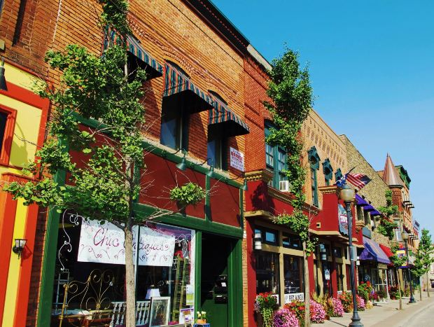
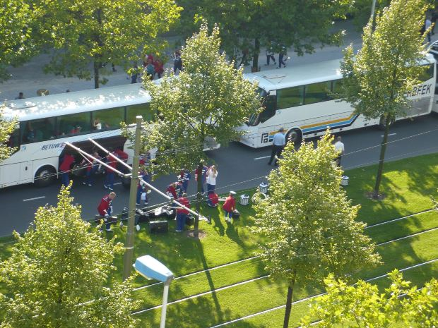
What Are Innovation Corridors?
“Placemaking”
Transit
Economic Development/ Innovation Hubs
Notes:
Innovation Corridors refers to a systematic approach to promoting economic development along key transportation corridors designated as part of the CONNECT Regional Growth Framework. The Innovation Corridors concept will explore the potential to unify place making, economic development/innovation hubs, and transit. Communities specifically could utilize this framework to promote public transit and high-performance broadband coordinated with transit-oriented housing, commercial development and important public services, including education. For the systems that make up the implementation phase of “CONNECT” to move forward, a work plan that gauges and grows ongoing organizational support must be designed.
One way of describing this concept is: Intentionally planning and developing our communities around the parallel goals of Placemaking, Economic Development, and Transit.

Slide 5
Innovation Corridors Framework: CONNECT Region Top Priorities
Parks & Open Space
Improved Water Quality
More Transportation Choices
Improved Air Quality
Support Our Communities
Work Closer to Home
Support Local Farms
More Housing Choices
Cost of Providing Services
Cost of My Commute
Notes:
FIRST COMPONENT of the Regional Growth FRAMEWORK is the Priorities
Regional Growth Priorities (top 10)
Over 8,400 participants

Slide 6
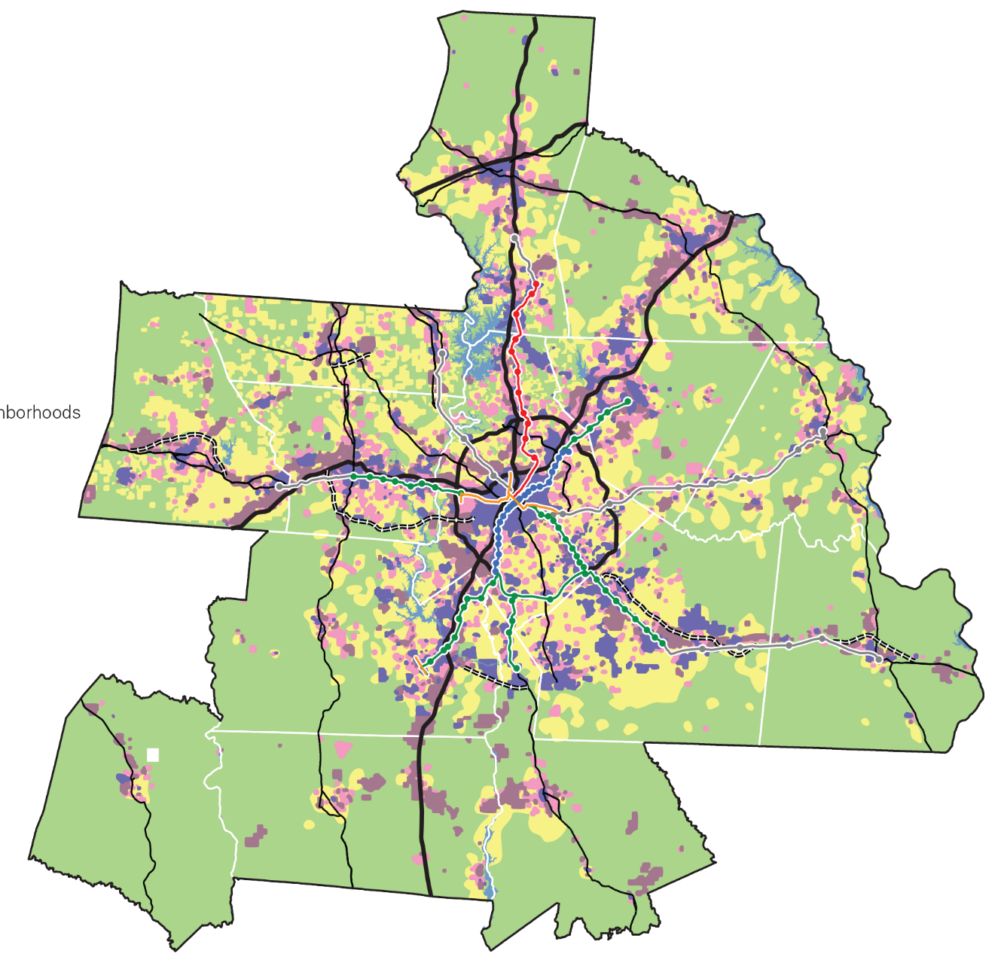
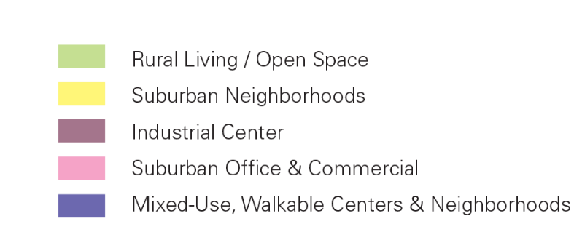
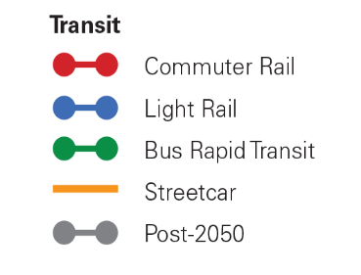
Innovation Corridors Framework: Regional Preferred Growth Concept
Major (re)investment in walkable downtowns, mixed-use activity centers, walkable neighborhoods & major transit corridors
More housing choices, travel choices, open space/farmland preservation & job centers
More efficient service areas for providing local government services
Notes:
SECOND COMPONENT
Preferred Growth Concept – a quilt of local –level preferred growth maps from 14 counties. Created from existing community plans, on-going discussions with local leaders, stakeholders and staff.
Regional Preferred Growth Concept ----Affirmed July 29, 2014
The final preferred growth concept points to the REGIONAL SYSTEMS that we need to grow and the need for local tools.
Major systems include: Transportation, Workforce and Economic Development, Housing, Land Use and Water

Slide 7
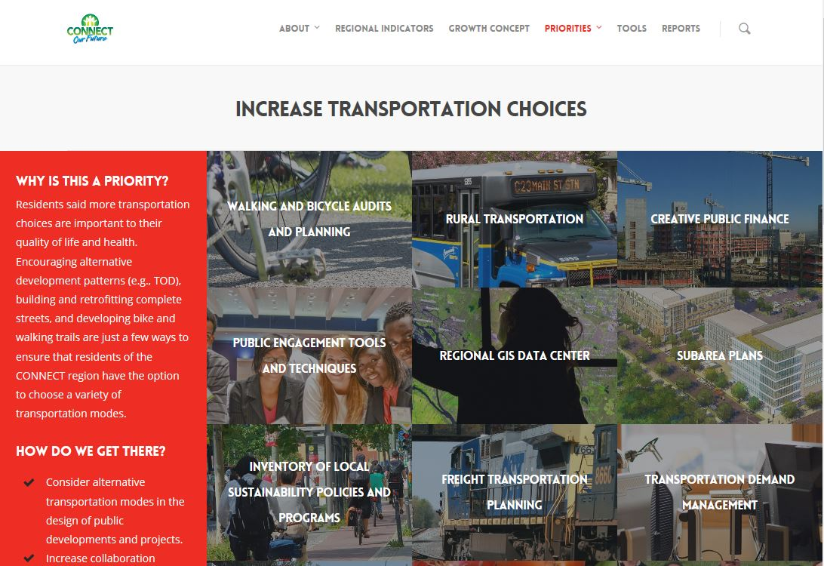
Innovation Corridors Framework: Tools
Notes:
Innovation Corridors Framework:
THIRD COMPONENT of the Regional Growth FRAMEWORK is the Toolkit
Close to 80 tools for local governments.

Slide 8
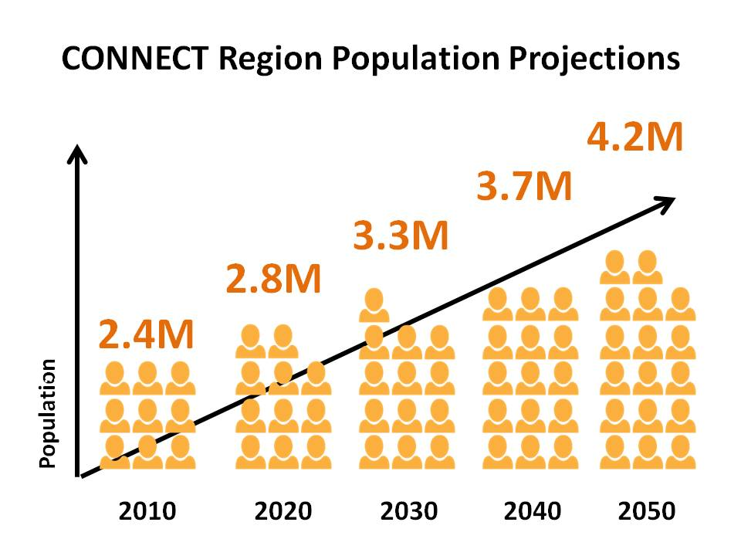
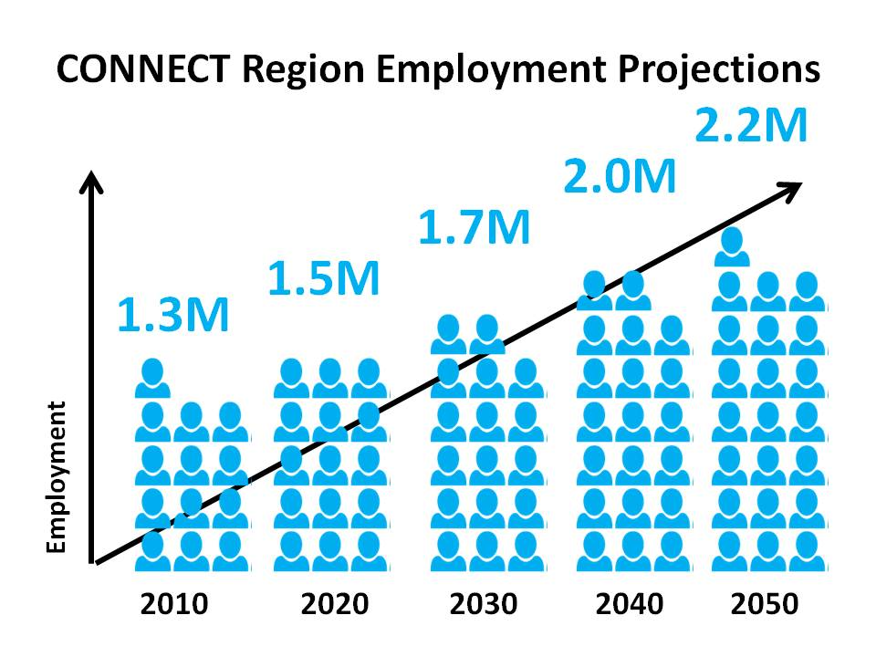
Why?: Expected Growth
Notes:
Context: As Dr. Johnson notes, we are “the place to be”—the people and jobs are coming.

Slide 9
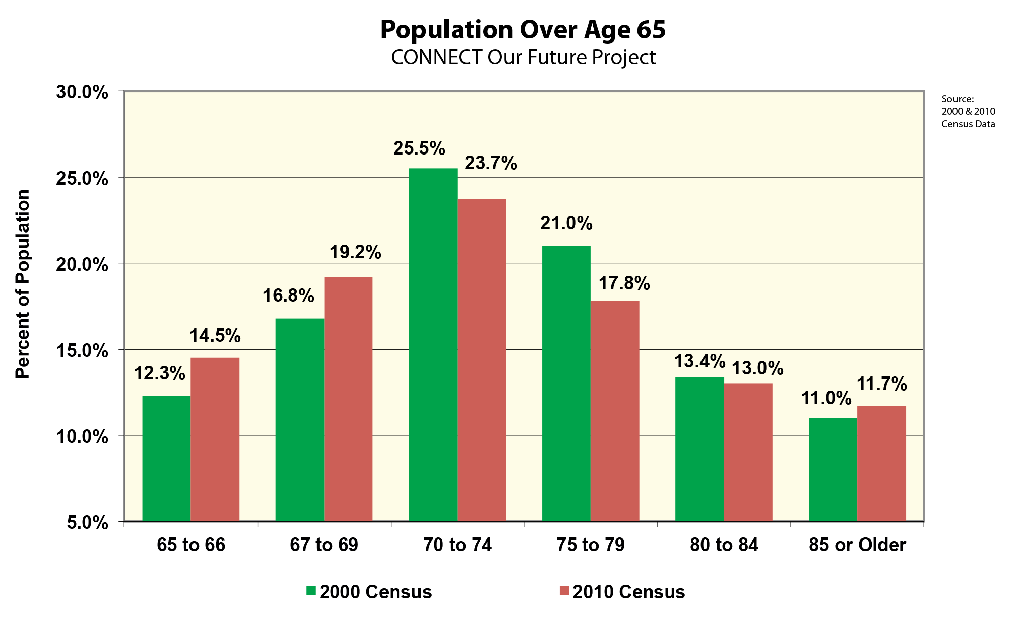
An Aging Population: Thinking About Future Development Differently
Notes:
Context: As we also learned from Dr. Johnson, our population is aging with early and late senior populations growing and expected to continue to grow. Our future places need to address this reality.

Slide 10
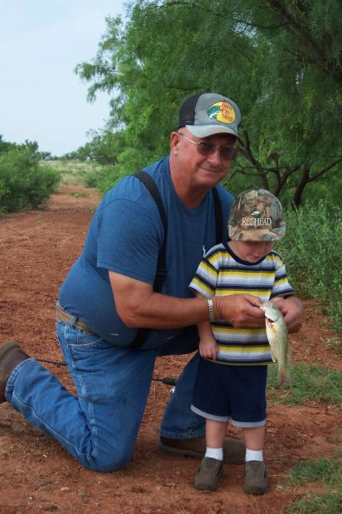
And Don’t Forget…
Notes:
Context: Further, we are seeing…
A growth in millennials, including those entering and increasingly making up the workplace
Seniors raising children; multi-generational households; female heads of households
And the list goes on…

Slide 11
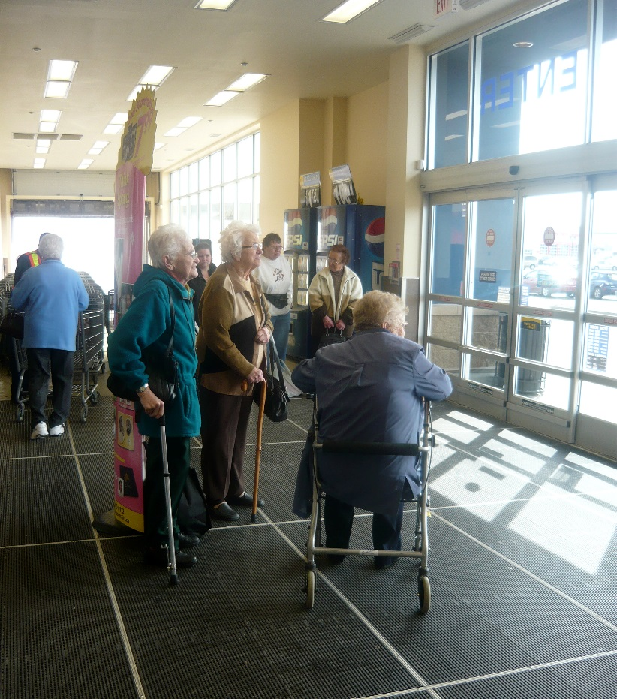
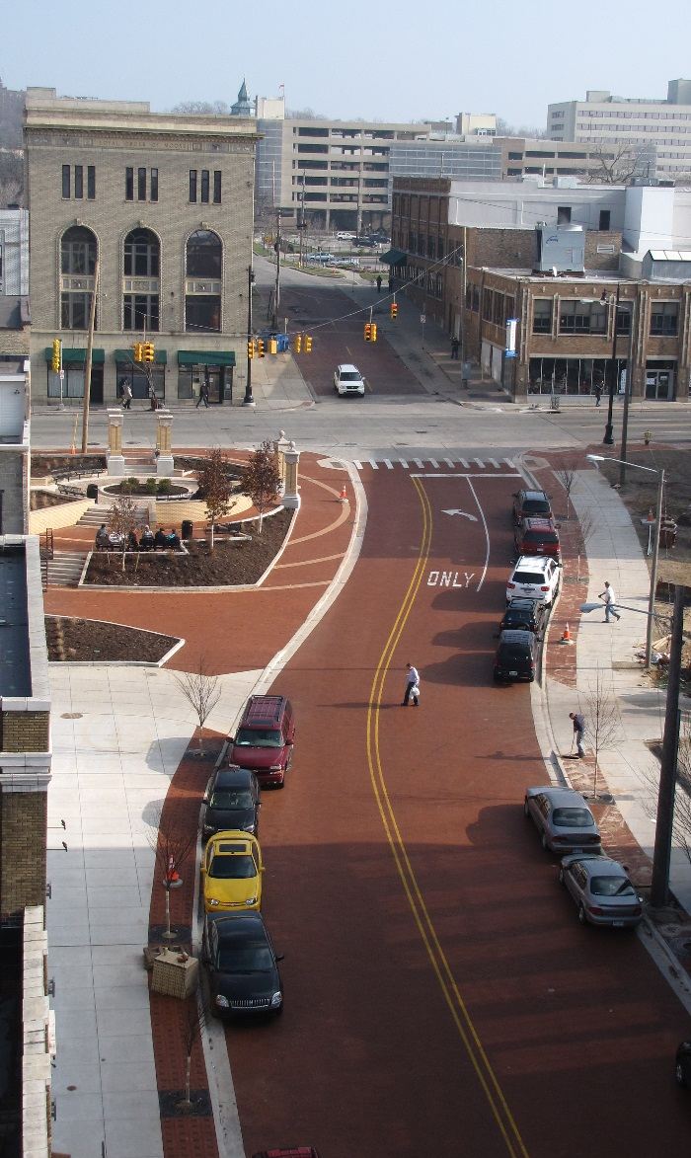
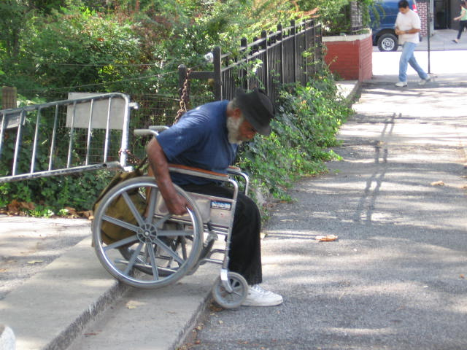
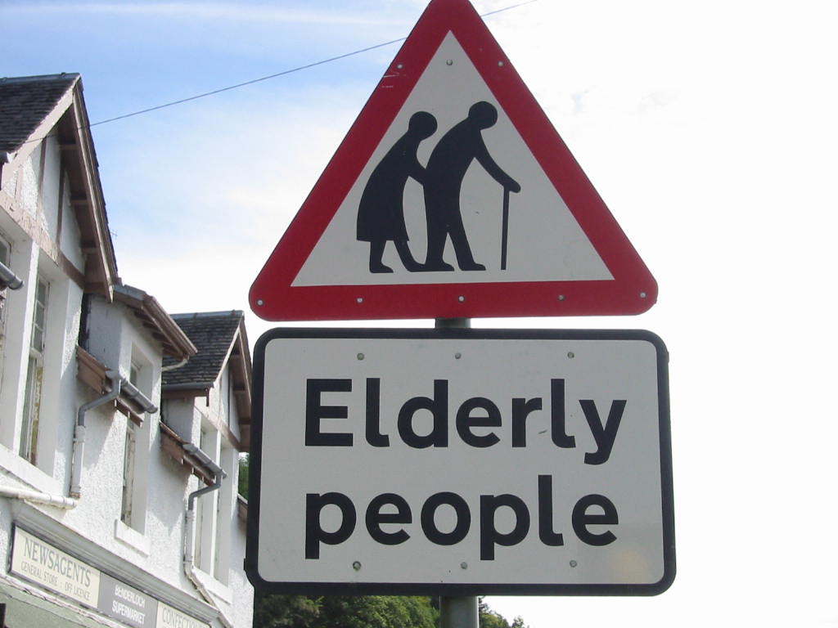
With These Shifts Come Challenges
Notes:
Relevance: How do we…
Address Mobility Limitations that come w/ chronic disabilities or physical impairments?
Address Economic constraints come with fixed incomes?
Support a key goal for our aging relatives to “age in place” and live independently for as long as possible?
Ensure multi-generational spaces near job, school, and home?
Provide Centers for collaboration and training?
Address the expected Impact on transit demand?

Slide 12
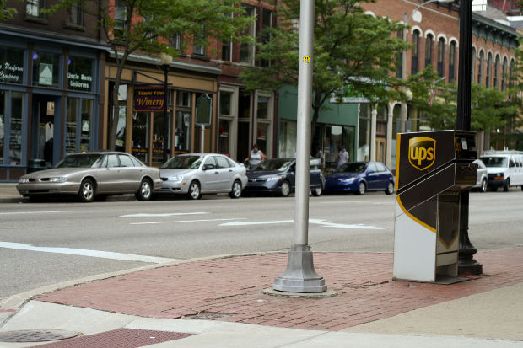
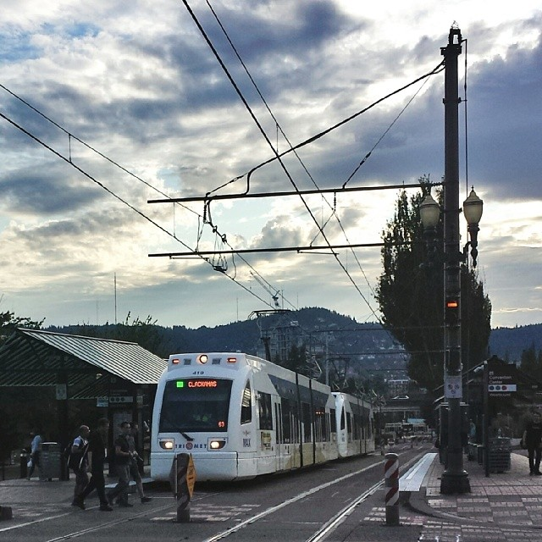
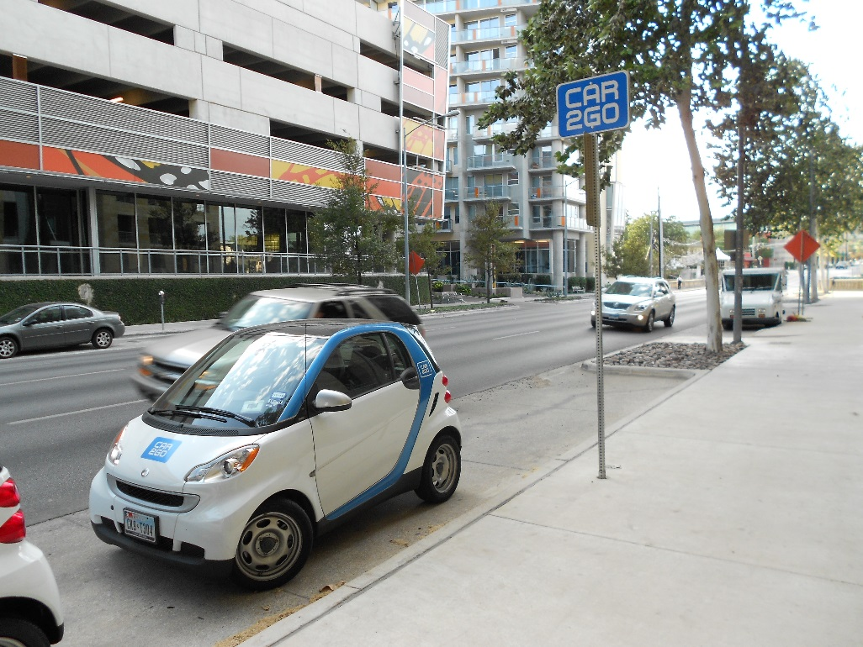
What Role Can the Innovation Corridors Concept Play?
Notes:
Meaning: Innovation Corridors can address things like:
General Accessibility of businesses, home, workplace, and public spaces have to be considered in our design across multiple age groups
Co-location and access to affordable housing and transportation for the elderly and families is enabling and empowering
Housing and work located within easy access of Services; E.g.-Childcare options
Housing will need to be Senior-friendly/include universal design
Transit Options need to remain economically competitive
We should have set expectations for access to information technology across all population groups

Slide 13
Keith Conover NC Broadband Infrastructure Office

Slide 14
Google access chief Kevin Lo told audiences at a broadband forum that the key strategy for attracting Google Fiber to your city is not about tax breaks; it's about cooperation. Internet providers need easy access to power poles, ducts and cable conduits. Not to mention maps that show where this equipment is situated, plus the location of water, power and gas lines, phone cables, utility tunnels and underground conduits. They also need construction permits issued quickly and complete cooperation of all city officials. - excerpt from CIO.com

Slide 15
Keith Conover NC Broadband Infrastructure Office keith.conover@nc.gov

Slide 16
Session Take-Aways
Movement: “The How” is changing-Do you understand what this means for your community and what hidden opportunities exist? How can you help communicate this to others?
Planning: Corridor identification? ROW acquisition? What are your community values and how can you ensure they are preserved? Planning processes that engage citizens and set forth a vision? Standing agreements around development approval that keep long term goals in mind?
Local government: Elected or staff, you have a role to play!

Slide 17
Comments and Questions?
Keith Conover NC Broadband Infrastructure Office keith.conover@nc.gov
Jason Wager
Centralina COG
jwager@Centralina.org

Slide 18
Innovation Café #3 Innovation Corridors: Charting Our Region’s Transit Opportunities
Disruptive Demographic Trends and the Implications for Regional Transit Planning, Innovation Hubs, and Place-Making?

Slide 19
Guiding Questions
Innovation Corridors is essentially about “placemaking” focused on identifying and developing elements that will support economic and job growth and continued quality of life for current and future generations in your community. What key stakeholders are required to achieve this task in your community?
Given the desire for better access to transit, urban living, and access to retail/work/recreational activities by Millennials and Baby Boomers, how can the region best develop a framework for private development to build upon?
How can broadband access be used to enhance innovation along the future transit corridors?
What strategies are needed to attract businesses along future transit corridors?
What strategies can/should be used to move forward with the Innovation Corridor concept?
What elements of the Innovation Corridors concept would be most appealing to your community?
What aspect of this concept would need clarification before this idea could be successfully communicated more broadly?
What are the “deliverables” required to build support for regional transit and to build support for funding Innovation Corridor Infrastructure outside of Mecklenburg County (through local option sales tax, tax increment financing, etc.)?

