Slide 1
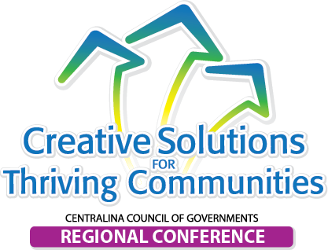
Getting to an Inclusive, Regional Economic Development Strategy
2017-2022 CEDS Strategic Overview
Centralina Economic Development Commission
April 12, 2018

Slide 2
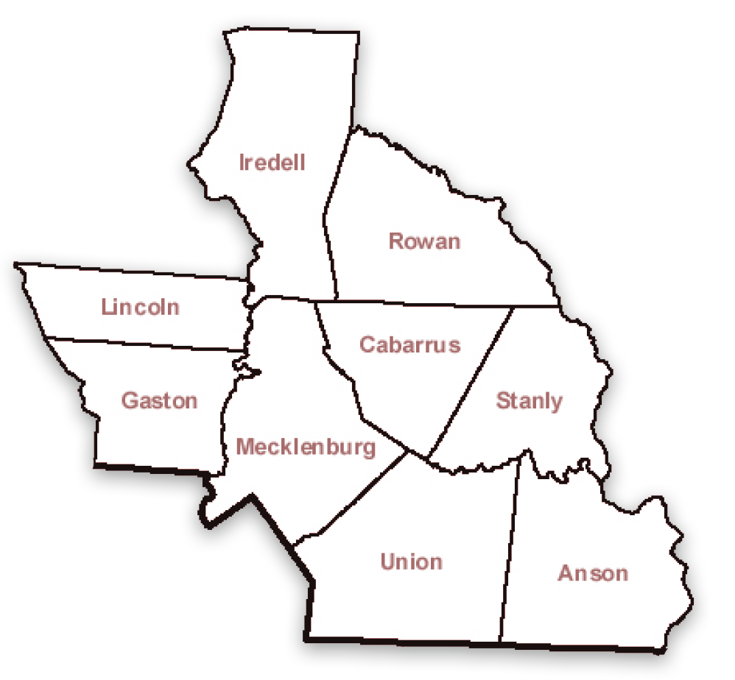
Centralina Economic Development Commission (CEDC)
Established in 2005
A public non-profit organization
Nine county area
US Commerce, EDA Economic Development District (EDD)
Notes:
As a designated Economic Development District (EDD) by the U.S. Department of Commerce's Economic Development Administration (EDA), the CEDC develops a Comprehensive Economic Development Strategy (CEDS) for the nine-county region.

Slide 4
2017-2022 Centralina CEDS
Goals
Build a Regional Competitive Advantage & Leverage the Marketplace It is easier to navigate downstream than row upstream, so we should build on our strengths and work with the market, not against it.
Business
and Industries
Establish & Maintain A Robust Regional Infrastructure
To be successful, we need to make sure investments in capital assets will support our communities, now and in the future
Infrastructure
Create Revitalized & Vibrant Communities
Just as a chain is only as strong as its weakest link, great regions make sure that all of their cities, towns, suburbs and rural areas are positioned to succeed.
Quality of Life
Develop Healthy and Innovative People
In an increasingly competitive and uncertain world, training, developing and educating our citizens will be critically important
Workforce

Slide 5
2017-2022 Comprehensive Economic Development Strategy

Slide 6
Summary Overview
The 2017 Prosperity for Greater Charlotte Comprehensive Economic Development Strategy outlines an approach to coordinate growth and prosperity that;
builds on the region’s strengths
prioritizes key regional industry clusters
emphasizes collaboration
Strategy reflects a holistic, modern view of economic development that continues global business recruitment while increasing focus for enhancing foundational assets in;
business retention and expansion
entrepreneurship
talent attraction and upskilled workforce
infrastructure and site product development
Goals and Action Plan provide optimal community spectrum for securing future health and prosperity of the Greater Charlotte region by additional focus on;
quality-of-life factors
economic equity and mobility

Slide 7
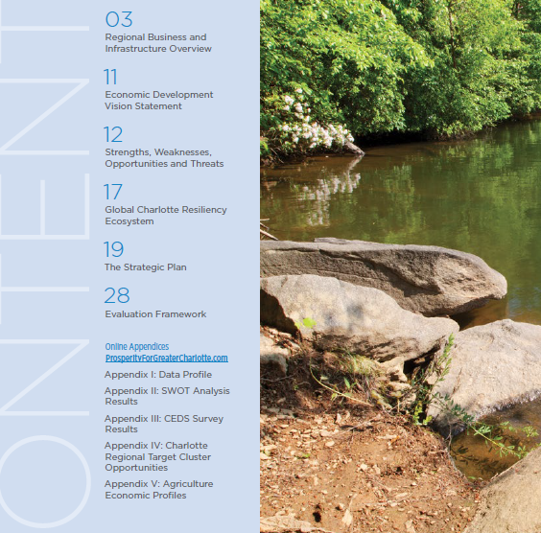
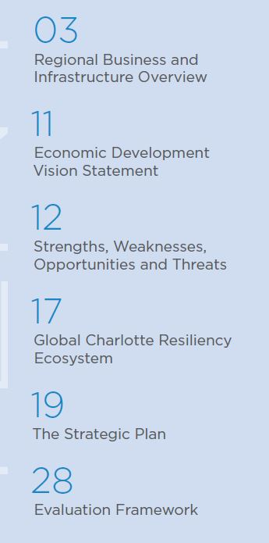
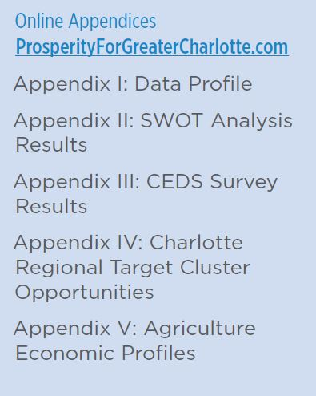
CEDS Table of Contents
Designed under 2015 EDA Best Practice Guidelines as 30 page Public Interest document

Slide 8
VISION: The Greater Charlotte region invests together to enforce its position as a global leader in business, innovation and talent.

Slide 9
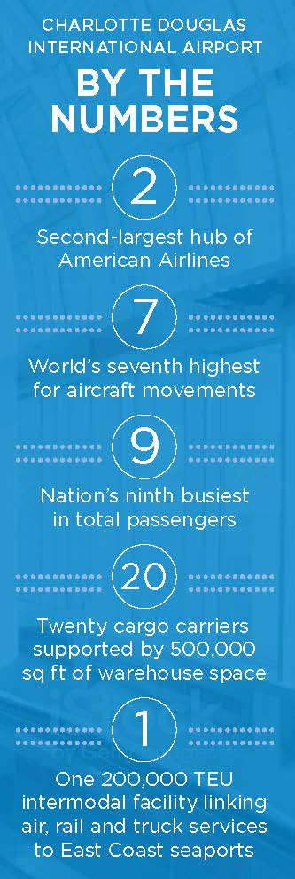
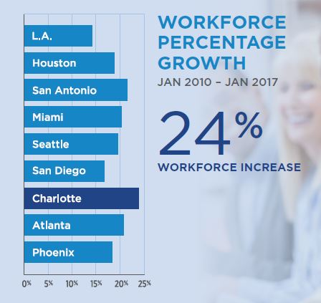
Regional Overview

Slide 10
Charlotte, the biggest city in North Carolina, saw a larger influx of millennials than any other city. Overall data shows that about 71,240 millennials moved to Charlotte while 60,533 moved out. That’s a net gain of 10,707.
The largest net gain on millennials coming to Charlotte came from interstate movers. Around 18,000 millennials came into Charlotte from outside the state of North Carolina, while only about 10,000 left Charlotte for another state.

Slide 11
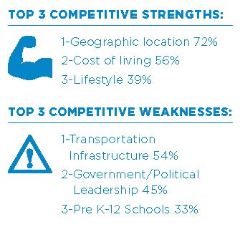
STRENGTHS, WEAKNESSES, OPPORTUNITIES AND THREATS (SWOT)
Results of Community-wide online
CEDS Survey of Economic Issues:
Top three actions leaders can do to make the region a better place for residents:
1 - Improve K-12 Education 51%
2 - Improve Roads and Connectivity 45%
3 - Create Job Opportunities 41%
Top three actions leaders can do to make the region a better place for businesses:
1 - Improve the K-12 education system 36%
2 - Improve infrastructure 30%
3 - Provide Small Business Support 29.5%

Slide 12
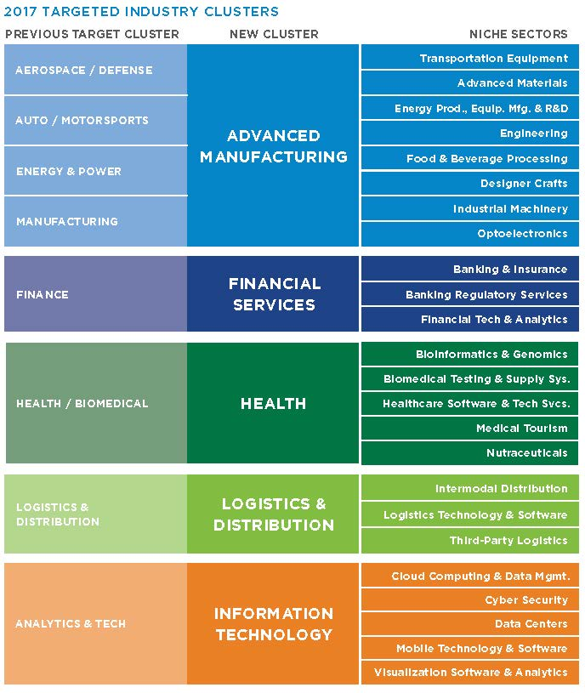
This Industry Cluster alignment is endorsed and adopted in this 2017 CEDS plan in strategic alignment of the common assets and priority focus of all the regional economic development organizations.
Business and Industry Cluster Focus
The 2016 Charlotte Regional Strategic Plan by Avalanche Consulting recommended five consolidated clusters to unify and update the current targets of the Charlotte Regional Partnership, Charlotte Chamber from the 2012 Prosperity for Greater Charlotte CEDS.

Slide 17
EVALUATION FRAMEWORK
Mechanism to gauge progress on the successful implementation of the overall CEDS
Performance measures will help to evaluate the regional economy through the implementation of the CEDS.

Slide 18
Marketing and Outreach: How do we ensure all stakeholders are aware of the CEDS and understand how it is a tool?

Slide 19
Developing a new CEDC website that displays CEDS data and dashboards for optimum user accessibility and support.
PRIORITY: High
RESOURCES: EDA Funding\CEDC Revenues\EDO members
Advisory Committee volunteers
TIMELINE: Feb 2018 / April 2018 - Develop RFP
May 2018 - Publish\Release RFP
June 2018 - Engage consultant
June / Sept 2018 - Develop website
October 2018 / Sept 2019 - Launch new website

Slide 20
Create a CEDS in a box presentation for elected officials. This tool can be used by both CEDC staff and CEDC Board members.
PRIORITY: High
RESOURCES: CEDC Staff
TIMELINE: Jan 2018- April 2018 - Develop presentation
April 2018 Annual Board Mtg - CEDC Board Preview
May-June 2018 - Training for CEDC Board
July 2018 – January 2019 hit the road and present to Member Counties \ Cities\ and Towns

Slide 21
Create a CEDS in a box presentation for economic development and community development leaders. This tool can be used by both CEDC staff and CEDC Board members to educate leaders on how the CEDS can work for them.
PRIORITY: High
RESOURCES: CEDC Staff
TIMELINE: Jan 2018 - April 2018 - Develop presentation
April 2018 Annual Board Mtg - CEDC Board Preview
May - June 2018 - Training for CEDC Board
July 2018 - September 2019 - Hit the road and present
to region’s Econ Dev Organizations;
Chambers of Commerce; Community Colleges

Slide 22
Michael Manis, CEcD
CCOG Director of Community and Economic Development
Contact: mmanis@centralina.org or 704 348-2720

