Slide 1
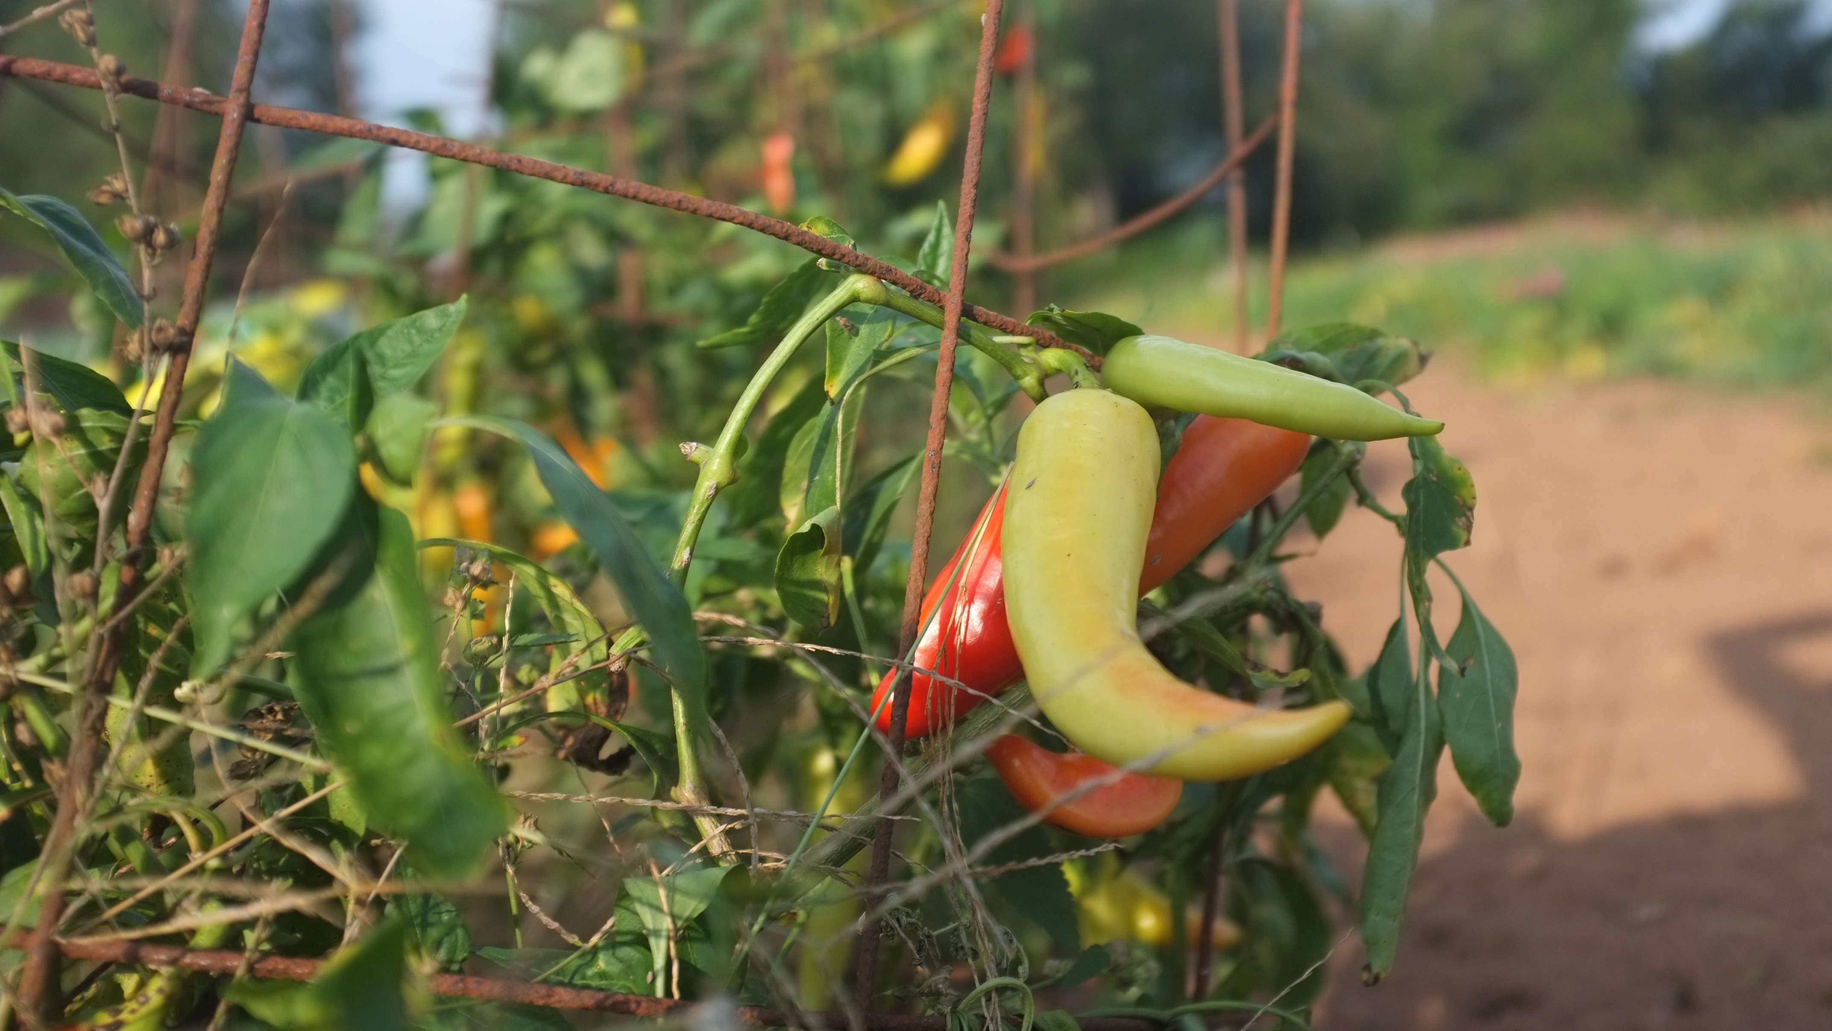

UNLOCKING THE POTENTIAL OF CHARLOTTE’S FOOD SYSTEM AND FARMERS’ MARKETS
Oct 2018
good food is
good
business
PREPARED FOR
The City of Charlotte
BY
27 East 21st Street, 3rd Floor New York, NY 10010
T: 212.260.1070
F: 917.591.5104
kkandp.com

Slide 2
PROJECT BACKGROUND
In 2015, the City Manager, at Council’s request, asked staff to examine Charlotte’s farmers markets and food system.
Mission
Develop a recommendation for a Charlotte public market system that supports food access, entrepreneurship, and farmers while building community and place throughout Charlotte and the region.
Team Members
Tom Warshauer – Housing & Neighborhood Services John Short – Housing & Neighborhood Services Lori Lencheski – Economic Development
Alberto Gonzalez – Planning Katrina Young – Planning/Zoning Jason Lawrence – CATS
Elliott Royal – Mecklenburg County Health Department Johanna Quinn / Keith Sorensen – CDOT
2

Slide 3




PROJECT BACKGROUND
4

Slide 4



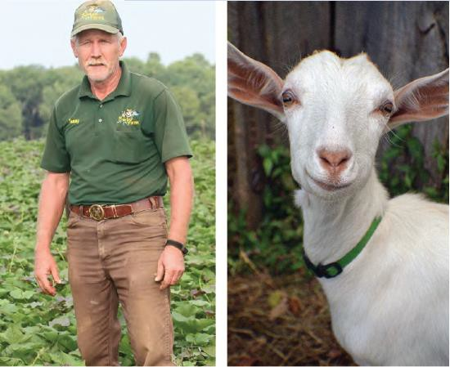
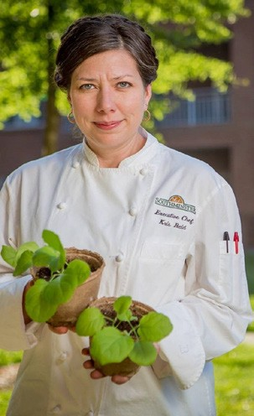

OUR PROCESS
Background Research, Data Analysis, and Mapping
OUR LOCAL FOOD SYSTEM
AT A GLANCE
CENTER for EN V IRONMENTA L FA R MING SYSTEMS
Cabarrus County Food System Assessment
Sidney Cruze and Jennifer Curtis
Charlotte-Mecklenburg Food Policy Council
VICTOR ROMANO, EdD
JOHNSON C. SMITH UNIVERSITY
KATHERINE METZO, PhD
ELEMENTAL RESEARCH & CONSULTING

Slide 5
OUR PROCESS
Interviews with over 40 stakeholders
BUYERS
Clark Barlowe, Heirloom Restaurant Julie Jackson, The Produce Box
Sandi Kronick, Eastern Carolina Organics Meghan Lambert, Johnson and Wales Jesse Leadbetter, Freshlist
Rickey Hall, Seeds For Change Brisa Hernandez, Atrium Health Alisha Pruett, The Bulb
Elliott Royal, Mecklenburg County Health Department
Anna Zuevskaya, Seeds For Change
SECTOR EXPERTS
Kristin Davis, NCSU Extension
Nicole DelCogliano, Organic Growers School Katherine Hebert, Centralina Council of Governments Thomas Moore, Carolina Farm Stewardship
Association
Dan Murrey, Piedmont Culinary Guild
Mary Newsom, UNC Charlotte Urban Institute Aaron Newton, Lomax Incubator Farm (CFSA) Zack Wyatt, Carolina Farm Trust
FARMERS
Brent Barbee, Barbee Farms Paul Brewington
Wilbert Gamble
Daniel Price, Freedom Farm
Mary Roberts, Windcrest Organics Kim Shaw, Small City Farm Pressly Williams, Renfrow Farms
MARKET MANAGERS
Chris Clouden, 7th Street Public Market Elizabeth Ann Dover, Plaza Midwood Farmers
Market
Elaine Jones, Atrium Health - University Farmers Market
Beverly McLaughlin, Mecklenburg County Market
Amie Newsome, Charlotte Regional Farmers Market
Reggie Singleton, Rosa Parks Farmers Market Mike Walker, Cotswold Farmers Market Theodore Williams, Charlotte Open Air Market Abby Wyatt, Davidson Farmers Market
POTENTIAL SITES
Greg Pappanastos, Savona Mill Todd DeLong, re: Eastland Mall Tony Kuhn, Station House Varian Shrum, Camp North End
FOOD ACCESS
Dr. Iris Cheng, Atrium Health Lisa Duffy, Atrium Health
Robin Emmons, Sow Much Good
Nadine Ford, Little Sugar Creek Community Garden

Slide 6
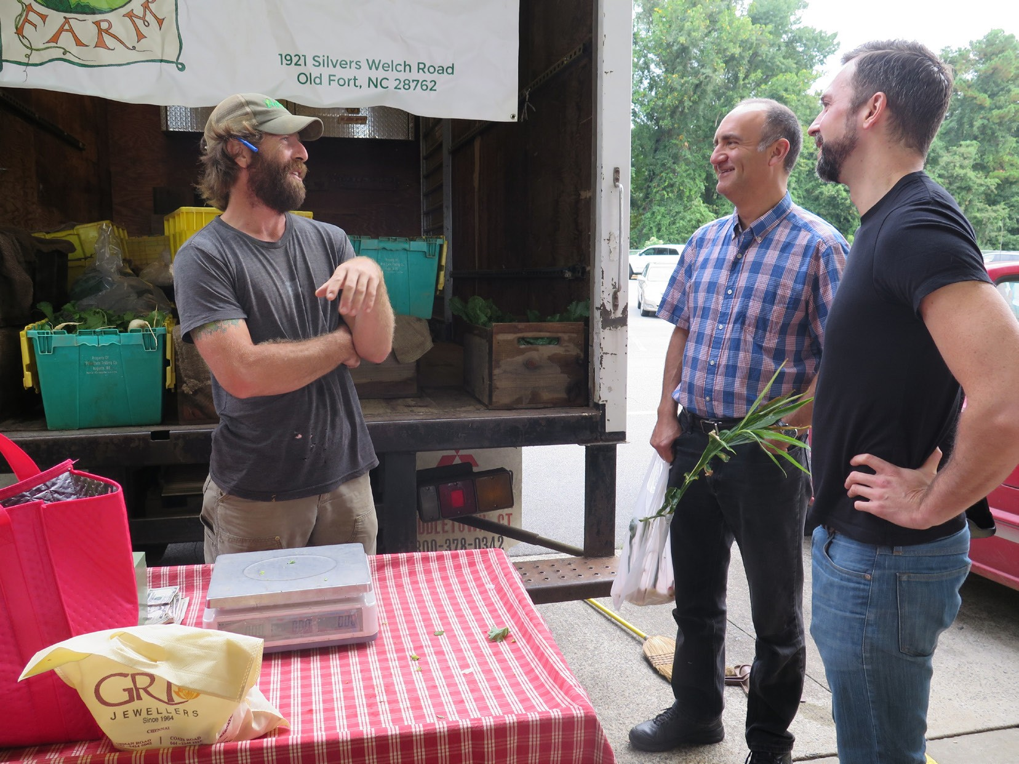
OUR PROCESS
Market Visits
MARKETS VISITED
Atherton Market Charlotte Open Air Market
Charlotte Regional Farmers Market Cotswold Farmers Market Davidson Farmers Market
Kings Drive Farmers Market
Matthews Community Farmers’ Market Mecklenburg County Market
Plaza Midwood Farmers Market

Slide 7
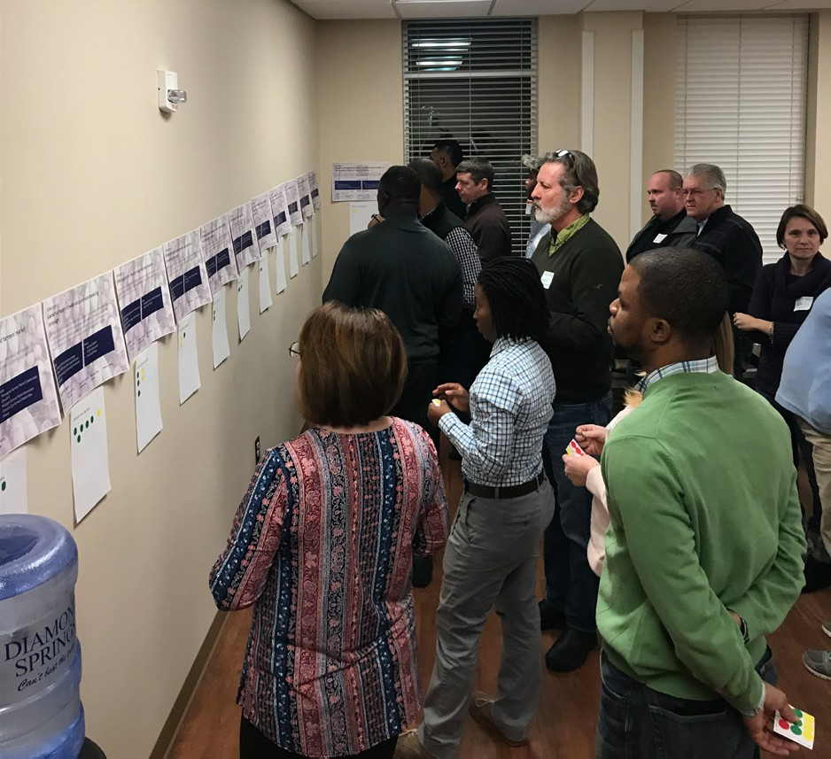
OUR PROCESS
Focus groups with nearly 30 participants
FARMER FOCUS GROUP ATTENDEES
Paul Brewington Lezlee Colrane
Amy Foster, Gilcrest Farm
Brian Hinson, Lucky Clays Fresh Gagan Hunter
Mary Beth Miller, Lomax Incubator Farm Thomas Moore, Carolina Farm Stewardship
Assocation
Dean and Jennifer Mullins, Laughing Owl Mary Roberts, Windcrest Farm
Jay Ross, Bell’s Best Berries Farm Reggie Singleton
Jessica Smith, Strongbird Ben Street, Fare Farm
Brad Todd, Lucky Clays Fresh
MARKET MANAGER FOCUS GROUP ATTENDEES
Chris Clouden, 7th Street Public Market Samantha DeRosa, Atherton Market Charles Dirico, Selwyn Farmers Market Tom Duncan, Friendship Gardens
Leslie James, Sugar Creek Farmers Market (proposed) Amie Newsome, Charlotte Regional Farmers Market Wil Jones, Rosa Parks Farmers Market
Isaiah Scott, Charlotte resident
Reggie Singleton, Rosa Parks Farmers Market
Brian Smith, Sugar Creek Farmers Market (proposed) Mike Walker, Cotswold Farmers Market
Theodore Williams, Charlotte Open Air Market Abby Wyatt, Davidson Farmers Market
Paulette Wilkes, Matthews Community Farmers’ Market

Slide 8
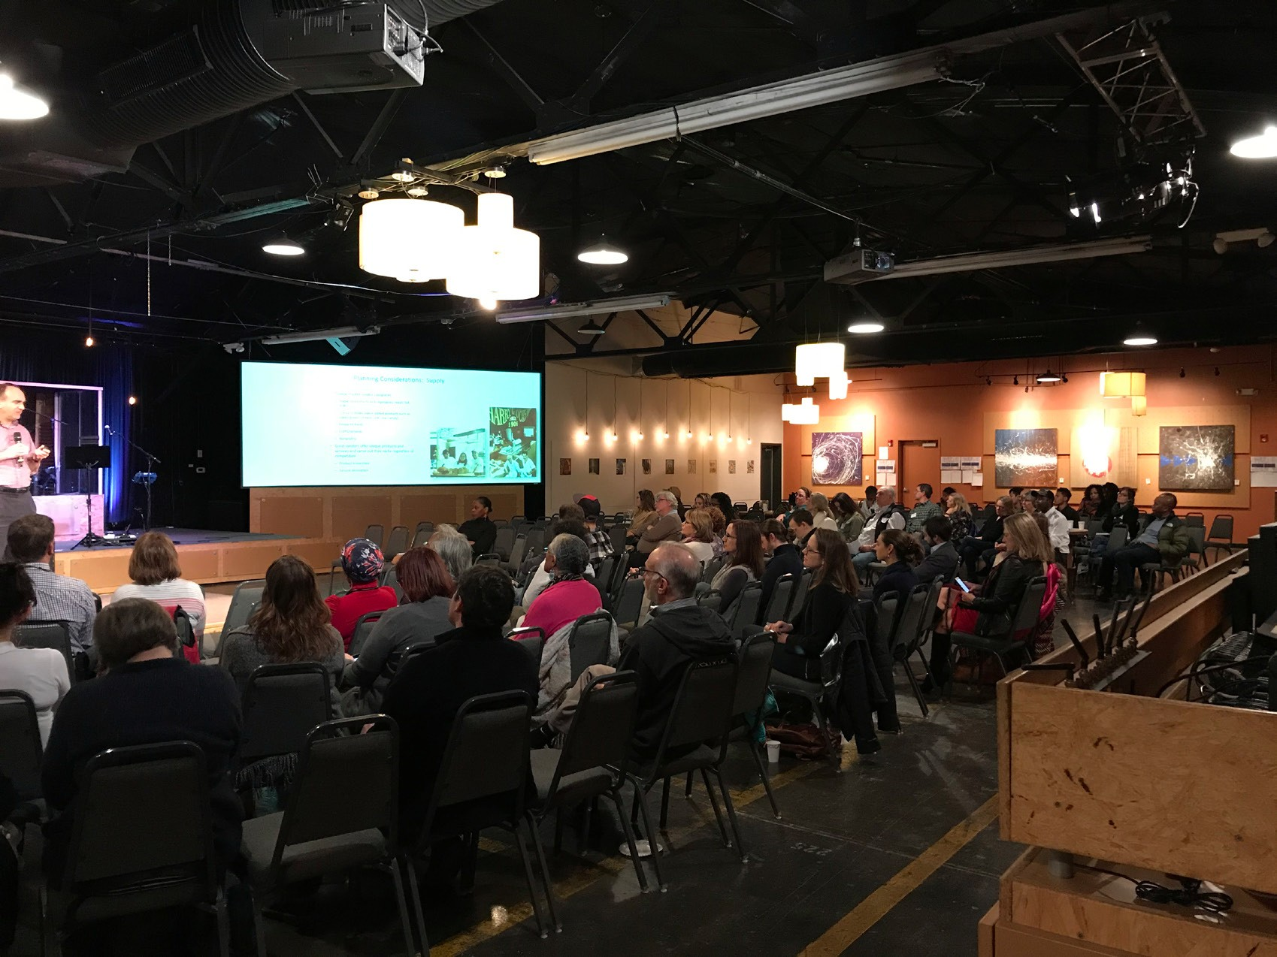
OUR PROCESS
Community meeting with over 100 attendees

Slide 9
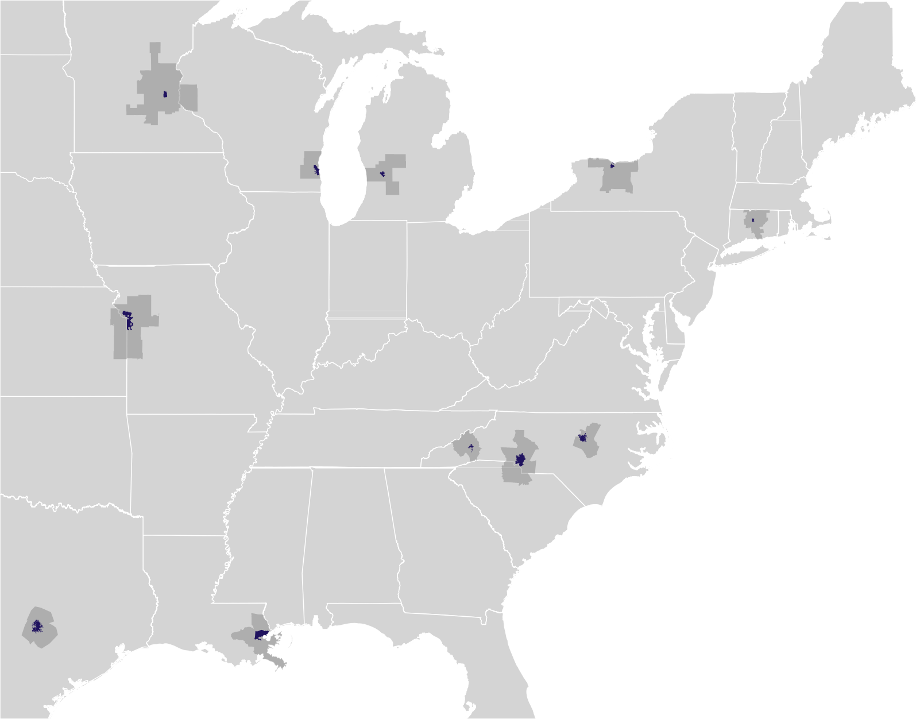
OUR PROCESS
Benchmarking and Model Research
MINNEAPOLIS
MILWAUKEE
ROCHESTER
GRAND RAPIDS
HARTFORD
KANSAS CITY
ASHEVILLE
RALEIGH
CHARLOTTE
AUSTIN
NEW ORLEANS

Slide 10
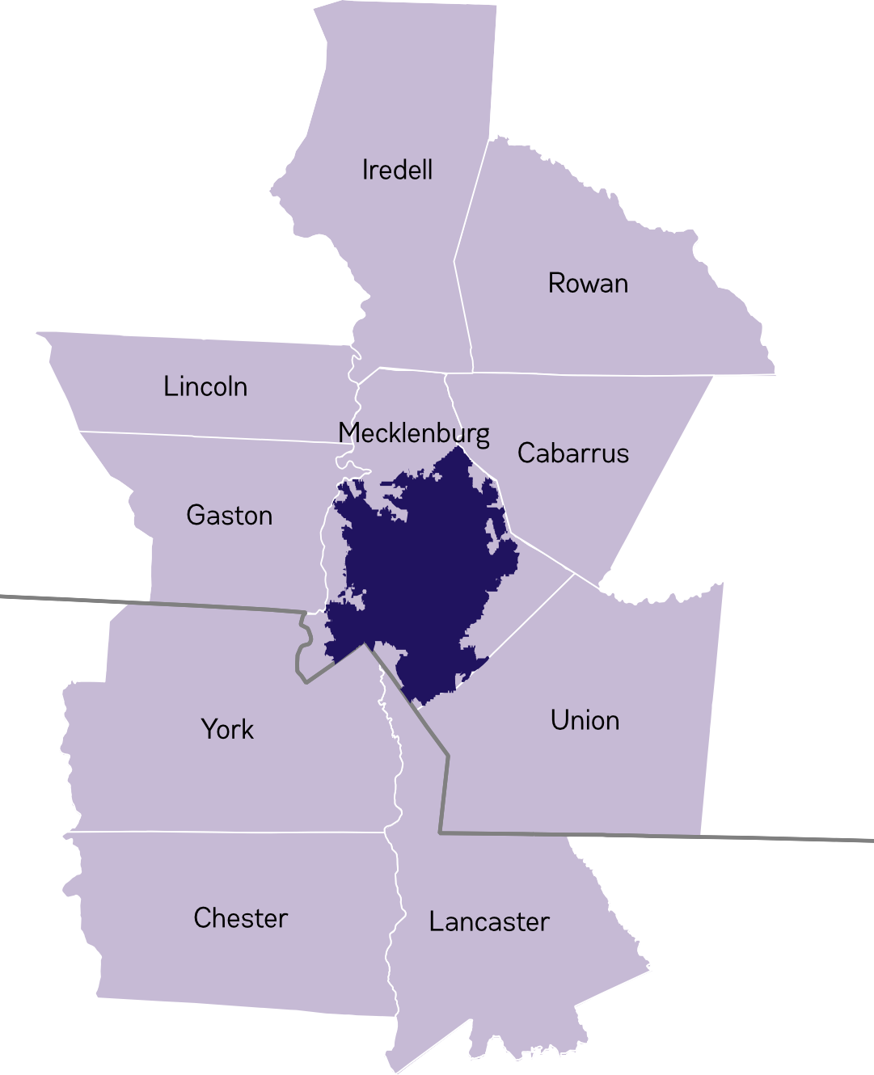
OUR PROCESS
Defining the Region
NORTH CAROLINA
CITY OF CHARLOTTE
SOUTH CAROLINA

Slide 11
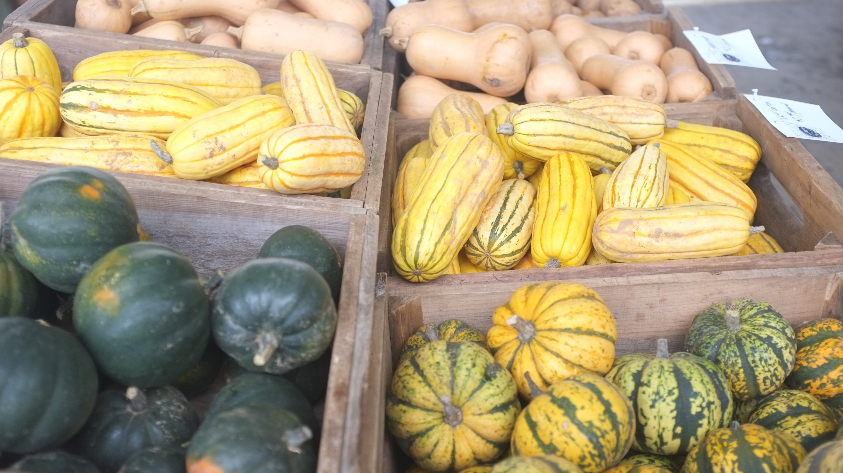

KEY FINDINGS: CHARLOTTE’S REGIONAL FOOD SYSTEM

Slide 12
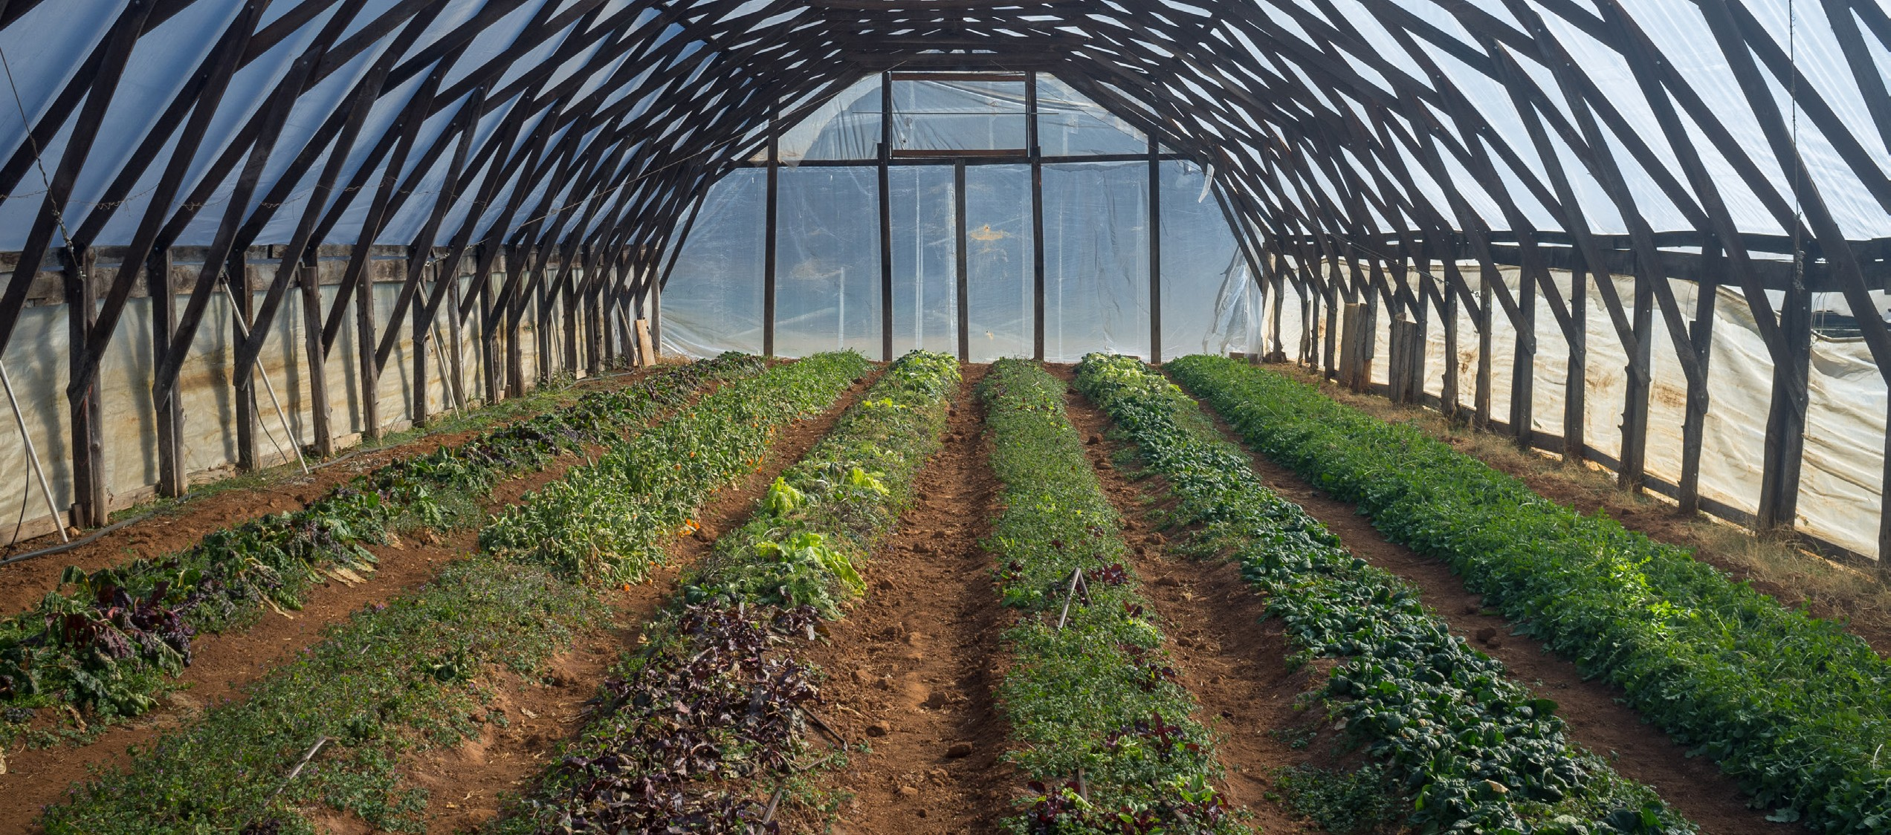
FINDINGS
Charlotte has the ingredients of a strong regional food economy.
“Farming in the Carolinas is great. We have great soil and we can grow all year round.”
- Farmer

Slide 13
FINDINGS
Charlotte has the ingredients of a strong regional food economy.
Farm Acreage and % of All Land in Farms
Agricultural Sales
Kansas City MSA | 67.3% | 3,124,397 |  |  |  |  |  |  |  |  |  | Minneapolis MSA | $2,169,822,000
Minneapolis MSA | 53.2% | 2,598,013 |  |  |  |  |  |  |  |  |  | Charlotte MSA | $1,201,565,872
Austin MSA | 65.0% | 1,754,333 |  |  |  |  |  |  |  |  |  | Grand Rapids MSA | $1,120,277,000
Charlotte MSA | 29.0% | 938,872 |  |  |  |  |  |  |  |  |  | Rochester MSA | $930,665,000
Rochester MSA | 44.4% | 927,382 |  |  |  |  |  |  |  |  |  | Kansas City MSA | $785,686,000
Grand Rapids MSA | 43.7% | 746,084 |  |  |  |  |  |  |  |  |  | Raleigh MSA | $411,889,000
Raleigh MSA | 29.2% | 395,945 |  |  |  |  |  |  |  |  |  | Austin MSA | $284,542,000
Milwaukee MSA | 31.7% | 295,193 |  |  |  |  |  |  |  |  |  | Milwaukee MSA | $250,058,000
New Orleans MSA | 11.2% | 229,706 |  |  |  |  |  |  |  |  |  | Hartford MSA | $222,355,000
Asheville MSA | 16.3% | 212,489 |  |  |  |  |  |  |  |  |  | Asheville MSA | $136,031,000
Hartford MSA | 13.0% | 125,896 |  |  |  |  |  |  |  |  |  | New Orleans MSA | $77,831,000

Slide 14
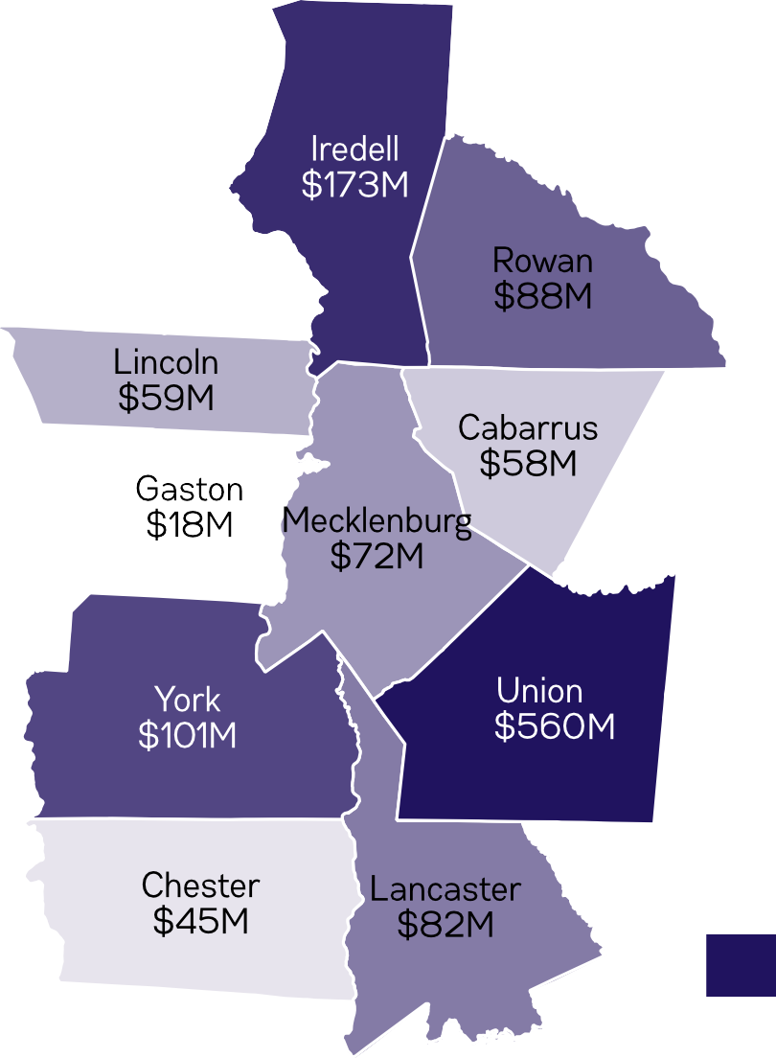
FINDINGS
Charlotte has the ingredients of a strong regional food economy.
Highest Agriculture Sales

Slide 15
FINDINGS
Charlotte has the ingredients of a strong regional food economy.
Population
Cities
Core Counties
MSA Regions
Austin | 947,897 |  |  |  |  |  |  |  | Hennepin County (Minneapolis) | 1,232,483 |  |  |  |  |  |  |  |  |  | Minneapolis MSA | 3,551,036
Charlotte | 842,029 |  |  |  |  |  |  |  | Travis County (Austin) | 1,199,323 |  |  |  |  |  |  |  |  |  | Charlotte MSA | 2,474,314
Milwaukee | 595,070 |  |  |  |  |  |  |  | Mecklenburg County (Charlotte) | 1,054,835 |  |  |  |  |  |  |  |  |  | Kansas City MSA | 2,104,115
Kansas City | 481,360 |  |  |  |  |  |  |  | Wake County (Raleigh) | 1,046,791 |  |  |  |  |  |  |  |  |  | Austin MSA | 2,056,405
Raleigh | 458,862 |  |  |  |  |  |  |  | Milwaukee County (Milkwaukee) | 951,448 |  |  |  |  |  |  |  |  |  | Milwaukee MSA | 1,572,482
Minneapolis | 413,645 |  |  |  |  |  |  |  | Hartford County (Hartford) | 892,389 |  |  |  |  |  |  |  |  |  | Raleigh MSA | 1,302,946
New Orleans | 391,495 |  |  |  |  |  |  |  | Monroe County (Rochester) | 747,727 |  |  |  |  |  |  |  |  |  | New Orleans MSA | 1,268,883
Rochester | 208,886 |  |  |  |  |  |  |  | Jackson County (Kansas City) | 691,801 |  |  |  |  |  |  |  |  |  | Hartford MSA | 1,206,836
Grand Rapids | 196,458 |  |  |  |  |  |  |  | Kent County (Grand Rapids) | 642,173 |  |  |  |  |  |  |  |  |  | Rochester MSA | 1,078,879
Hartford | 123,287 |  |  |  |  |  |  |  | Orleans Parish (New Orleans) | 391,495 |  |  |  |  |  |  |  |  |  | Grand Rapids MSA | 1,047,099

Slide 16
FINDINGS
The Charlotte region underperforms in key regional food economy indicators.
DIRECT-T0-CONSUMER SALES IN BENCHMARK COMMUNITIES: SALES AND PERCENT OF TOTAL AGRICULTURE SALES
DIRECT-T0-CONSUMER SALES IN BENCHMARK COMMUNITIES: SALES PER CAPITA
Hartford MSA | 5.92% | $13,174,000 |  |  |  |  |  |  |  |  | Hartford MSA | $10.92
Asheville MSA | 3.10% | $4,220,000 |  |  |  |  |  |  |  |  | Rochester MSA | $9.98
Milwaukee MSA | 1.54% | $3,858,000 |  |  |  |  |  |  |  |  | Asheville MSA | $9.33
New Orleans MSA | 1.44% | $1,123,000 |  |  |  |  |  |  |  |  | Grand Rapids MSA | $8.00
Rochester MSA | 1.16% | $10,762,000 |  |  |  |  |  |  |  |  | Minneapolis MSA | $4.34
Grand Rapids MSA | 0.75% | $8,378,000 |  |  |  |  |  |  |  |  | Milwaukee MSA | $2.45
Minneapolis MSA | 0.71% | $15,405,000 |  |  |  |  |  |  |  |  | Kansas City MSA | $1.76
Austin MSA | 0.66% | $1,889,000 |  |  |  |  |  |  |  |  | Charlotte MSA | $1.57
Raleigh MSA | 0.49% | $2,004,000 |  |  |  |  |  |  |  |  | Raleigh MSA | $1.54
Kansas City MSA | 0.47% | ^{$3,698,000} Austin MSA $0.92
Charlotte MSA | 0.32% | ^{$3,884,000} New Orleans MSA $0.89
Direct-to-consumer sales in the Charlotte region are just $1.57 per capita, compared to several benchmark cities with direct sales in excess of $8 per capita.

Slide 17
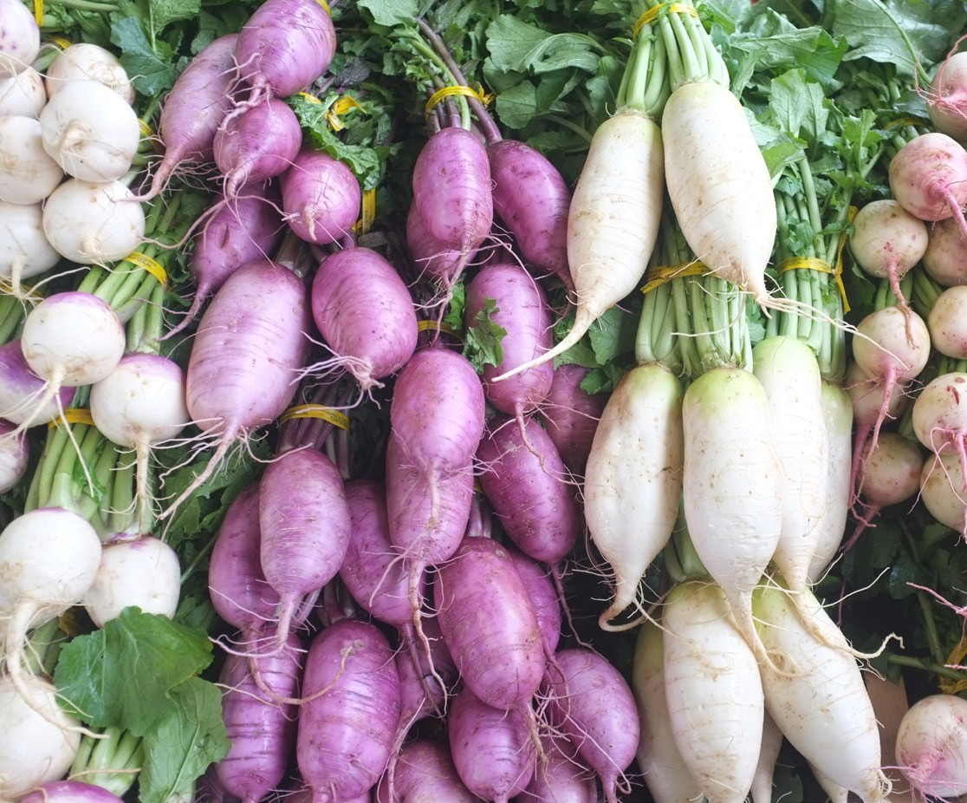
FINDINGS
The Charlotte region underperforms in key regional food economy indicators.
FRUIT AND VEGETABLE ACREAGE PER 1000 RESIDENTS IN BENCHMARK COMMUNITIES
Rochester MSA | 69.21
Grand Rapids MSA | 46.21
Asheville MSA | 15.42
Minneapolis MSA* | 12.53
Raleigh MSA | 11.61
Hartford MSA | 6.12
Milwaukee MSA* | 2.89
Kansas City MSA* | 0.95
Charlotte MSA* | 0.93
Austin MSA* | 0.38
New Orleans MSA* | 0.26

Slide 18
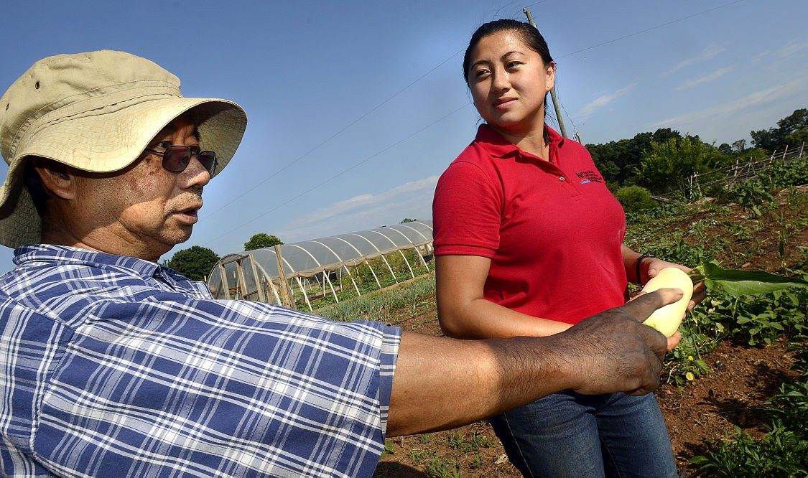
FINDINGS
Farmers of color and immigrant farmers play an increasingly important role in the region’s farm economy.
FARMERS OF COLOR IN THE CHARLOTTE REGION: 2012 FARMS AND GROWTH 2007-2012
Farms with Black or African American operators
169
farms
50%
growth
2007-2012
Farms with Hispanic or Latino operators
108
farms
15%
growth
2007-2012
Farms with Asian operators
48
farms
45%
growth
2007-2012
photo: Hickory Record

Slide 19
FINDINGS
Mecklenburg County agricultural land is at risk.
The county lost over a third of its farms and over half its farm acreage from 1997 to 2012
Farm Acreage and % of All Land in Farms
Travis County (Austin) | 39.9% | 252,686
Kent County (Grand Rapids) | 29.0% | 157,493
Jackson County (Kansas City) | 28.7% | 110,891
Monroe County (Rochester) | 23.5% | 98,676
Wake County (Raleigh) | 15.8% | 84,229
Buncombe County (Asheville) | 17.0% | 71,480
Hennepin County (Minneapolis) | 19.4% | 68,856
Hartford County (Hartford) | 11.5% | 54,062
Mecklenburg County (Charlotte) | 4.6% | 15,439
Milwaukee County (Milkwaukee) | 3.0% | 4,563
Orleans Parish (New Orleans) | 0.1% | 111

Slide 20
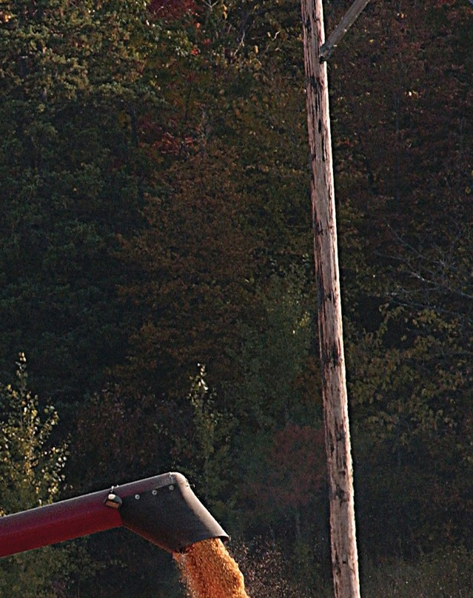






FINDINGS
Mecklenburg County agricultural land is at risk.
Building momentum for a Voluntary Agricultural District (VAD)
Mecklenburg County is one of 12 NC counties without a VAD - and the only major urban one
Led by MC Soil & Water Conservation District with UNC Charlotte, Charlotte-Mecklenburg Food Policy Council, and Rivendell Farms
Tax benefits and increased protections for farms
VOLUNTARY
AGRICULTURAL
DISTRICT
North Carolina Agricultural Districts

Slide 21
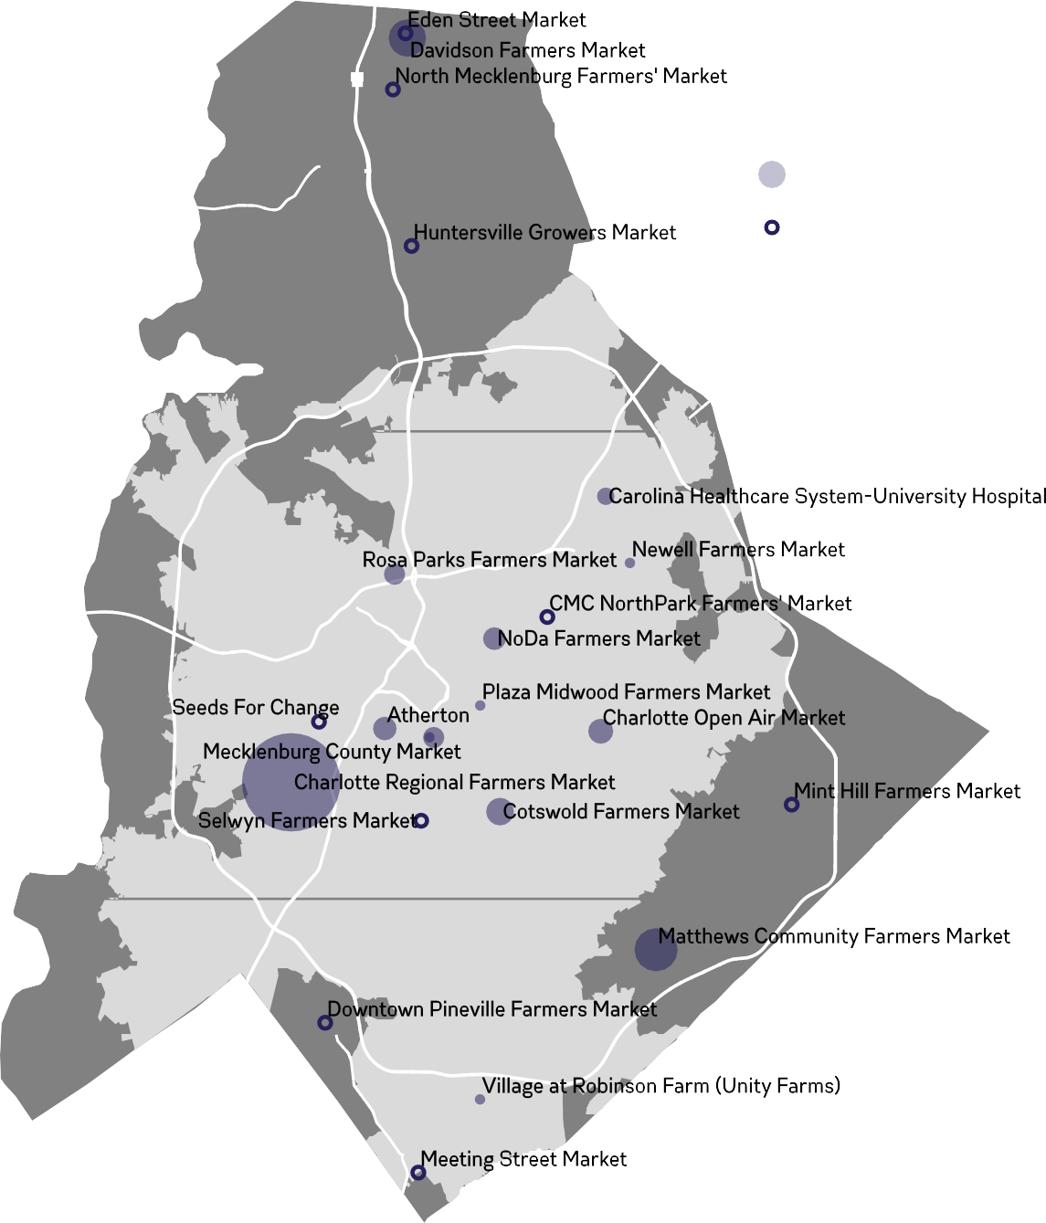
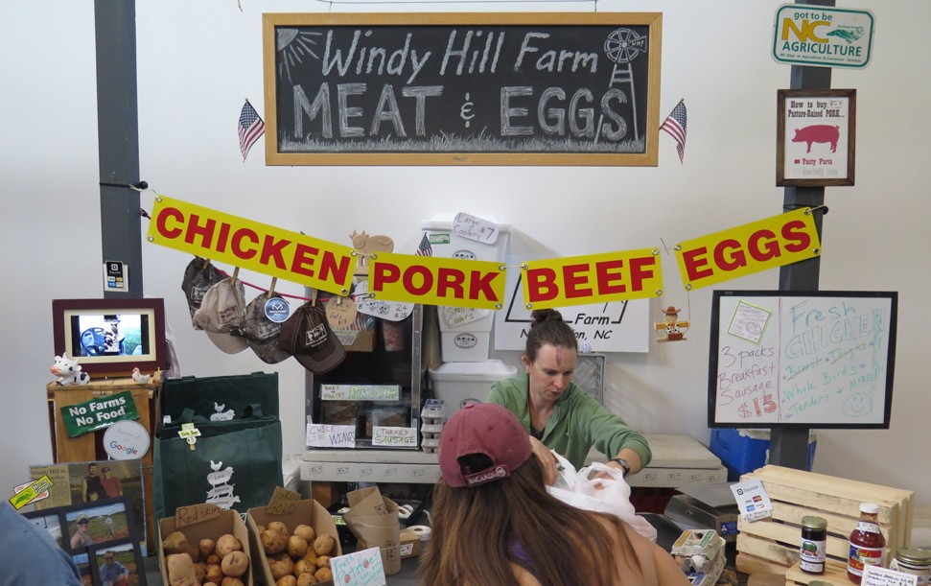
FINDINGS
Charlotte’s farmers’ markets are missing an opportunity to coordinate and collaborate.
23 active markets in Mecklenburg County No formal platform for coordination
Markets are sized by number of vendors Unknown number of vendors

Slide 22
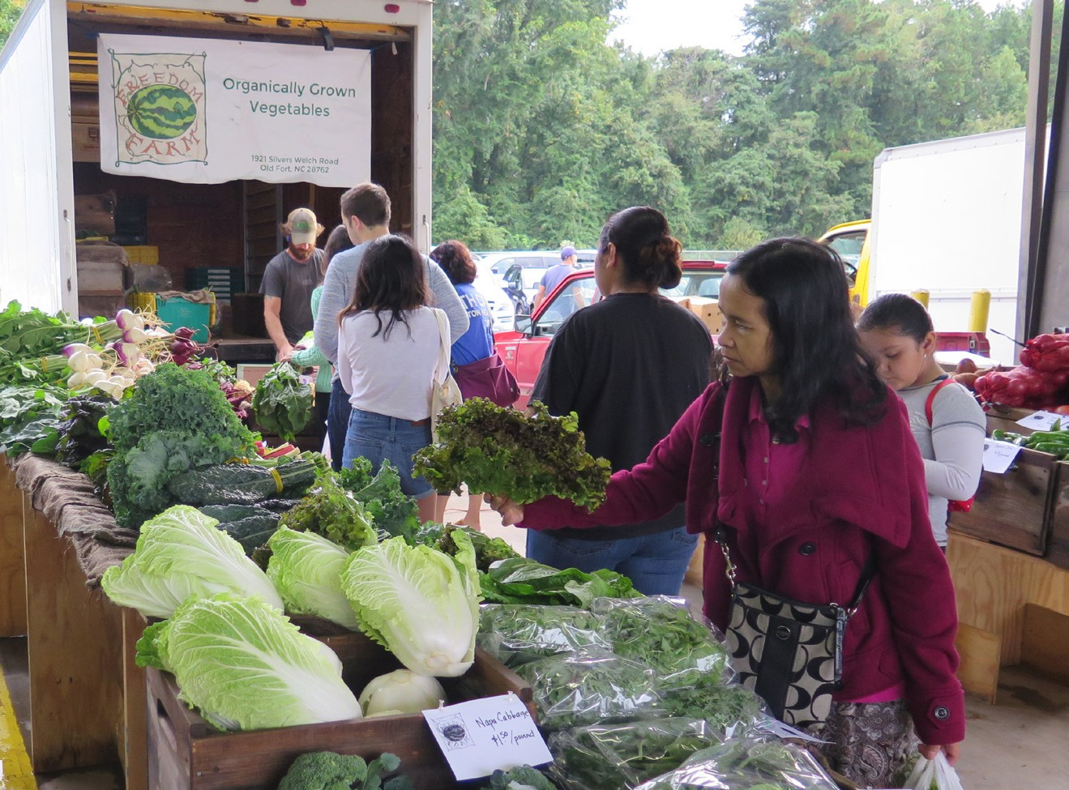
FINDINGS
The Charlotte Regional Farmers Market underperforms compared to other state-run markets.
Annual Visitors, 2017
Charlotte: Western NC: Piedmont Triad: Raleigh:
500,000
1.2 M
1.6 M
3.4 M

Slide 23
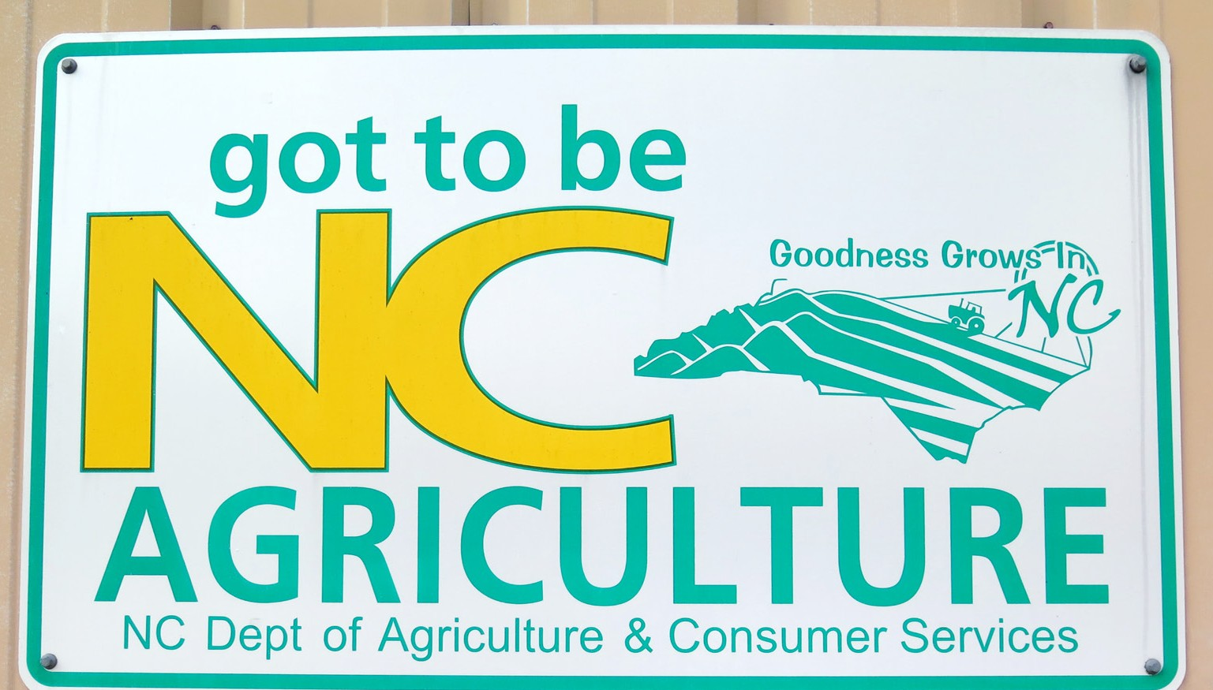

FINDINGS
The city’s farmers’ markets lack clear communications about locally and regionally produced foods.

Slide 24
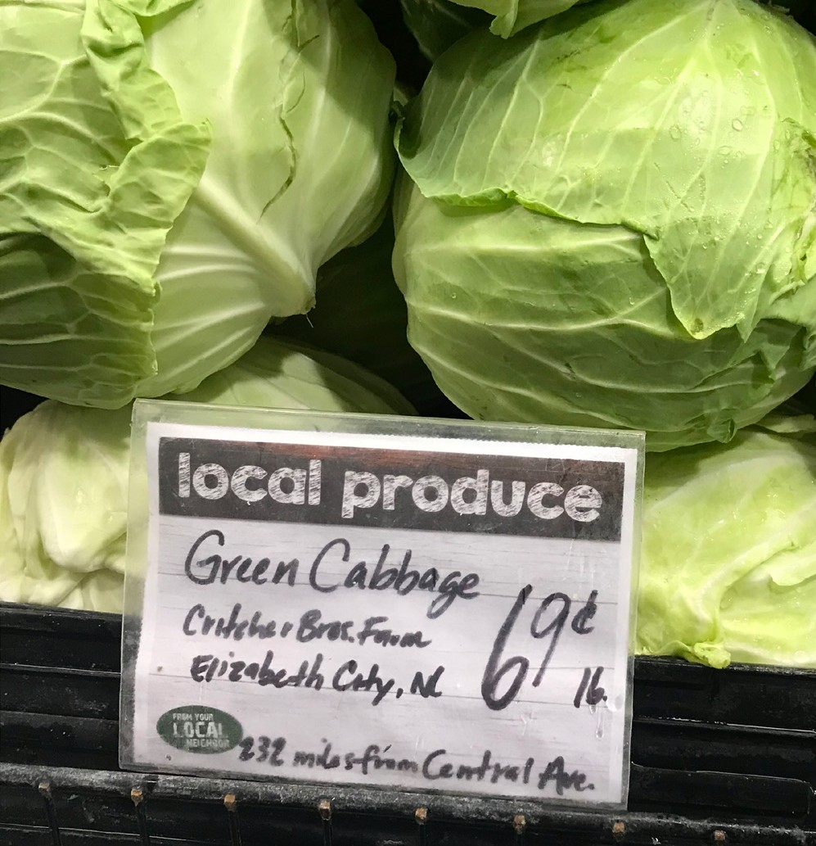
FINDINGS
Wholesale market opportunities are lacking.
DIRECT-T0-RETAILER WHOLESALE SALES IN BENCHMARK COMMUNITIES: FARMS AND PERCENT OF ALL FARMS
Asheville MSA | 9.3% | 264
Hartford MSA | 8.8% | 175
Rochester MSA | 7.8% | 332
New Orleans MSA | 6.1% | 63
Raleigh MSA | 4.9% | 122
Grand Rapids MSA | 3.5% | 165
Milwaukee MSA | 3.5% | 61
Charlotte MSA | 2.7% | 201
Minneapolis MSA | 2.2% | 288
Austin MSA | 1.7% | 152
Kansas City MSA | 1.0% | 132

Slide 25
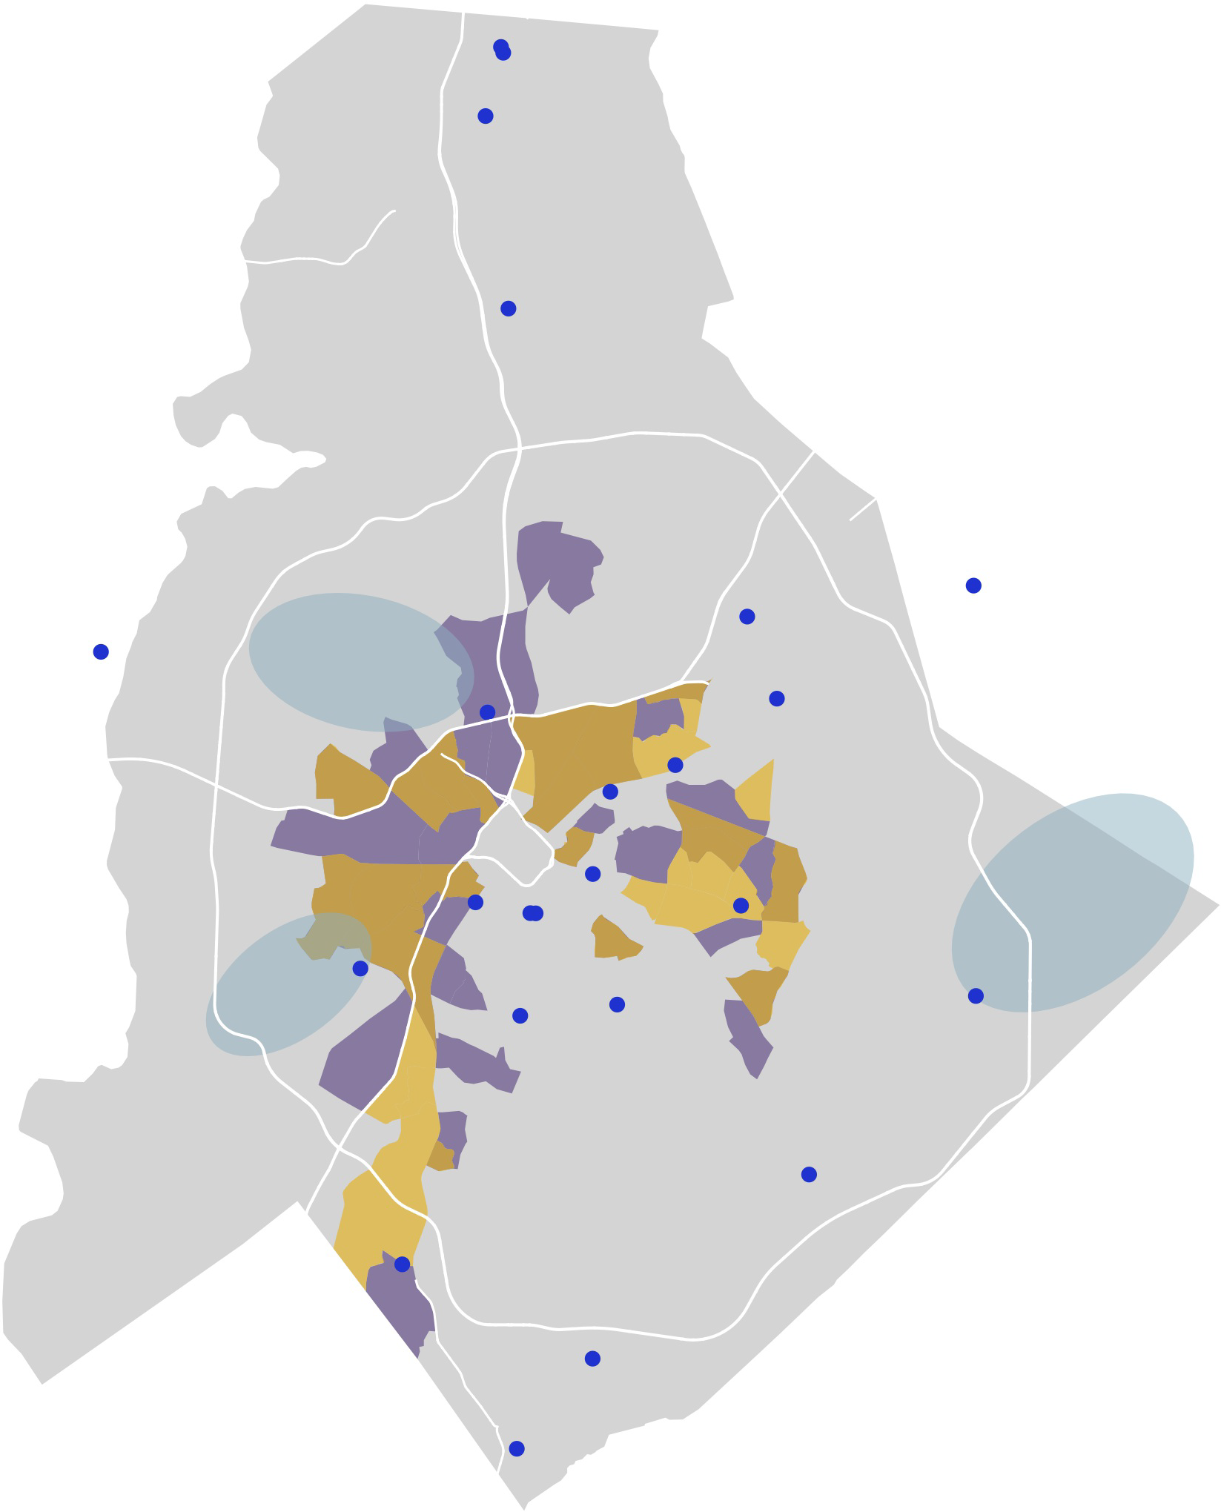

FINDINGS
The city’s farmers’ markets can do a better job of responding to the geography of food access and food insecurity.
2015 USDA Low-Income Low-Access area
Carolinas Healthcare System Social Determinants of Health high-risk area
Overlap of USDA and CHS SDOH risk areas
State of the Plate Food Insecurity High-Risk Communities
Farmers’ Market

Slide 26
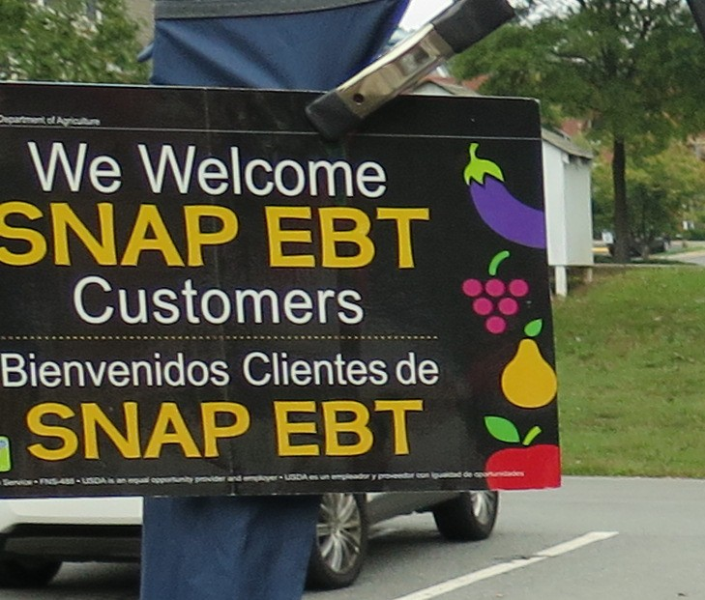
FINDINGS
Charlotte’s farmers’ markets severely underperform in SNAP acceptance.
SNAP ACCEPTANCE AT FARMERS’ MARKETS IN BENCHMARK COMMUNITIES (2018)
markets per
10K
 | # of markets | households on SNAP
Asheville | 8 | 20.17
Minneapolis | 19 | 6.90
Kansas City | 12 | 4.48
Austin | 12 | 4.37
New Orleans | 9 | 2.99
Rochester | 8 | 2.78
Raleigh | 4 | 2.73
Hartford | 5 | 2.43
Grand Rapids | 3 | 2.12
Milwaukee | 13 | 1.93
Charlotte | 6 | 1.78

Slide 27
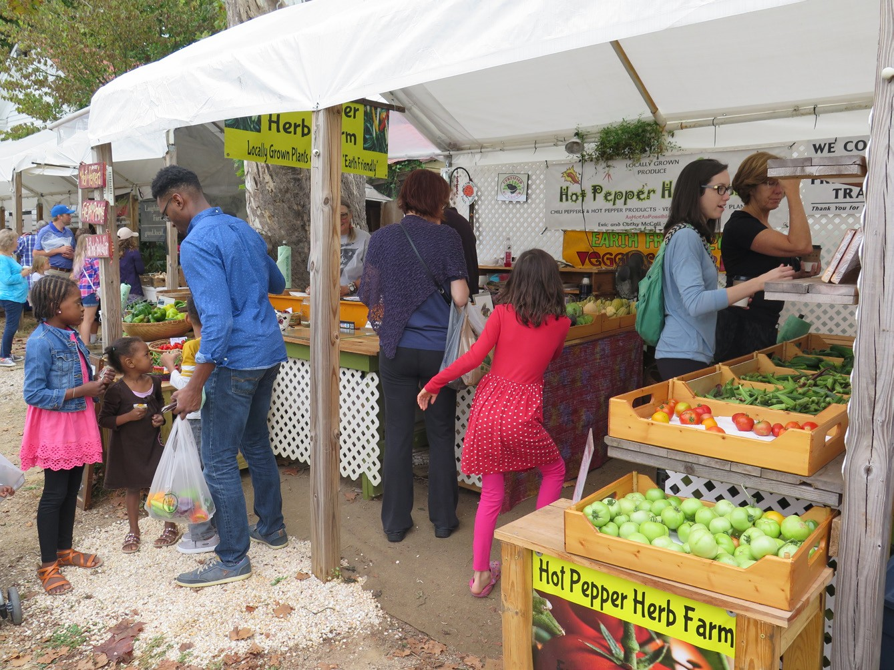
FINDINGS
Education and marketing are needed to help advance a culture of local and healthy eating.

Slide 28
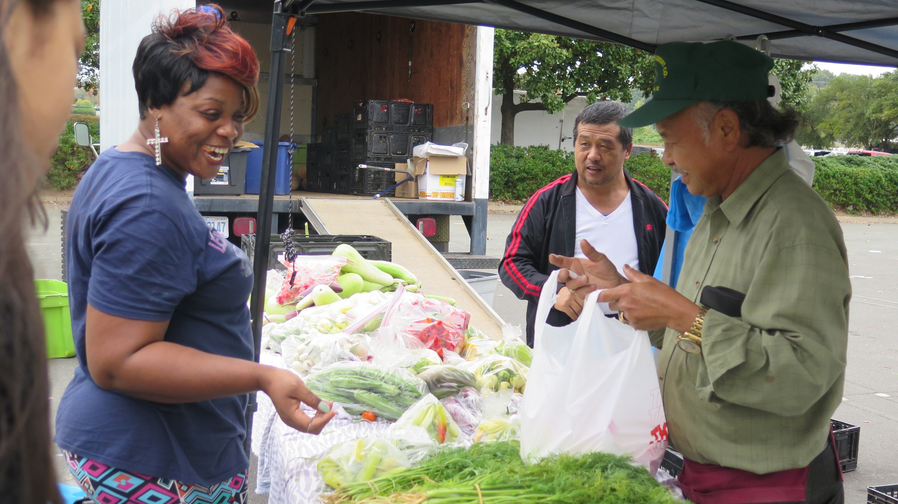
RECOMMENDATIONS
32
Unlocking the Potential of Charlotte’s Farmers’ Markets and Food System: An Assessment and Plan 32

Slide 29
RECOMMENDATIONS
Create a Charlotte Farmers’ Market Association.
Pursue improvements to the Charlotte Regional Farmers Market.
Explore opportunities for new public markets and large-scale farmers’ markets.
Maintain and increase the production of food in Charlotte’s ‘foodshed’, especially by supporting career pathways and improved livelihoods for the region’s farmers.
33

Slide 30
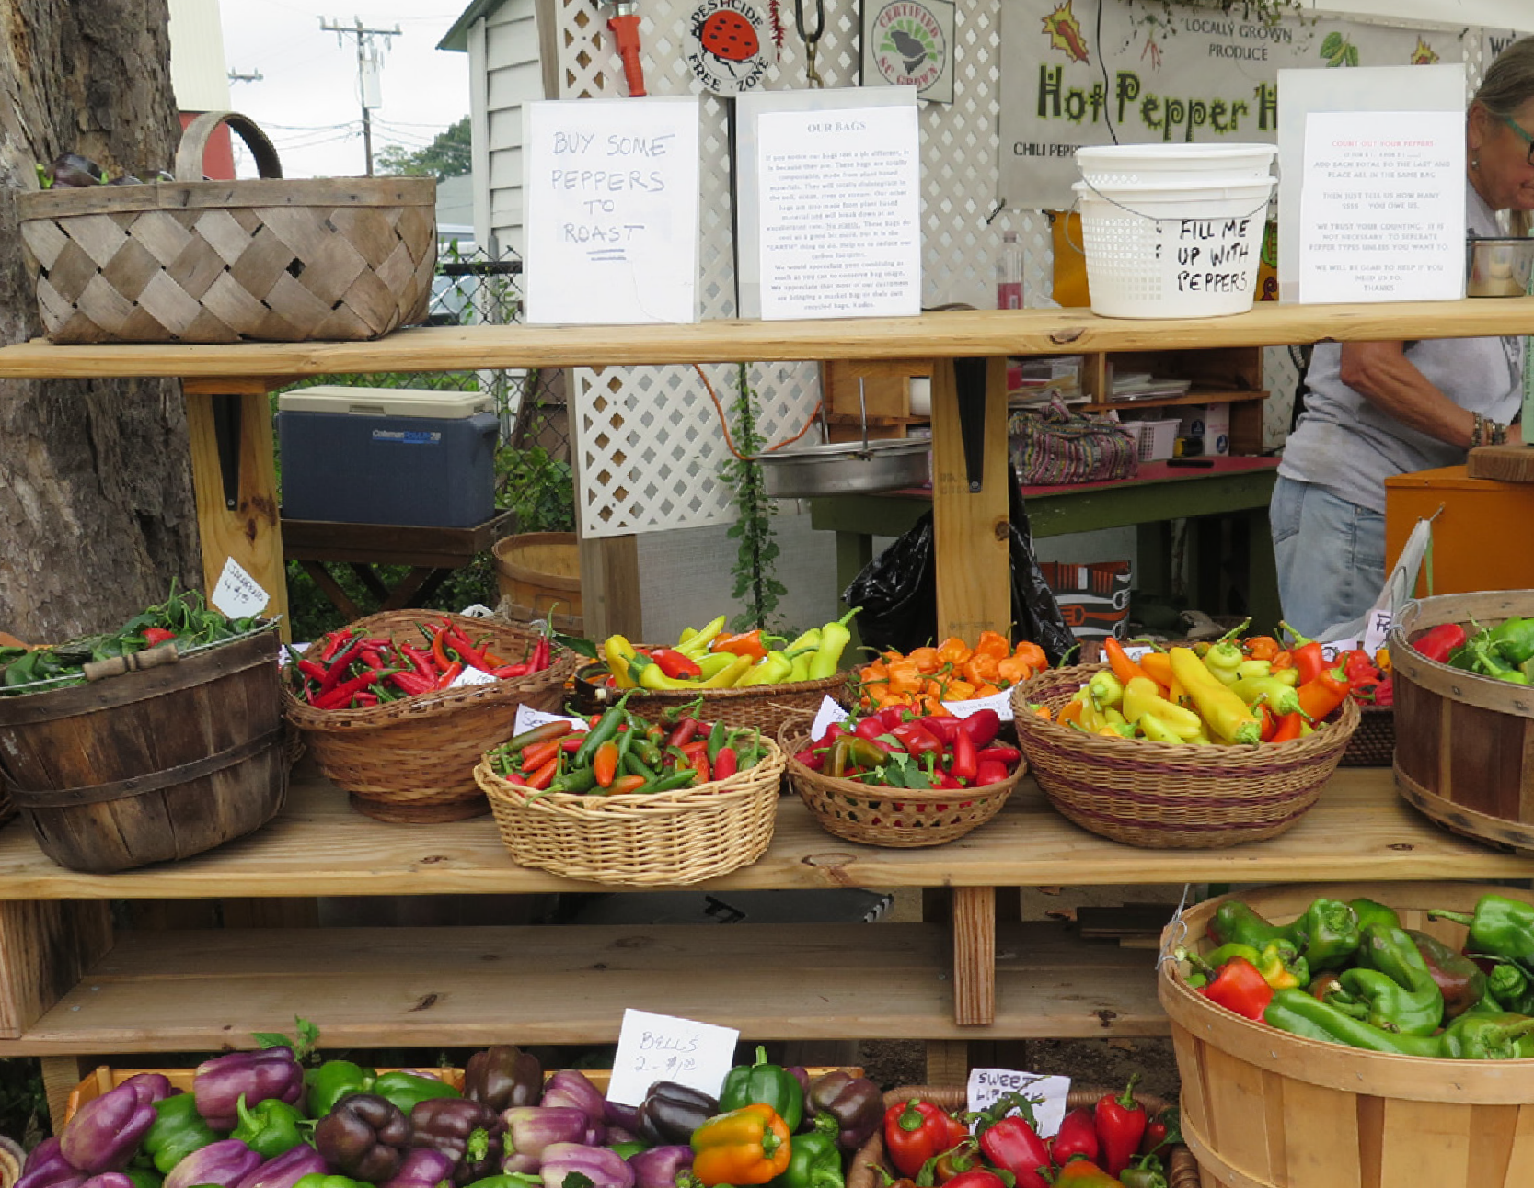
RECOMMENDATIONS
1. Create a Charlotte Farmers’ Market Association.
OBJECTIVE
To coordinate and strengthen the city’s existing and new farmers’ markets through an entity governed by farmers’ market managers and sponsors and supported by paid staff.
KEY ACTIVITIES
Marketing and promotion, which will require a city-wide brand development and customer targeting strategy that can be customized for use by individual markets
Expansion and promotion of SNAP, Double Bucks and other food assistance programs at the city’s farmers’ markets
Engagement with city zoning to create a consistent and supportive legal framework across the city
Sharing of best practices
Coordinated farmer applications
Common farm inspections
Coordination of emergency food providers to pick up surplus, end-of-day foods
34

Slide 31
RECOMMENDATIONS
1. Create a Charlotte Farmers’ Market Association.
ROLE OF THE CITY
Commit staff time to support the initial convenings and launch of the Charlotte Farmers’ Market Association.
Commit seed funding ongoing support for years 2 and 3, leveraging additional financial support from outside partners.
KEY PARTICIPANTS
Market managers
Host organization
Sponsoring organizations
Food system advocates
Food/culinary professionals
City farmers’ market task force
35

Slide 32
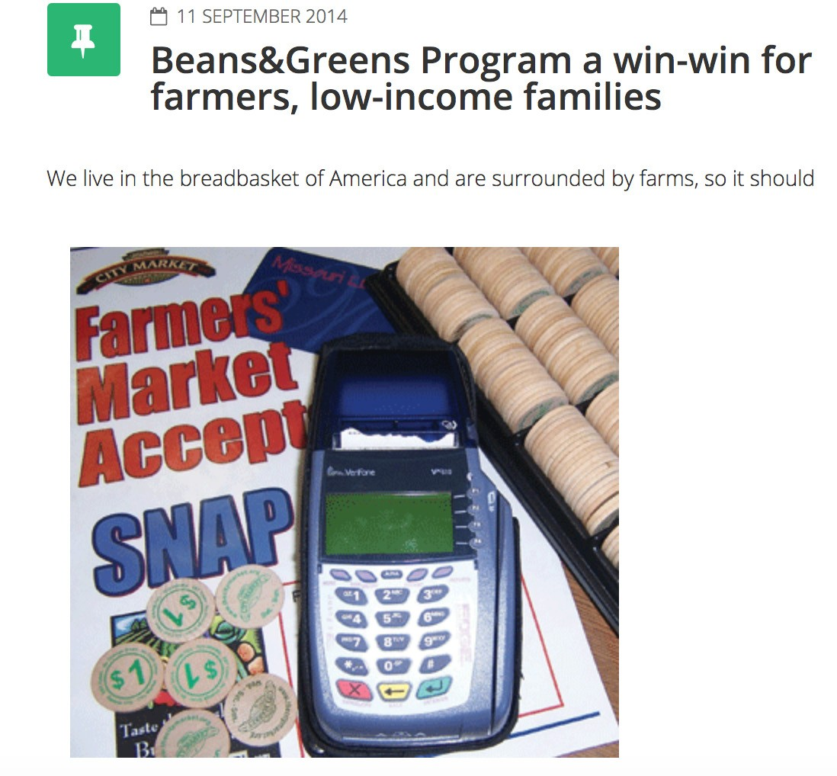

RECOMMENDATIONS
1. Create a Charlotte Farmers’ Market Association.
MODEL: CULTIVATE KANSAS CITY
38

Slide 33
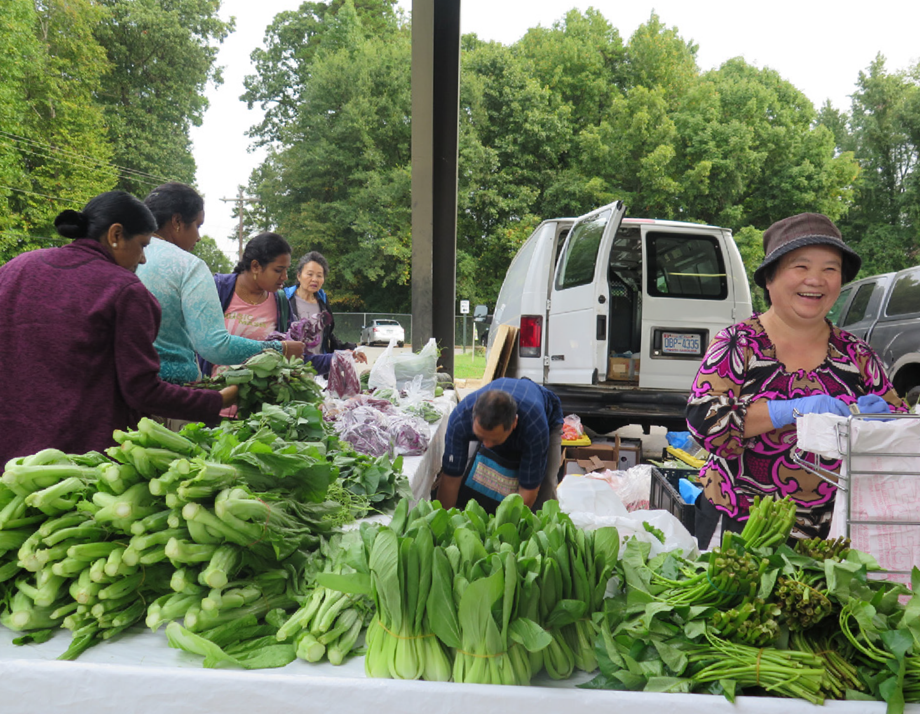
RECOMMENDATIONS
2. Pursue improvements to the Charlotte Regional Farmers Market.
ROLE OF THE CITY
Assist in the convening of state and other partners to address this opportunity
Support for the SNAP program
Help to address access and visibility issues, especially via improved intersection at Billy Graham Parkway
KEY PARTICIPANTS
NC Department of Agriculture and Consumer Services
Charlotte Farmers’ Market Association (Recommendation 1)
Sponsor organizations and funders
40

Slide 34
RECOMMENDATIONS
2. Pursue improvements to the Charlotte Regional Farmers Market.
IMPLEMENTATION
Identification of a lead partner to assist with SNAP implementation
Partnership development between state, city and local funders to support master planning effort
EXPECTED OUTCOMES
Food access improvements: the CRFM has the potential to be the area’s largest farmers’ market SNAP and Double Up Bucks redemption point
Increased farmer sales
Re-introduction of local food wholesaling, leading to increased wholesale activity
Value-added production and jobs
Education
Improved social/gathering space
41

Slide 35
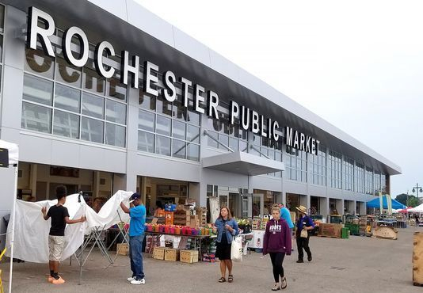
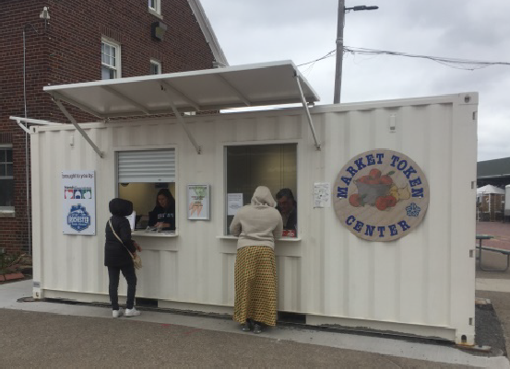
RECOMMENDATIONS
2. Pursue improvements to the Charlotte Regional Farmers Market.
MODEL: ROCHESTER PUBLIC MARKET
42

Slide 36
RECOMMENDATIONS
3. Explore opportunities for new public markets and large-scale farmers’ markets
OBJECTIVE
To explore the feasibility and create conceptual plans for new permanent farmers’ market and public market facilities at accessible locations around Charlotte.
KEY ACTIVITIES
Goal refinement and public engagement
Market research
Site identification and analysis
Merchandising and tenant mix plan
Facility and site design
Ownership/management options and operating policies
Potential infrastructure improvements for smaller existing markets
44

Slide 37
RECOMMENDATIONS
3. Explore opportunities for new public markets and large-scale farmers’ markets
ROLE OF THE CITY
Initiation and leadership of this initiative
Identify approximately $125K in city funding for public market feasibility and concept development.
KEY PARTICIPANTS
Local food advocates
Funders
CATS
Neighborhood/community groups near potential sites
45

Slide 38
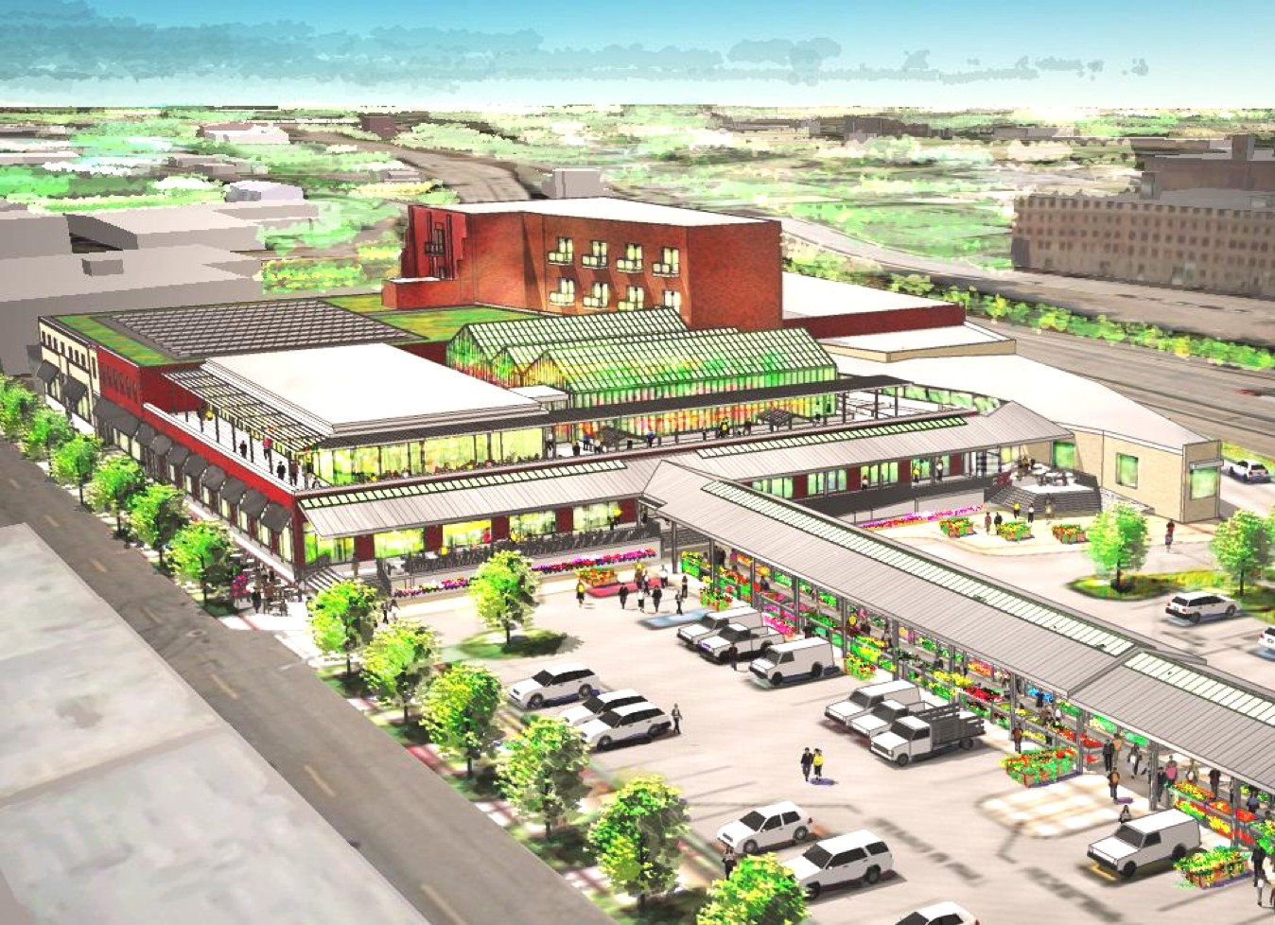
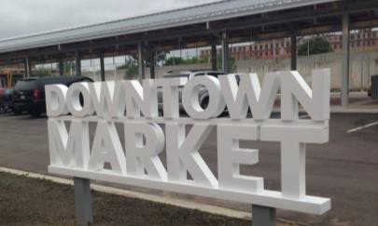
RECOMMENDATIONS
3. Explore opportunities for new public markets and large-scale farmers’ markets
MODEL: GRAND RAPIDS DOWNTOWN MARKET
Development cost: $30 million
Annual operating budget: $2.1 million
Annual vendor sales: $14.6 million
Jobs created: Over 300
47

Slide 39
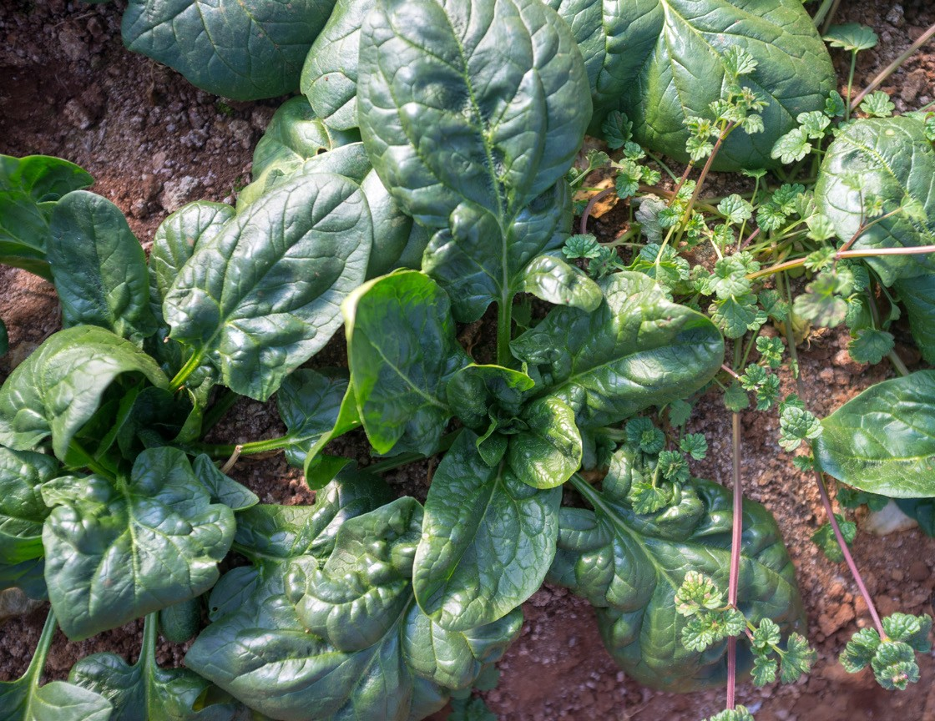
RECOMMENDATIONS
4. Maintain and increase the production of food in Charlotte’s ‘foodshed’, especially by supporting career pathways and improved livelihoods for the region’s farmers.
OBJECTIVE
To preserve farming in the Charlotte region as a viable career, way of life, and robust economic engine, and to sustain and increase the volumes of food produced in the region for its residents.
KEY ACTIVITIES
Convening a regional foodshed task force and summit
Maintaining and expanding resources for farmers and food entrepreneurs
Supporting expanded market opportunities for the region’s farmers
Developing local food procurement policies for public and private institutions
Development of a regional food branding initiative - possibly in coordination with CFMA joint marketing and branding
49

Slide 40
RECOMMENDATIONS
4. Maintain and increase the production of food in Charlotte’s ‘foodshed’, especially by supporting career pathways and improved livelihoods for the region’s farmers.
ROLE OF THE CITY
Partner with Centralina Council of Governments and others to initiate convening of key foodshed stakeholders for regional foodshed task force.
Seek city funding to partially support the task force and first Regional Foodshed Summit, leveraging robust additional support from diverse partners Work with County to convene City and County workforce programs.
Identify opportunities for increased procurement of locally grown foods by city agencies and public institutions.
KEY PARTICIPANTS
Centralina Council of Governments and governments across the region
Farm-oriented non-profits
Health organizations
Many others!
50

Slide 41
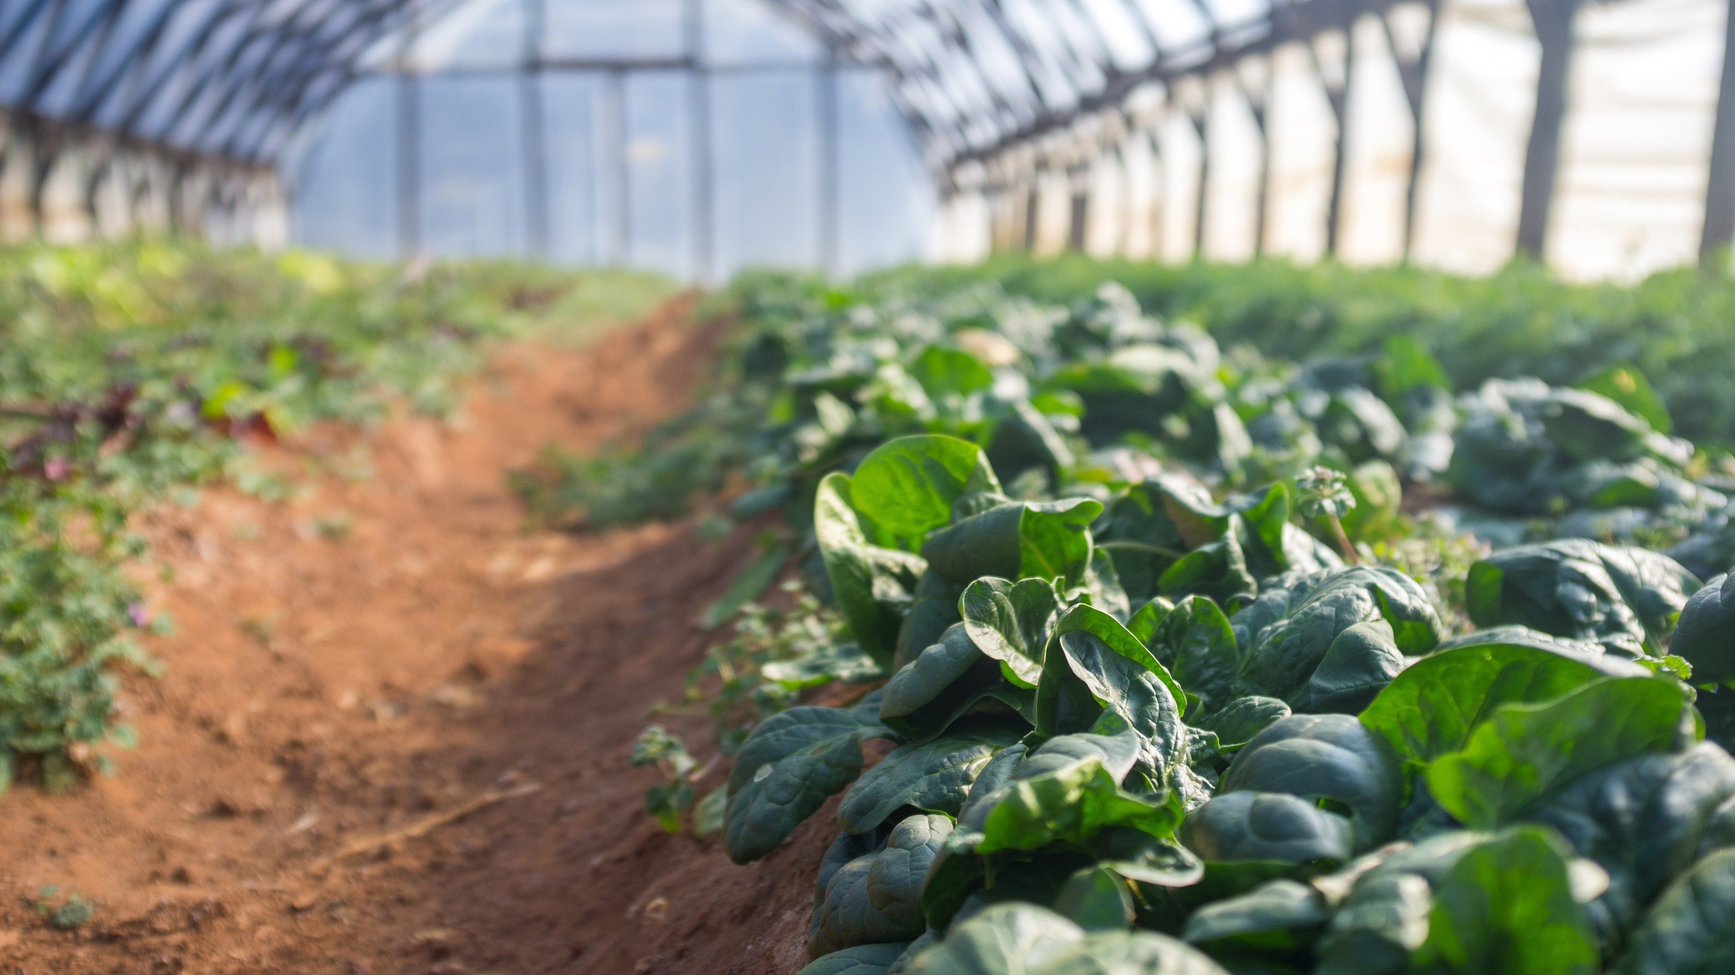
DISCUSSION AND QUESTIONS
53
Unlocking the Potential of Charlotte’s Farmers’ Markets and Food System: An Assessment and Plan 53

