Slide 1
Engaging the Community to Achieve Health Equity
October 10, 2018

Slide 2
Intended Outcomes of this Session
Share some health statistics impacting our local community
Discuss why community engagement is important
Provide diverse ways to engage the community in ways that can promote positive change
Share our experiences in successful, and not so successful, community engagement activities
Notes:
Chrystal to talk through this slide

Slide 3
The Lee Institute and Gaston Family Health Services
The Lee Institute serves and strengthens organizations and individuals who share a commitment to building great communities.
Gaston Family Health Services is a community sponsored, family-centered provider of health care, health education and preventive care services without regard for the ability to pay.
Notes:
Chrystal and Donyel -- Briefly describe our roles in this work.

Slide 4
Why is community engagement important for achieving health equity?
Notes:
Chrystal to talk through this slide…
Ask the question and allow responses from the session participants.
What have their experiences been in this work?

Slide 5
Some General Health Statistics in NC
59% of health center patients are uninsured (41% of other Federally Qualified Health Center, or FQHC, patients are uninsured)
40.5% of health center patients are African-American (27.1% of other FQHC patients are African-American)
63.6% of health center patients have been diagnosed with obesity (33.5% of other FQHC patients have been diagnosed with obesity)
15% of health center patients have been diagnosed with diabetes (13.5% of other FQHC patients have been diagnosed with diabetes)
36% of health center patients have been diagnosed with hypertension (27% of other FQHC patients have been diagnosed with hypertension)
Notes:
Donyel to talk through this slide…
General statistics impacting our local community

Slide 6
Core Principles of Public Engagement
Notes:
Transition slide – Chrystal
In working with the CCOG during the CONNECT Our Future project a few years ago, The Lee Institute developed some core principles around how we approach this work.

Slide 7
Public Engagement
__________________________________________________________________________________________
Notes:
Chrystal slide
First and foremost… engagement CANNOT be a checkbox activity – Why??? (ask participants)

Slide 8
Core Principles of Public Engagement
Public Engagement requires:
Clearly defined purpose and influence points
Transparency to the public
Managing expectations
Connecting early on in the process
Engagement to be both an outcome and requirement of building trust and civic participation
Notes:
Chrystal slide

Slide 9
Continuum of Engagement
Multiple gatherings of new group for deeper understanding & commitment
One-time gathering of new group
Multiple gatherings of intact group for deeper understanding & commitment
Cost, Time, Outreach
One-time gathering of external intact group
Internal gathering
Impact
Notes:
Chrystal slide

Slide 10
Working Together
Healthier Highland Family Reunion Event to identify actionable ways to improve health and wellness outcomes in the area
The Lee Institute was engaged to help design activities that would allow community members to have their voices heard around issues impacting them relating to health
Captured, themed and analyzed the data with recommendations around priorities based on what was heard
Gaston Family Health Center implemented the work and continue to engage community for improved outcomes and sustainability
Notes:
Chrystal describes Lee role in the work… transitions to Donyel

Slide 11
Characteristics of the Highland Community
Over 2,000 residents
Mostly African American
No grocery store
Two convenience stores
Several churches
Health center
Community center
Two Head Start locations
Notes:
Donyel slide

Slide 12
Take it to the community
59% of health center patients are uninsured (41% of other FQHC patients are uninsured)
40.5% of patients are African-American (27.1% of other FQHC patients are African-American)
63.6% of patients have been diagnosed with obesity (33.5% of other FQHC patients have been diagnosed with obesity)
15% of patients have been diagnosed with diabetes (13.5% of other FQHC patients have been diagnosed with diabetes)
36% of patients have been diagnosed with hypertension (27% of other FQHC patients have been diagnosed with hypertension)

Slide 13
The Community’s Voice Matters
Notes:
Donyel slide

Slide 14
Keys To Effective Engagement
Select trusted members of the community to be the champion of your work.
Embrace and encourage the input from community members.
Value the community members as a true partner.
Support the community’s efforts and ideas.
Notes:
Donyel slide

Slide 15
Highland Family Reunion
Notes:
Donyel slide

Slide 16
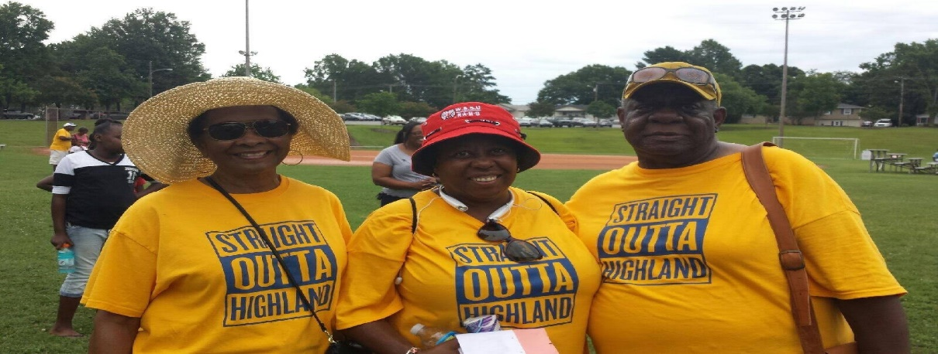
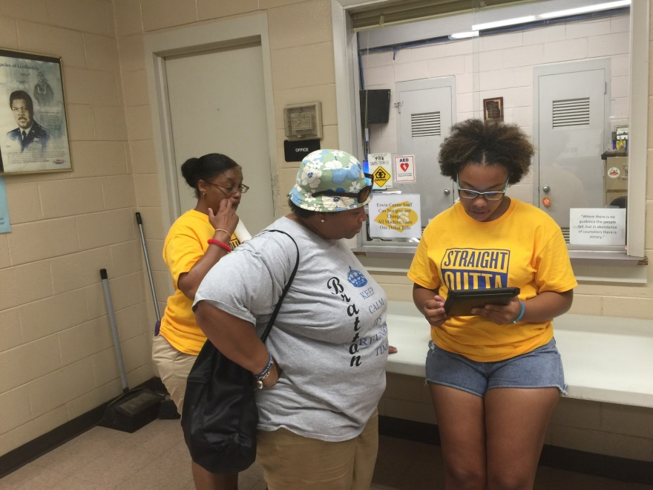
Notes:
Donyel slide

Slide 17
Maximize Opportunities for Engagement
2016 Highland Family Reunion
2016 Movie Night
2017 Highland Family Reunion
2017 Line Dancing Sessions
2017 Family Bingo Night
2018 Building A Healthier Highland Conference
2018 Highland Family Reunion
Notes:
Donyel slide

Slide 18
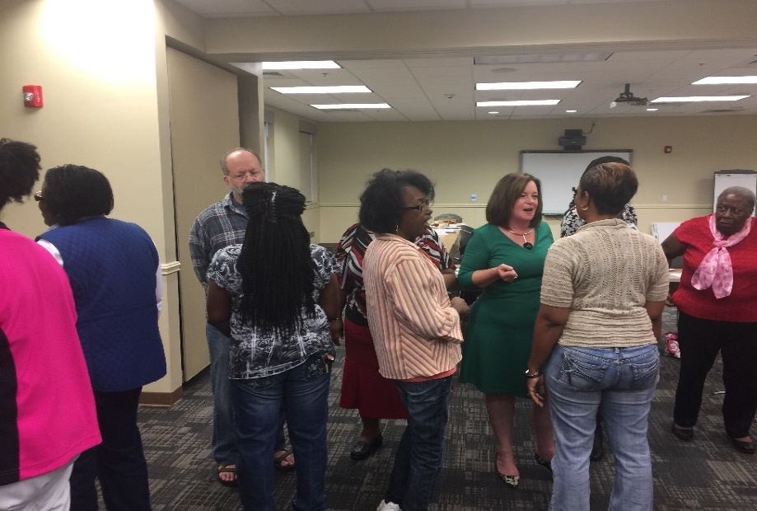
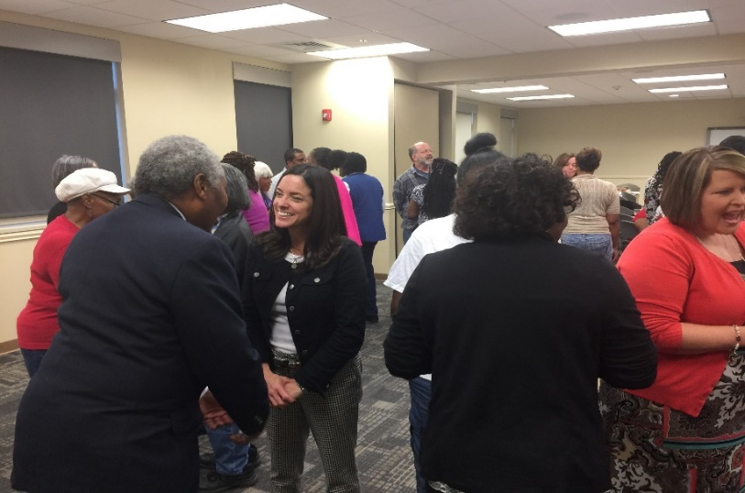
Resident and Partner Investment
Notes:
Donyel slide

Slide 19
Sustaining Community Engagement and Involvement “Community Centered Health Approach”
Clinical Shift to Support Community Centered Health
Community/Environmental or Policy Change
Increase Community Capacity and Sustainability
Notes:
Donyel slide

Slide 20
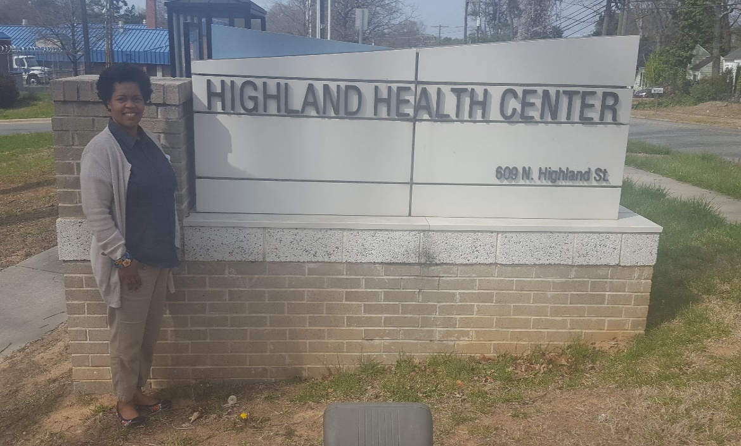
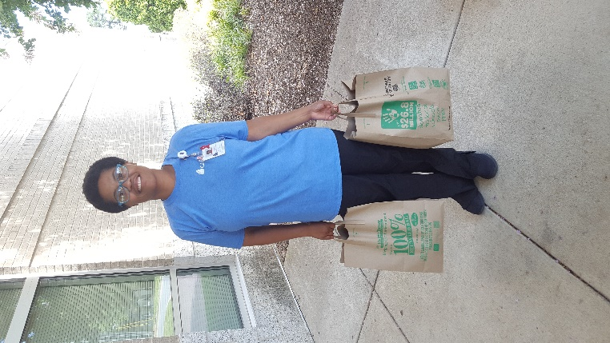
Clinical Shift To Support Community Centered Health
Operational procedures, use of data, training, hiring, procurement, community relationships, staffing models, etc.
Notes:
Donyel slide

Slide 21
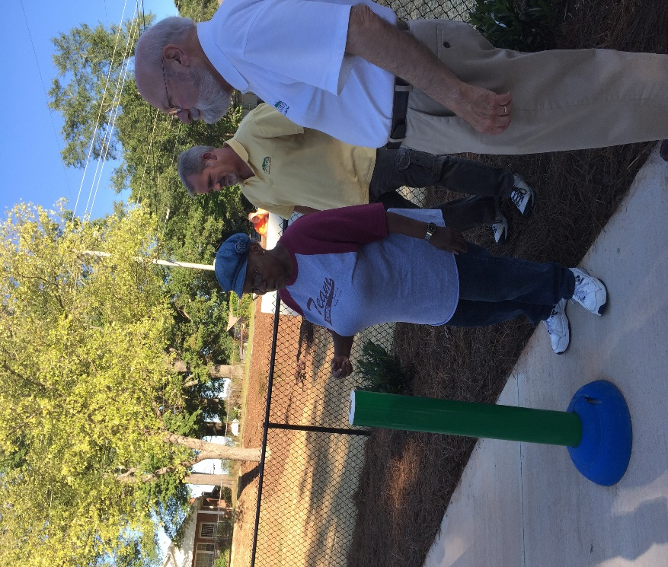
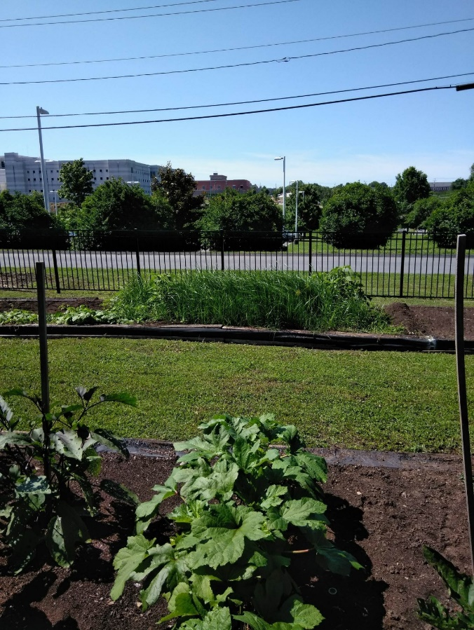
Community/Environment or Policy Change
Environmental, cultural, policy or promotional changes that improve or prevent health condition(s)
Notes:
Donyel slide

Slide 22
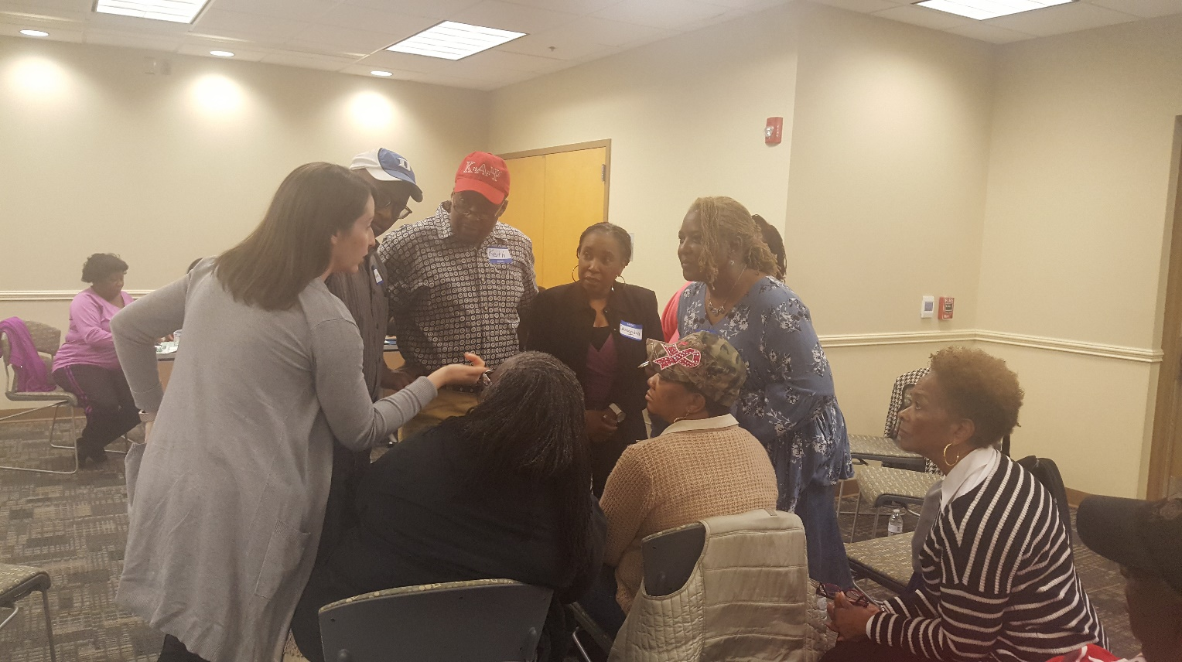
Increase Community Capacity and Sustainability
Structures, skills/knowledge, relationships, leadership, and resources
Notes:
Donyel slide

Slide 23
Some Considerations
Race is considered a "marker" for certain health problems
Factors such as income, education, access to health care, stress and racism are among the major causes of the poorer health of minorities on many health measures, compared to whites
Disparities in health care not only result in inequities but also limit continued improvement in quality of care and population health
Result is unnecessary health care costs
Notes:
Chrystal slide…
So when considering how to engage communities for health equity, you must consider not only the health care system, but the other systems that also impact access to healthcare
Must not assume that WE have the answers -- must ASK the question of those impacted and find ways to help address those issues in a way that allows the community to take control of their improved outcomes – CAPACITY BUILDING not “hand outs” or paternalistic behaviors

Slide 24
Thank you!
Contact Information
Donyel Barber ∙ Gaston Family Health
∙ dbarber@GFHS.Info
Chrystal Joy ∙ The Lee Institute ∙ cjoy@leeinstitute.org

