Slide 1

Greater Charlotte Regional Freight Mobility Plan
Coordinating Committee Meeting #4
Welcome
January 28, 2016
9:00am—11:00am

Slide 2
Agenda
Welcome and Introductions
Project Status
Fixing America’s Surface Transportation (FAST) Act and the Implications for Freight
Draft Freight Plan Goals and Objectives
Stakeholder Engagement
Freight Network Tiering Criteria
Prioritization
Schedule
Questions

Slide 3
Project Status
Complete
Working
Existing Conditions
Bottlenecks
Network Identification
Land Use, Facility, Infrastructure & Regulatory Gaps
Existing Land Uses
Regional Freight Land Use Policies and Regulations
Best Practices
O-D Analysis and Freight Corridors
Commodity Flows
Economic Impacts
Truck Parking
Prioritizing Regional Needs
Performance Measures
Truck Parking Capacity and Needs
Road/Rail Network Corridor Demand
Technology Trends
Safety and Security
Public Private Partnerships
Bottlenecks & LOS
Pavement/Bridge Conditions
High Crash Location
Economic Opportunity
Rail/Truck Grade Crossings
Intermodal Connections
Freight Impacted, Related or Focused
Goals Addressed
Quantifiable and Trackable
Greater Charlotte Regional Freight Mobility Plan
Stakeholder Engagement

Slide 4
Fixing America’s Surface Transportation (FAST) Act and the Implications for Freight

Slide 5
FAST and Freight
The bill places major emphasis on freight investments by creating a new National Highway Freight Program (NHFP)
  Funded from the HTF at an average of $1.2 billion per year and distributed to the States by formula.
In addition, a new discretionary program entitled the Nationally Significant Freight and Highway Projects is established, funded at an average of $900 million per year.
Source: AASHTO Summary published December 16, 2015

Slide 6
Freight Network Provisions in FAST—USDOT
Creates a National Multimodal Freight Network (NMFN)
  Includes a National Highway Freight Network consisting of all Interstate Highways
  41,000 primary freight network highway miles identified under MAP-21 and other State-identified highway segments
  Includes non-highway modes
    Class I freight railroads, Ports >2 million short tons, Inland and intracoastal waterways, Great Lakes and St. Lawrence Seaway, Marine highways, 50 US airports with highest annual landed weight, Other assets as identified by Undersecretary of Policy

Slide 7
Freight Policy Provisions in FAST—USDOT
Requires USDOT to create a National Multimodal Freight Policy (NMFP) (administered by the USDOT Undersecretary for Policy) to improve the condition and performance of the NMFN.
  USDOT must complete a National Strategic Freight Plan (NSFP) every five years to include processes for multi-State project delivery, and financial and regulatory barriers to freight movement.

Slide 8
Freight Funding Provisions in FAST—USDOT
Establishes a new National Highway Freight Program (NHFP) as part of the core Federal-aid Highway Program structure. The NHFP will direct Federal resources and policies to NHFN improvement.
  This formula program is authorized at $6.2 billion over five years, and each State’s share of the NHFP will be based on the State’s overall share of highway program apportionments
  Flexibility of NHFP dollars within a State will be related to its share of miles on the Primary Highway Freight System.
Repeals the increased (90-95 %) Federal match (in MAP-21) for freight projects on interstates and highways.

Slide 9
Freight Funding Provisions in FAST—USDOT
Creates the Nationally Significant Freight and Highway Projects (NSFHP) discretionary grant program designed for major highway and freight projects funded at $4.5 billion over five years.
Certain non-highway projects are eligible to receive portions of the NHFP and NSFHP dollars
  For example, provides eligibility for truck parking and surface transportation infrastructure improvements in port terminals for direct intermodal interchange, transfer, and port access.

Slide 10
USDOT to Develop Transportation Investment Data and Planning Tools
USDOT is to develop Transportation Investment Data and Planning Tools to support a performance-based approach to evaluate proposed freight-related projects, including:
  Methodologies for systematic analysis of benefits and costs on a national or regional basis;
  Tools for the evaluation of freight-related projects to consider safety, economic competitiveness, urban and rural access, environmental sustainability, and system condition in the project selection process;
  Improved methods for data collection and trend analysis;
  Encouragement of public-private collaboration on data sharing activities while maintaining the confidentiality of all proprietary data; and
  Other tools to assist in effective transportation planning.

Slide 11
USDOT to Develop Transportation Investment Data and Planning Tools
The USDOT will also identify transportation-related model data to support a broad range of evaluation methods and techniques to assist in making transportation investment decisions.
The USDOT will consider any improvements to existing freight flow data collection efforts that could reduce identified freight data gaps and deficiencies and help improve forecasts of freight transportation demand.

Slide 12
State Freight Plan Development
Mandates all States receiving NHFP formula funds to create a State Freight Plan within two years of enactment.
A State Freight Plan may be developed separately from or incorporated into the statewide strategic long-range transportation plan.
A State Freight Plan must address at least a 5-year forecast period and be updated at least once every 5 years.
A freight investment plan component will include projects (or phase of a project) only if funding its completion is available within the time period identified.
Each state is encouraged to establish a Freight Advisory Committee (FAC).

Slide 13
State Freight Plan Contents
An identification of significant freight trends, needs, and issues;
A description of the freight policies, strategies, and performance measures to guide freight-related transportation investment decisions;
When applicable, a listing of critical multimodal rural and urban freight facilities and designated corridors;
A description of how the plan will improve the State’s ability to meet the National Multimodal Freight Policy goals and the National Highway Freight Program goals;
A consideration of innovative technologies and operational strategies (including ITS), that improve the safety and efficiency of freight movement;

Slide 14
State Freight Plan Contents (cont)
A description of improvements required to address roadway deterioration by heavy vehicles (mining, agricultural, energy cargo or equipment, and timber vehicles) if projected to do so;
An inventory of facilities with freight mobility issues, such as bottlenecks, and a description of strategies to address them;
Consideration of any significant congestion or delay caused by freight movements and mitigation strategies;
A freight investment plan that includes a list of priority projects and describes how available funds would be invested and matched; and
Consultation with the State Freight Advisory Committee (if applicable).

Slide 15
State DOT Freight Planning and Performance Measures Requirements
States must report their progress of performance targets to the USDOT.
If a State DOT does not achieve or make significant progress toward achieving performance targets after one reporting cycle, State must submit a report describing the actions they will undertake to achieve their targets in the future.

Slide 16
State DOTs Use of Funds to Improve Freight Movement
The FAST Act requires States to obligate NHFP funds for projects to improve the movement of freight on the NHFN.
A State’s funding allocation is based on the number of Primary Highway Freight System (PHFS) miles relative to all PHFS miles.
If greater than or equal to 2 percent, it may obligate funds to any of the NHFN network elements except for interstates not part of the PHFS.
If less than or equal to 2 percent, it may obligate funds to any segment of the NHFN, which would include all interstates.
Limits States to the use of no more than 10 percent of apportioned funds on certain non-highway projects.

Slide 17
Nationally Significant Freight and Highway Projects
Creates the Nationally Significant Freight and Highway Projects discretionary program for DOTs.
Grants must be at least $25 million, and may only be made to State or local government agencies or groups of multiple agencies. Other features include:
  Highway freight projects must be on the NHFN or a highway or bridge project on the NHS.
  Non-highway projects are limited to $500 million over five years, must improve freight on the NHFN, and provide public benefits.
  Each year, 10 percent of the program must be set aside for Small Projects (a minimum $5 million grant).
  25 percent of annual funding will be set aside for projects in rural areas.
  Congress may disapprove funding for a project within 60 days of USDOT’s selection.

Slide 18
Draft Freight Goals and Objectives

Slide 19
Draft Goals and Objectives
GOAL 1: ECONOMIC COMPETITIVENESS AND EFFICIENCY
Support economic competitiveness by making investment decisions for transportation modes that make the most efficient use of limited public resources, as well as by pursuing sustainable funding possibilities.
OBJECTIVES
  Develop, integrate, and support a freight transportation system supporting Charlotte’s position as a major freight hub via a network of highways, railroads and airports
  Encourage regional efforts to maximize the region’s competitiveness in freight and logistics
  Support initiatives at international and regional airports that increase the attractiveness of the airport as a major cargo facility

Slide 20
Draft Goals and Objectives
GOAL 2: SAFETY AND SECURITY
Improve the safety and security of the freight transportation system.
OBJECTIVE
  Designate safe routes, with minimal urban exposure, for the transport of hazardous materials
GOAL 3: INFRASTRUCTURE PRESERVATION AND MAINTENANCE
Improve the state of good repair of the freight transportation system.
OBJECTIVE
  Develop regionally significant streets and highways in a manner which manages congestion and minimizes travel times and distances

Slide 21
Draft Goals and Objectives
GOAL 4: ENVIRONMENTAL STEWARDSHIP
Reduce adverse environmental and community impacts of the freight transportation system.
OBJECTIVE
  Encourage land use planning that supports and promotes the movement of freight by railroad
  Reduce the emissions resulting from freight movement
GOAL 5: CONGESTION AND RELIABILITY
OBJECTIVES
  Reduces the frequency of recurring and non-recurring congestion on the freight system

Slide 22
Draft Goals and Objectives
GOAL 6: PERFORMANCE AND ACCOUNTABILITY
OBJECTIVES
  Decrease the costs of freight movement by reducing empty backhaul movements
  Improve freight system operations and information sharing through improvements in technology
  Increase freight knowledge and expertise by planners and elected officials throughout the region
  Implement a performance-based tracking process to determine how well the freight system is functioning relative to freight investments

Slide 23
Stakeholder Engagement

Slide 24
Stakeholder Engagement

Slide 25
Freight Network Identification

Slide 26
Freight Network Identification
The identification of the regional freight network will be based on the following questions:
  Is this network responsible for movement of significant numbers of goods between cities and trade centers within the region and/or beyond its borders?
  Does the network play a significant role in the economy or the region?
  Does the network provide access to important intermodal facilities or freight origins/destinations?

Slide 27
Draft Tier Criteria
Tier 1
  All interstate Highways
  Class I Railroads and Terminals
  Charlotte-Douglas International Airport
Tier 2
  Other commercial service airports
  Shortline Railroads and Terminals
  Roadways with >20% ADTT
Tier 3
  Connecting/switching Railroads
  Strategic general aviation airports
  Those transportation related nodes or links important freight that link Tier 1 and Tier 2 nodes or links.

Slide 28
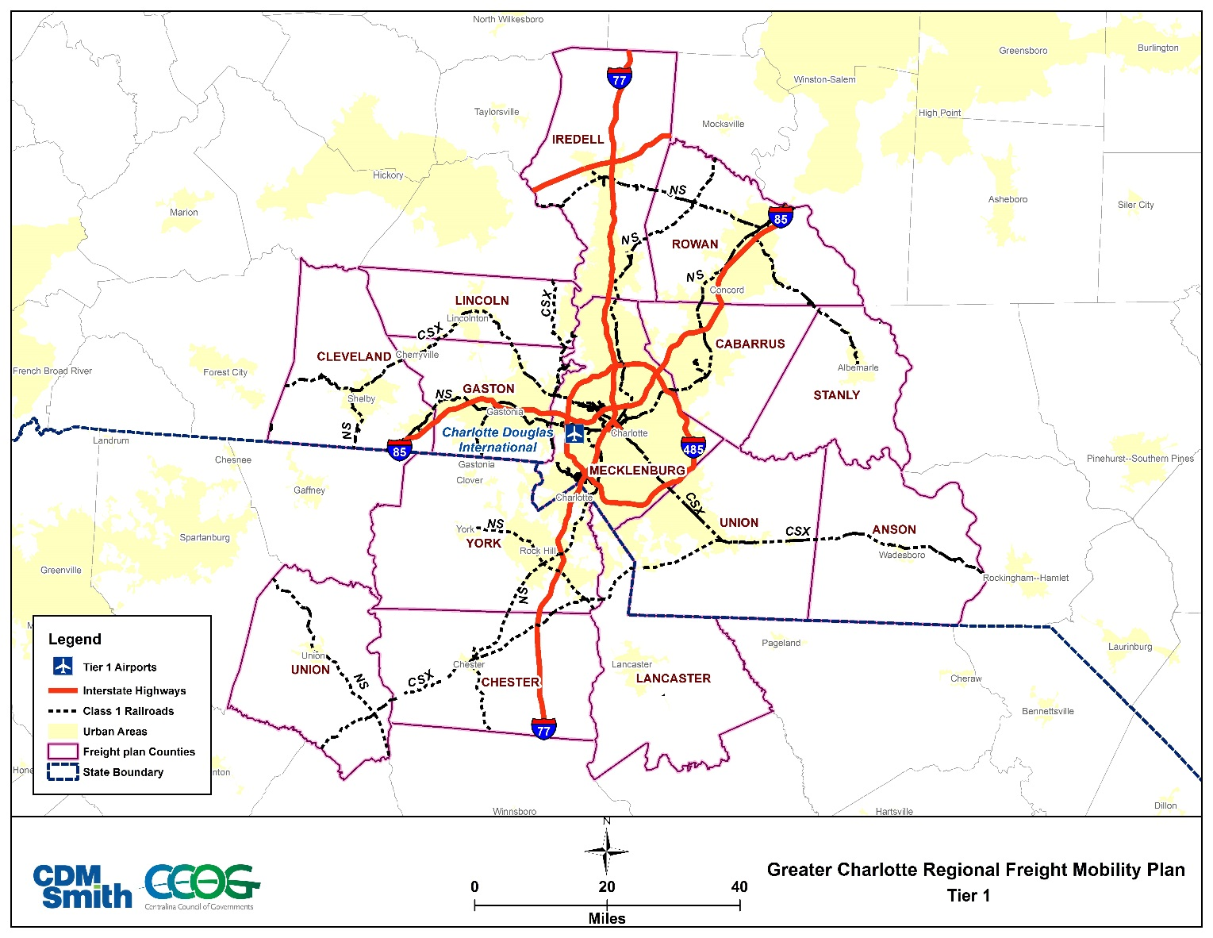
Potential Multimodal Freight Network—Tier 1
563 miles of Interstates
929 miles of Railroads
1 Airport

Slide 29
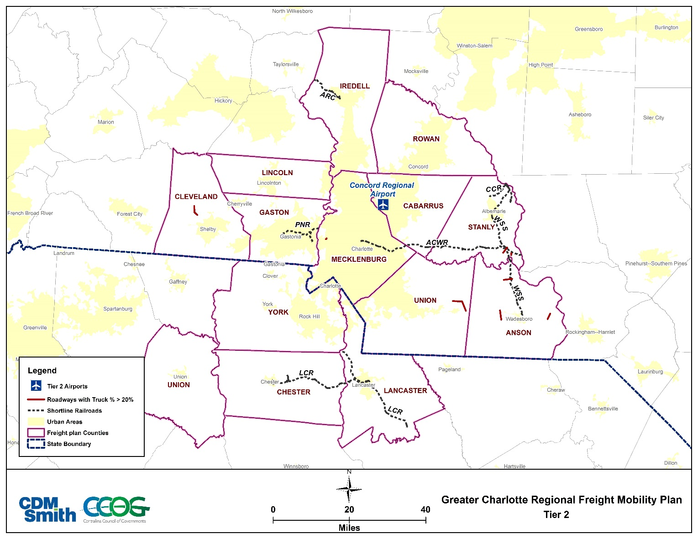
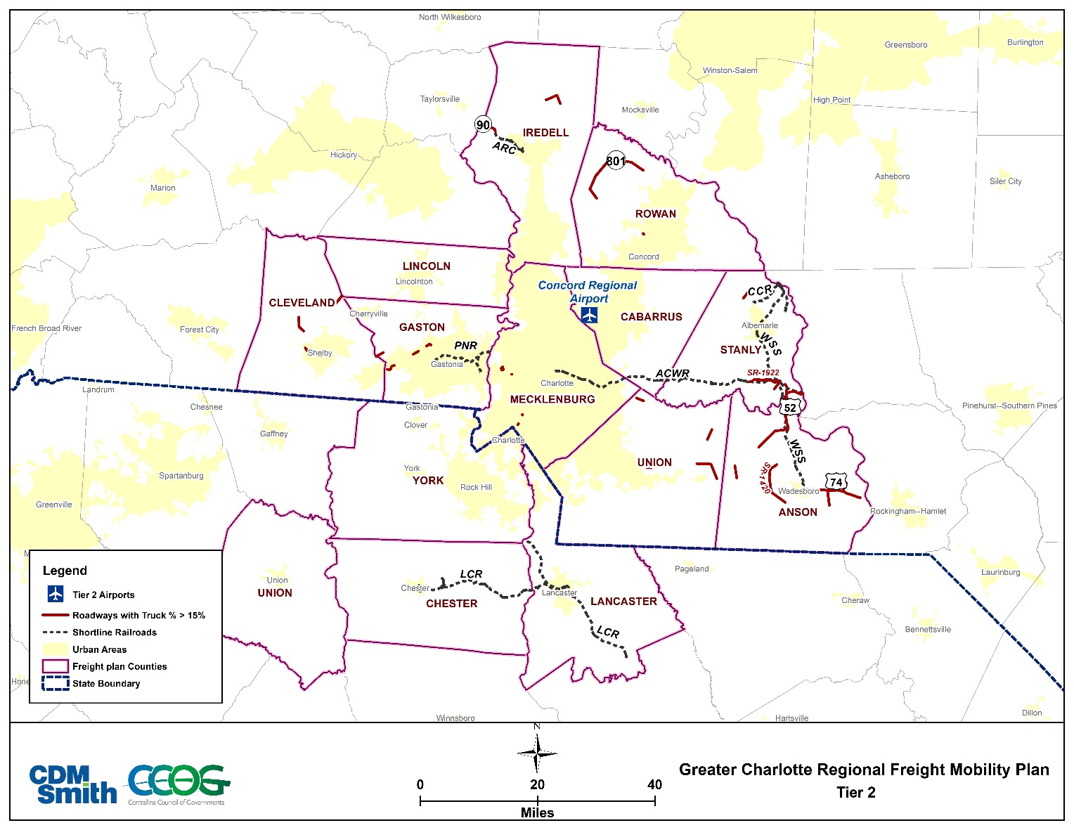
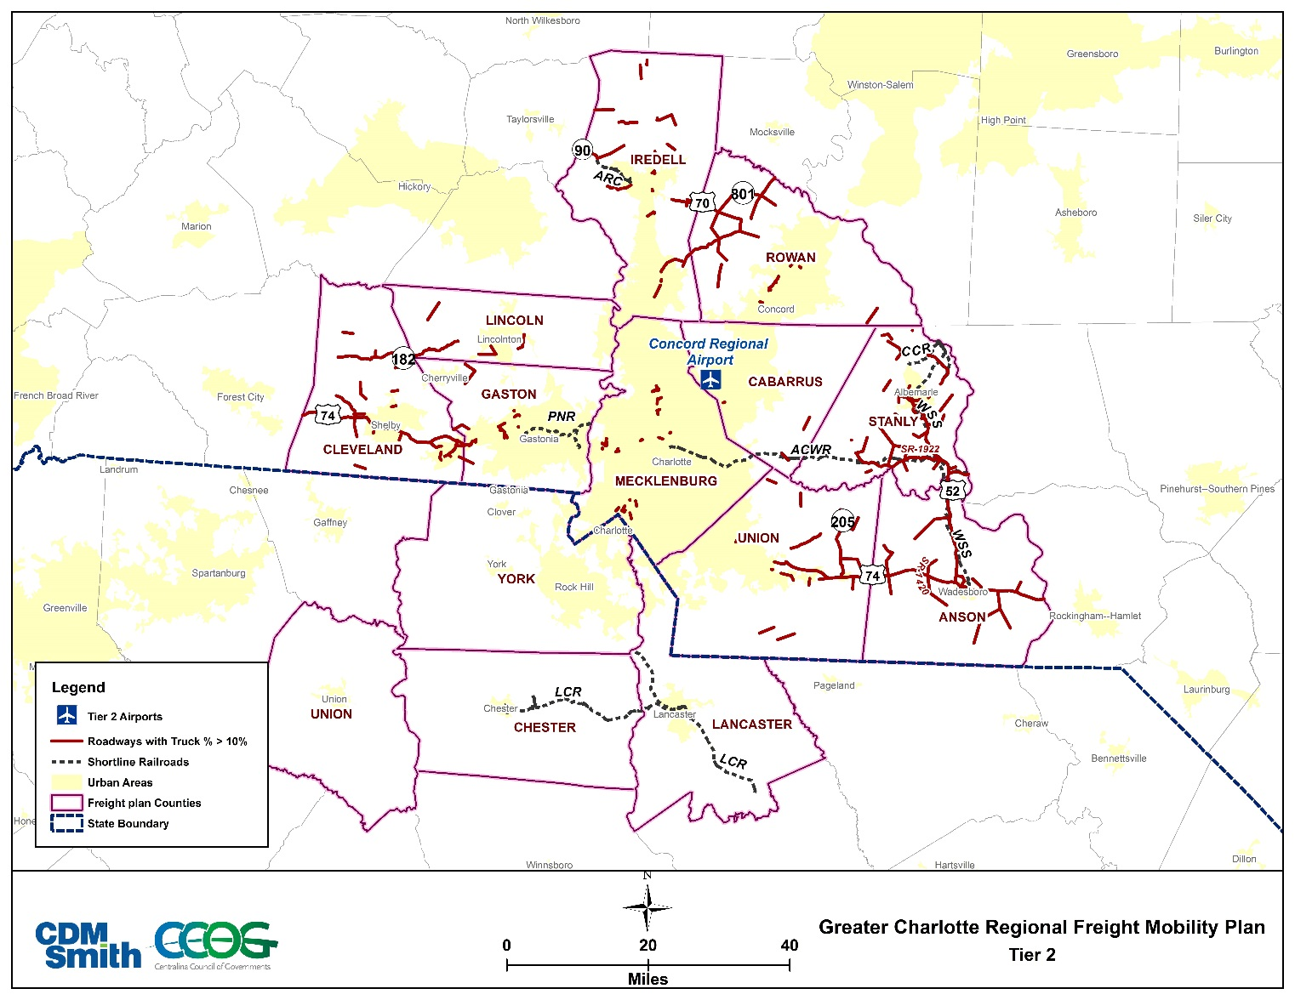
Potential Multimodal Freight Network—Tier 2
202 miles of Railroads
1 Airport
Roadways with >20% Trucks—17 miles
Roadways with >15% Trucks—105 miles
Roadways with >10% Trucks—493 miles

Slide 30
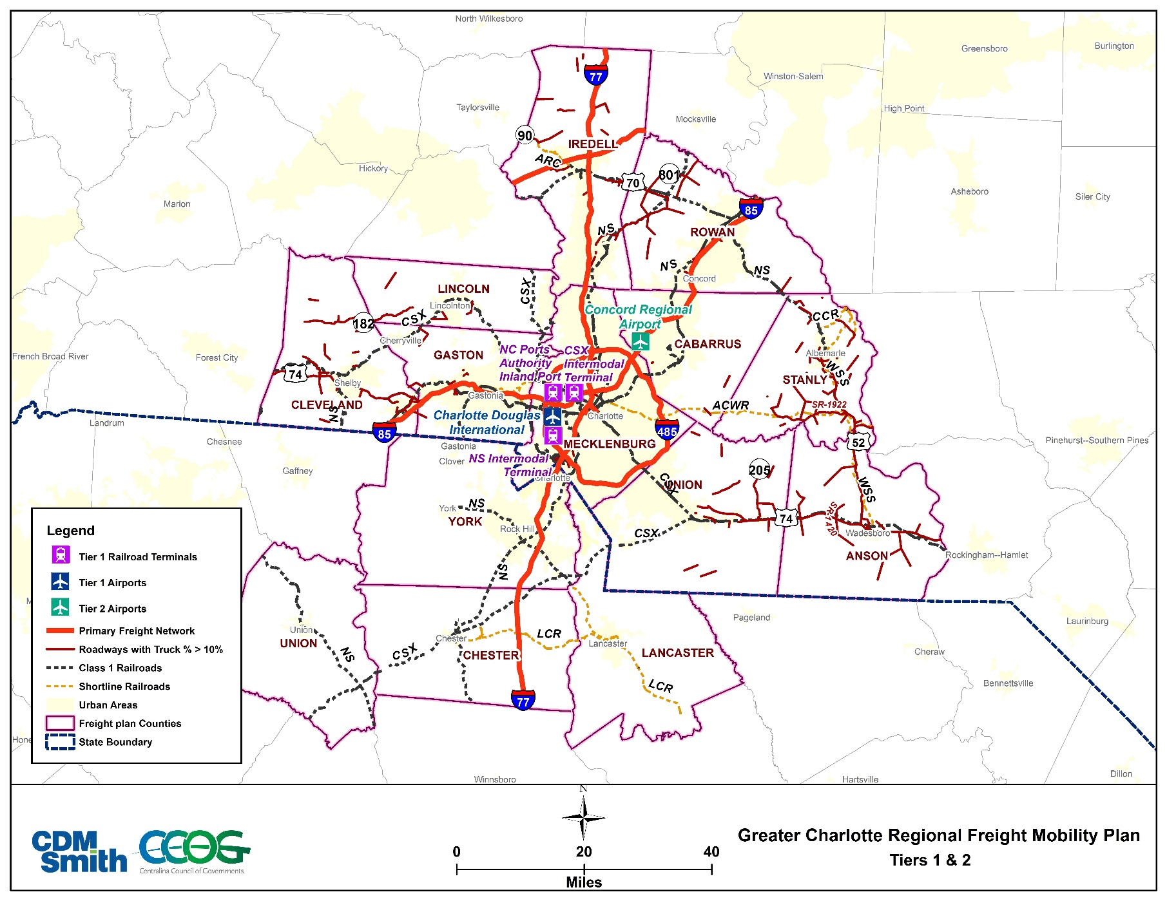
Potential Multimodal Freight Network—Tiers 1 & 2

Slide 31
Project Prioritization

Slide 32
Freight Project Prioritization
As available funding for transportation becomes more constrained, decision-makers need better information to help make the most strategic investment choices.
Project prioritization provides a data-informed approach to evaluating competing needs and conditions in order to identify transportation investments to meet current and future freight needs.

Slide 33
Freight Project Prioritization
There are three categories to define a project’s freight relevance.
  Freight focused –Addresses a specific freight transportation need.
  Freight related –Addresses multiple transportation concerns, of which freight is one element.
  Freight impacted –Addresses general transportation needs; however, freight mobility may be positively affected.

Slide 34
Freight Project Prioritization
The prioritization process includes four steps:
  Evaluate a list of potential projects.
  Perform a gap analysis to identify projects that were missing from the initial list of potential investments.
  Define prioritization filters and project scoring factors for each mode.
  Analyze each project on the final list and produced a scoring classification for each.

Slide 35








Project Prioritization Framework
Goal 1: Economic Competitiveness and Efficiency
Project Prioritization | Criteria |  | Factors
Is on the defined tiered network Improves access to/from existing or developing freight hubs Preserves freight reliant jobs Improves freight network access Improves access to freight generators Improves access among two or more modes Supports retention or expansion of business Supports or expands freight related land use |  | Freight Impacted |  | Does not improve
 |  | Freight Related |  | Somewhat improves
 |  | Freight Focused |  | Improves
 |  |  |  | Significantly improves
 |  |  |  | Greatly improves

Slide 36
Project Prioritization Framework
Goal 2: Safety & Security
Project Prioritization | Criteria |  | Factors
Reduces number of weight restricted bridges Improves geometric conditions Improves high truck crash locations Improves at-grade crossings Improves truck parking availability Improves safety/security at facilities (parking, intermodal, etc.) Improves freight incident response times Educates the public about freight system safety and security issues |  | Freight Impacted |  | Does not improve
 |  | Freight Related |  | Somewhat improves
 |  | Freight Focused |  | Improves
 |  |  |  | Significantly improves
 |  |  |  | Greatly improves

Slide 37
Project Prioritization Framework
Goal 3: Infrastructure Preservation & Maintenance
Project Prioritization | Criteria |  | Factors
Improves or maintains existing pavement to a state of good repair Improves structurally deficient bridges Improves rail lines to increase allowable speeds Maintains air cargo facilities |  | Freight Impacted |  | Does not improve
 |  | Freight Related |  | Somewhat improves
 |  | Freight Focused |  | Improves
 |  |  |  | Significantly improves
 |  |  |  | Greatly improves

Slide 38
Project Prioritization Framework
Goal 4: Environmental Stewardship
Project Prioritization | Criteria |  | Factors
Reduces air emissions Reduces impact to wetlands and water quality Reduces energy consumption Reduces other adverse residential and community impacts Separates freight operations from community activities |  | Freight Impacted |  | Does not reduce
 |  | Freight Related |  | Somewhat reduces
 |  | Freight Focused |  | Reduces
 |  |  |  | Significantly reduces
 |  |  |  | Greatly reduces

Slide 39
Project Prioritization Framework
Goal 5: Congestion & Reliability
Project Prioritization | Criteria |  | Factors
Improves bridges with vertical clearance issues or weight restrictions Addresses freight bottlenecks Improves multimodal connections Improves system capacity and/or freight operations Establishes or improves access to intermodal, transload, and/or air cargo facilities Improves rail/truck at-grade crossing delays Improves air cargo facilities for increased throughput |  | Freight Impacted |  | Does not improve
 |  | Freight Related |  | Somewhat improves
 |  | Freight Focused |  | Improves
 |  |  |  | Significantly improves
 |  |  |  | Greatly improves

Slide 40
Project Prioritization Framework
Goal 6: Performance & Accountability
Project Prioritization | Criteria |  | Factors
Uses ITS technology to improve freight system operations and information sharing Assists in reducing the cost of freight movement |  | Freight Impacted |  | Does not assist
 |  | Freight Related |  | Somewhat assists
 |  | Freight Focused |  | Assists
 |  |  |  | Significantly assists
 |  |  |  | Greatly assists

Slide 41
Schedule

Slide 42
Schedule

Slide 43
Greater Charlotte Regional Freight Mobility Plan
Coordinating Committee Meeting #4
January 28, 2016
9:00am—11:00am
Questions and Open Discussion

